Slide 1
Hadron Physics
Lecture #1: The quark model, QCD, and hadron spectroscopy
Lecture #2: Internal structure of hadrons: momentum and spin
Lecture #3: Internal structure of hadrons: charge, magnetism, polarizability
Lecture #4: Hadrons as laboratories (and other miscellaneous topics)

Slide 2
Properties of hadrons: momentum and spin
Structure functions and Deep Inelastic Electron Scattering
spin and flavor structure
Other processes:
Semi-inclusive scattering, transversity
Deeply Virtual Compton Scattering & Generalized Parton Distributions
“quark model” vs “partons”

Slide 3
references for this section
Halzen & Martin: Quarks and Leptons
F.E. Close: An Introduction to Quarks and Partons
Perkins: Introduction to High Energy Physics
Cahn and Goldhaber: The Experimental Foundations of Particle Physics
Xiangdong Ji: Graduate nuclear physics lecture notes
http://www.physics.umd.edu/courses/Phys741/xji/lecture_notes.htm
Lectures from the Hampton University Graduate School (HUGS), particularly 2007 (Reno), 2008 (Elouadhriri) and 2009 (Burkardt)
http://www.jlab.org/hugs/archive/
Special thanks to
Zein-Eddine Meziani, Temple University
Naomi Makins, University of Illinois

Slide 4
1930’s:
1950’s:
(Chadwick NP 1935)
(Stern NP 1943)
proton charge radius from (e,e’)
(Hofstadter NP 1961)
μ_{p} ~ 3 μ_{N}
r_{p} ~ 1 fm
1970’s:
1990’s:
partons in proton via inelastic (e,e’)
(Friedman,Taylor,Kendall, NP 1990)
asymptotic freedom → QCD
(Gross, Politzer, Wilcek, NP 2004)
polarized targets
Intense CW electron beams
improvement in polarized e sources
1980’s: exploration of phenomena
  various scaling phenomena
  “the spin crisis”
  “the EMC effect”
2000’s:
lattice QCD
Generalized Parton Distributions
transversity, DVCS, moments, ….

Slide 5
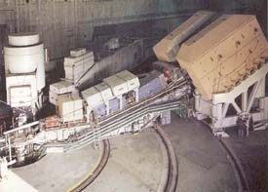
Deep Inelastic Electron Scattering
M. Briedenbach et al,
Phys Rev Lett 23, 935 (1969)
from J. Friedman Nobel lecture, 1990

Slide 6
Kinematics of electron scattering
A common reference frame to work in is the LAB frame with a stationary target:
k’
k
case 1: elastic scattering
q_{μ}
p
p’
It is common to assume the electron is massless (extreme relativistic limit). In this
case, if one conserves 4-momentum:
and can easily show:

Slide 7
Inelastic electron scattering
Using Fermi’s Golden rule, we integrate over the recoiling target quantities, average over initial spin states, sum over final spin states. For elastic scattering, we integrate over an energy-conserving delta function. For inelastic scattering we skip the last step.
k’
k
interaction strength and photon propagation
q_{μ}
p
p’
outgoing may no longer be a proton
lepton current
hadron current

Slide 8
the hadronic current
Elastic scattering: the target is left intact and we measure its net response to the EM current as a function of momentum transferred to it by the photon.
Inelastic scattering: target might to into an excited state, or break up
where in principle W₁ and W₂ depend on both Q² and energy loss (ν). These encode all of the strong interaction dynamics between the partons.

Slide 9
Unpolarized electron scattering, cont’d
after some manipulation, the cross section becomes
σ_{Mott}
This is the famous “Rosenbluth” formula. Often this is also expressed in terms of helicity of the photon being exchanged.
photon polarization, wrt q
virtual photon “flux”
photoabsorption
cross sections

Slide 10
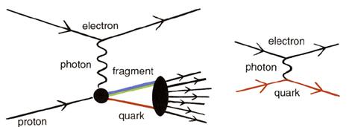
Deep Inelastic Electron Scattering
energy available to produce particles in final state
from Nobel lectures, 1990
Experimentally, W₂ and W₁ seem to depend on only one variable
“scaling” (anticipated by Bjorken, 1967)
scaling good when (Q²,ν) →∞, and if the partons have no transverse momentum .

Slide 11
DIS and quark momentum distributions
x = fraction of proton’s momentum carried by individual quark
(in reference frame where proton moving ~ speed of light…)
The scaling behavior is good when (Q²,ν) →∞, and holds in the limit that the quark transverse momentum is 0.
proton:
parton distribution functions
If isospin symmetry is good, which says that u in the neutron is just like d in the proton:

Slide 12
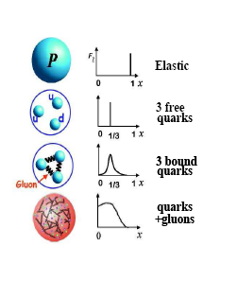
interpretation of parton distributions
x = fraction of the proton’s momentum carried by the struck quark, in the “infinite momentum”
frame
q
xp
p
(1-x)p
limits:
at very low x, the sea quarks
should dominate
here the valence quarks should
dominate and u_{v} >> d_{v} .

Slide 13
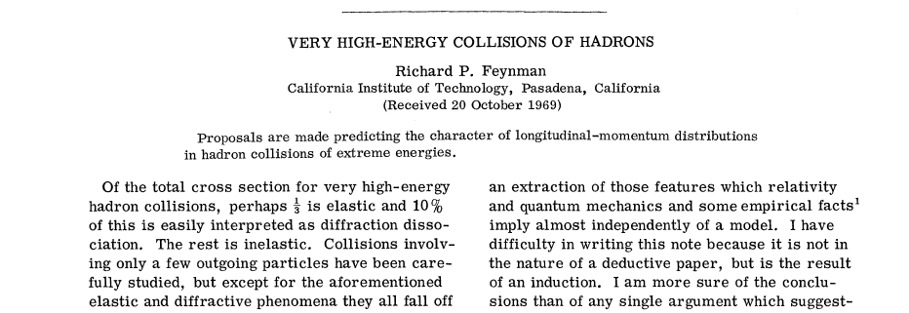

parton distribution functions
Phys. Rev. Lett. 23, 1415 - 1417 (1969)
The parton distribution functions are a property of
the target, not of the process.
partons ←→ pointlike quarks

Slide 14
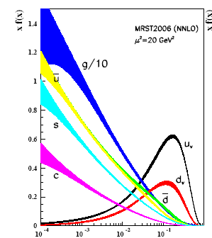
quark distribution functions
F₂(x) “scaling” is violated
when the strong interaction
is “strong” (low x or small Q²)

Slide 15
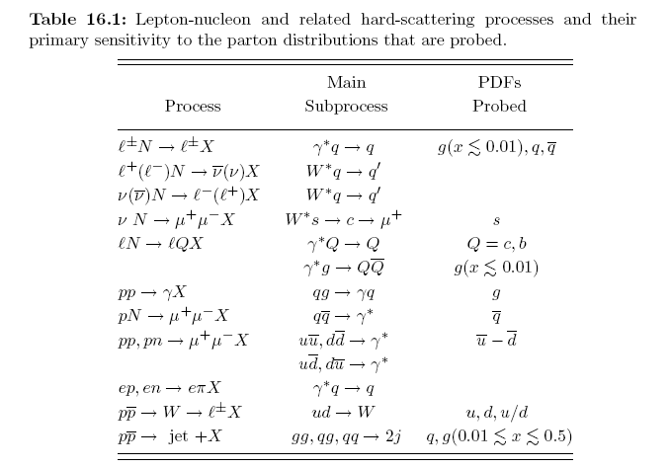
parton flavors
from http://pdg.lbl.gov

Slide 16
Deep Inelastic ν−nucleon scattering
F_{1,2,3} are weak interaction equivalents of those measured in electron scattering. Experimentally, they seem again to only depend on x (to lowest order) and are combinations of quark momentum distributions.
Experimentally, for target w/equal numbers of neutrons and protons:
(if ignore s-quarks...)

Slide 17
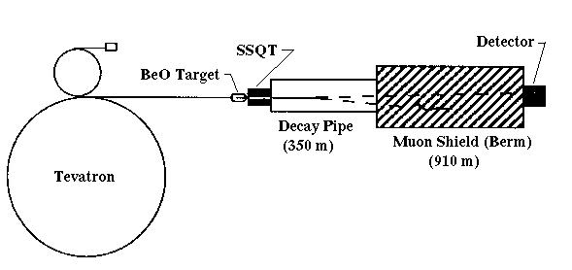
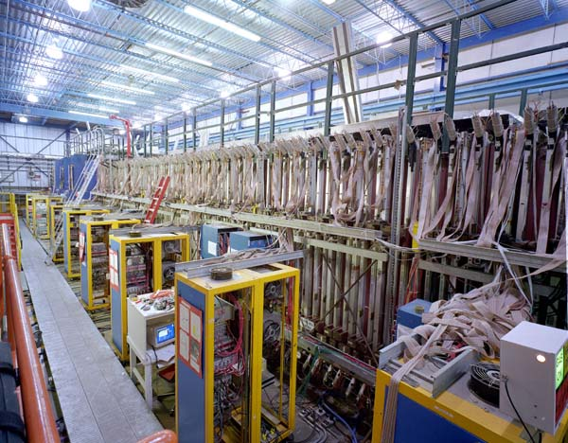
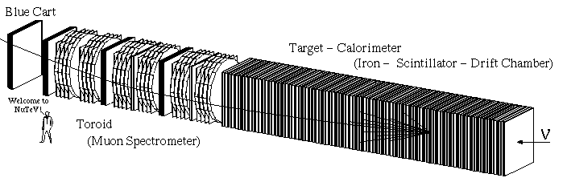
NuTeV: deep inelastic ν scattering
p
SSQT: series of magnets
selects charge state of π,K
http://home.fnal.gov/~bugel/tour.html

Slide 18
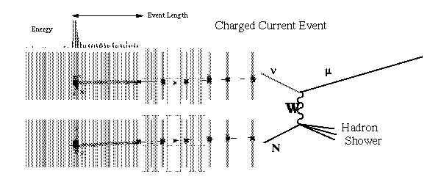
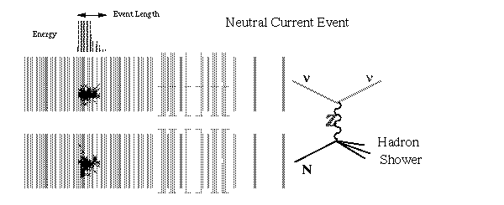
NuTeV detector tracks

Slide 19
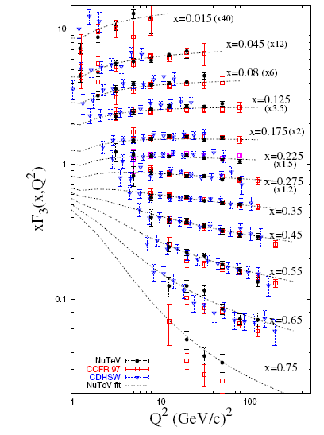
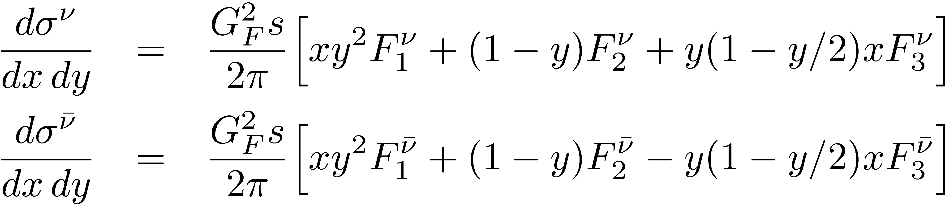
neutrino scattering: F₃(x)
M. Tzanov, et al.,
Phys. Rev. D 74 (2006) 012008

Slide 20
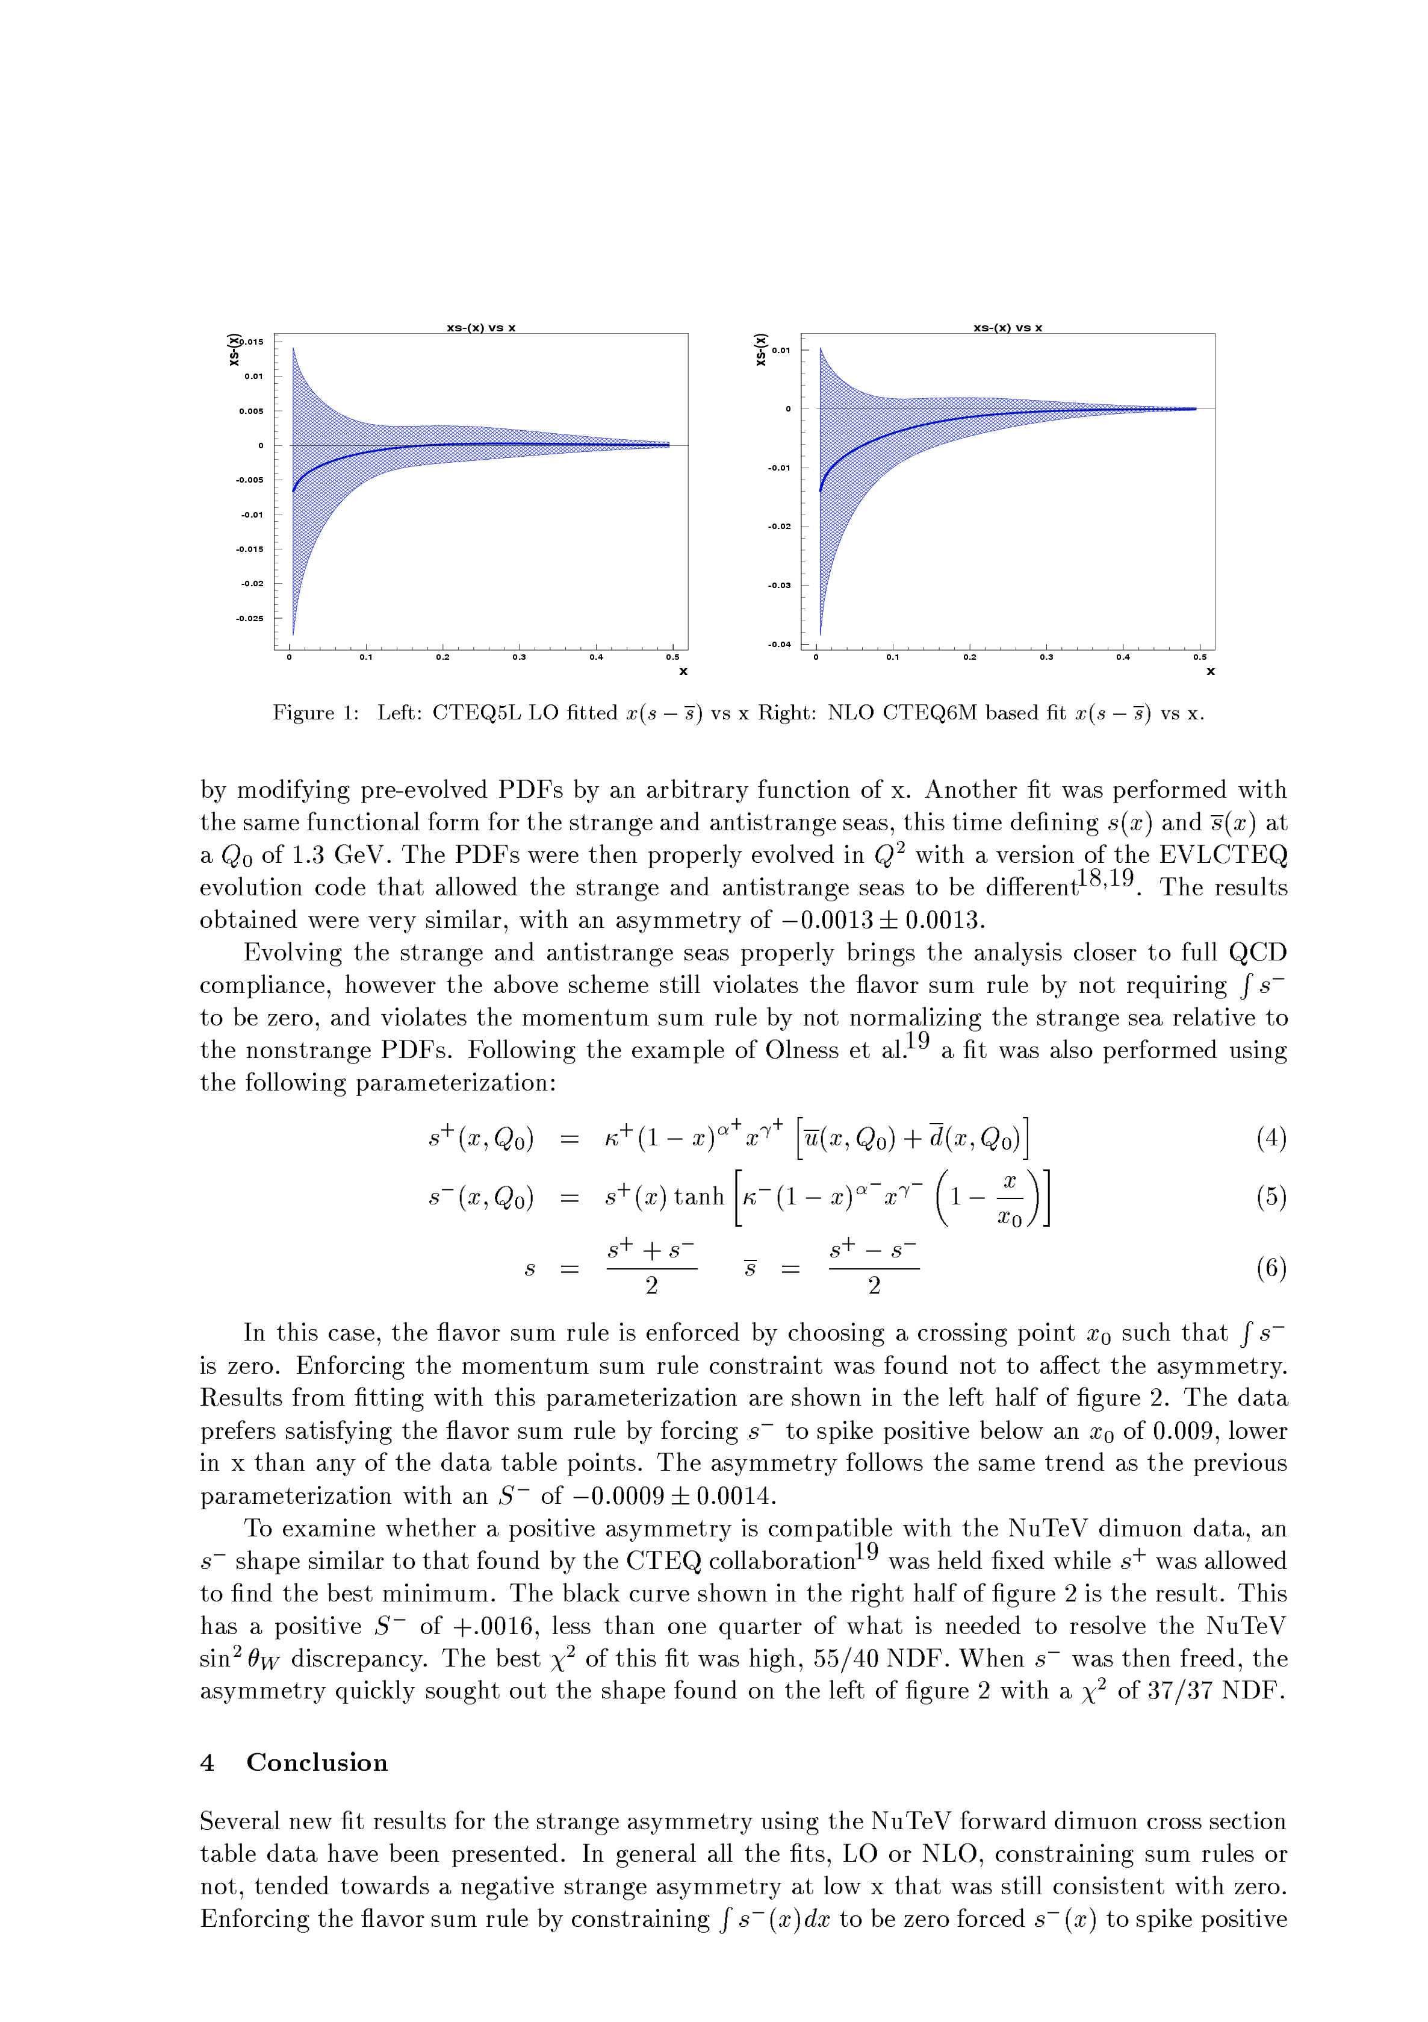
NuTeV s-quark momentum distributions
from this they extract sin²θ_{W}
0.01
NuTeV fit (NLO)
0
-0.01
x[s(x)-s(x)]
-0.02
CTEQ6M, NLO
NuTeV → D. Mason et al, hep-ex/0405037
-0.03
-0.04
see also http:// home.fnal.gov/~gzeller/nutev.html
0
0.1
0.2
0.3
0.4
0.5
x

Slide 21
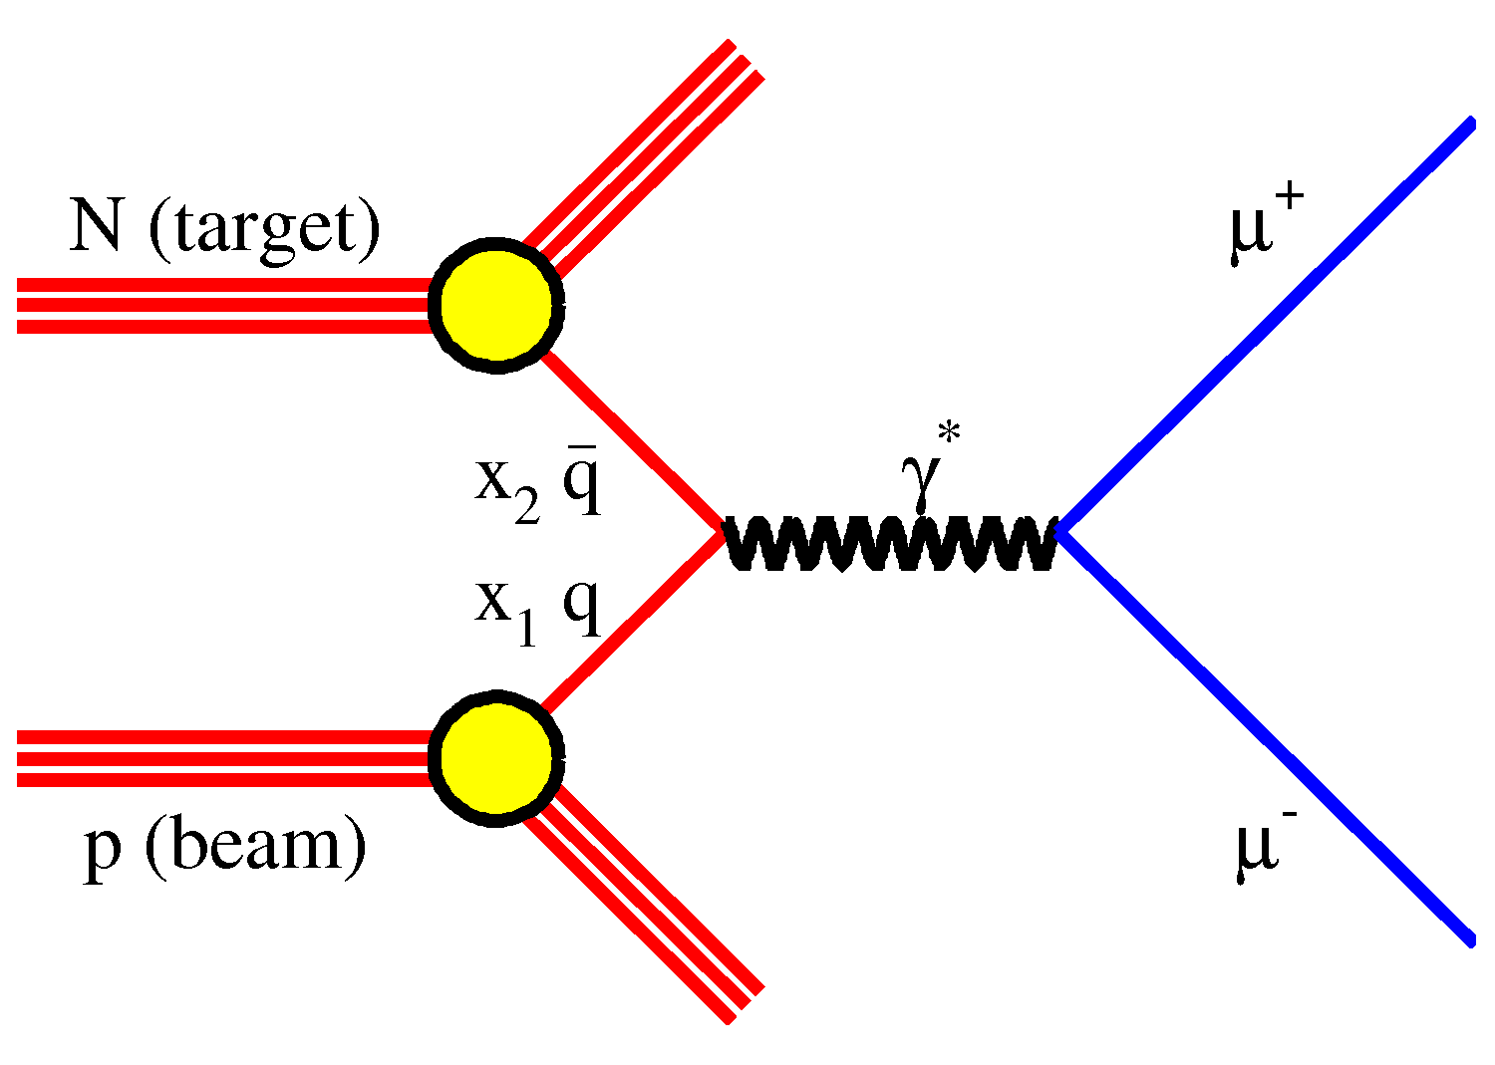
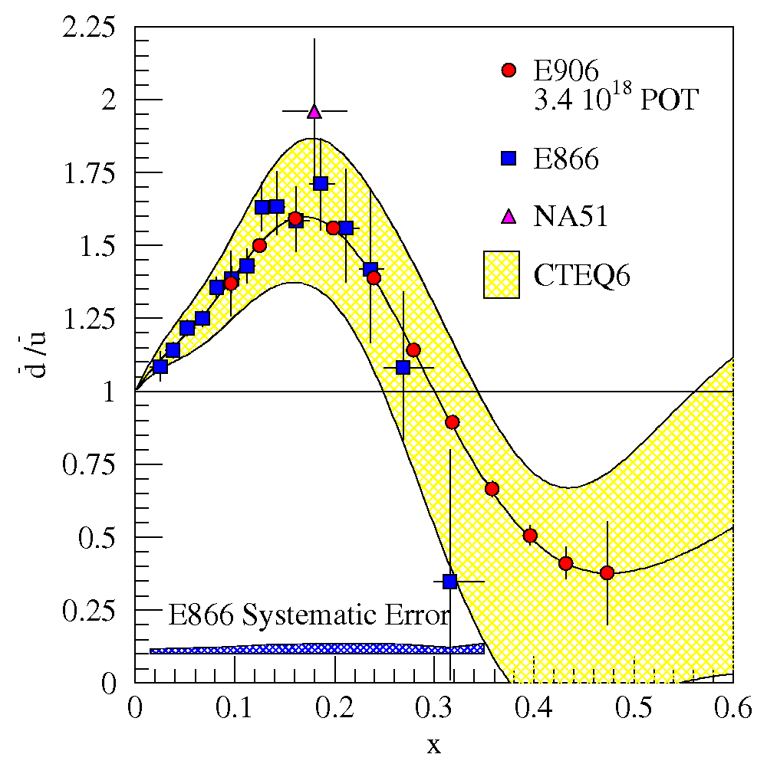
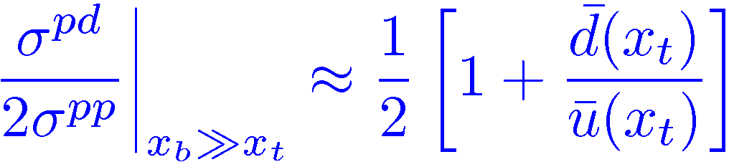
The Drell-Yan process: antiquarks
FNAL E866:
E. Hawker, etal, PRL 80 (1998) 3715
FNAL E906:
scheduled for 2010
future program at J-PARC

Slide 22
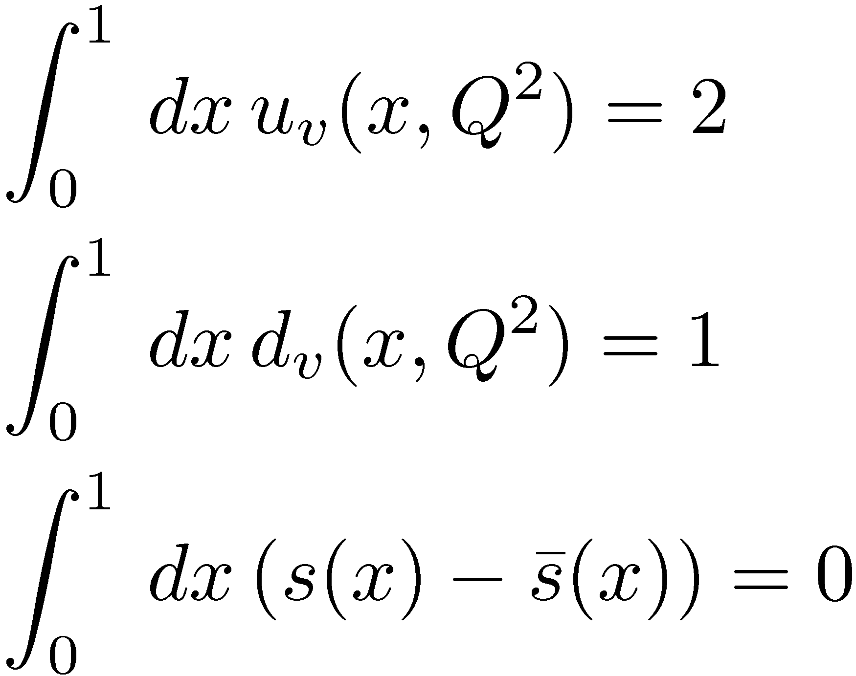
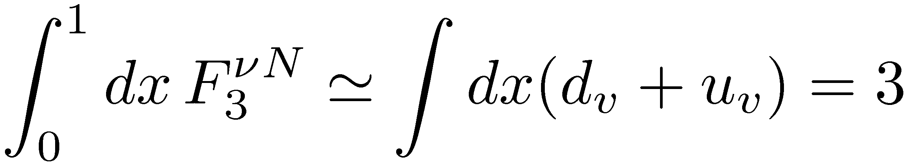
sum rules
counts the net excess of quarks over anti-quarks of each type
Gross-Llewellyn-Smith sum rule: counts the excess quarks over anti-quarks, as seen by neutrinos
Adler sum rule (neutrinos)
Gottfried sum rule (electrons)
Bjorken sum rule (axial charge)

Slide 23
The hadronic tensor with spin-dependence
http://pdg.lbl.gov

Slide 24
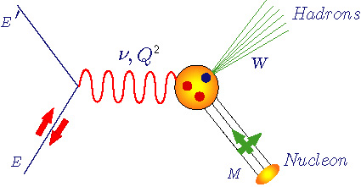

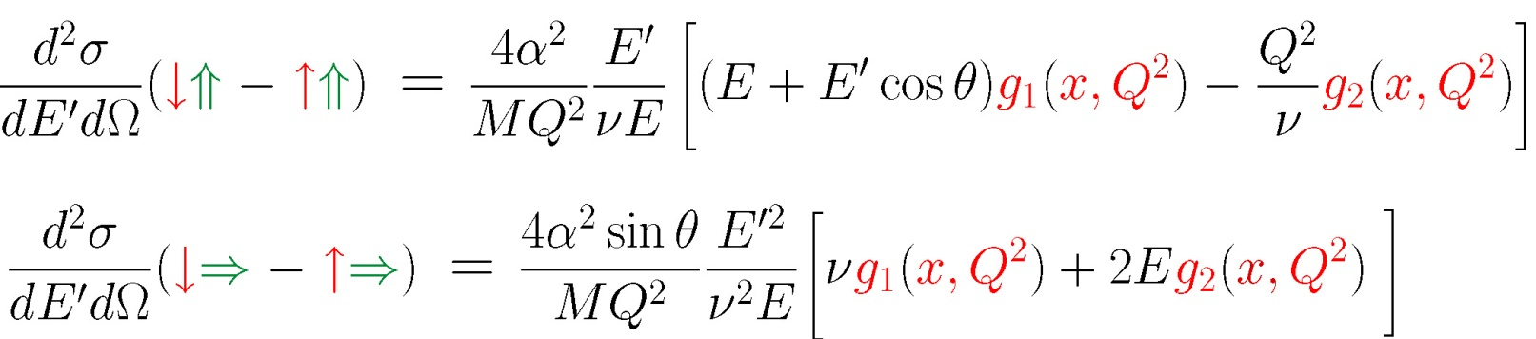
Spin Structure Functions
(slide from Z. Meziani)
Unpolarized structure functions F₁(x,Q²) and F₂(x,Q²)
Polarized structure functions
g₁(x,Q²) and g₂(x,Q²)
U
Q² :Four-momentum transfer
x : Bjorken variable
: Energy transfer
M : Nucleon mass
W : Final state hadrons mass
L
T

Slide 25
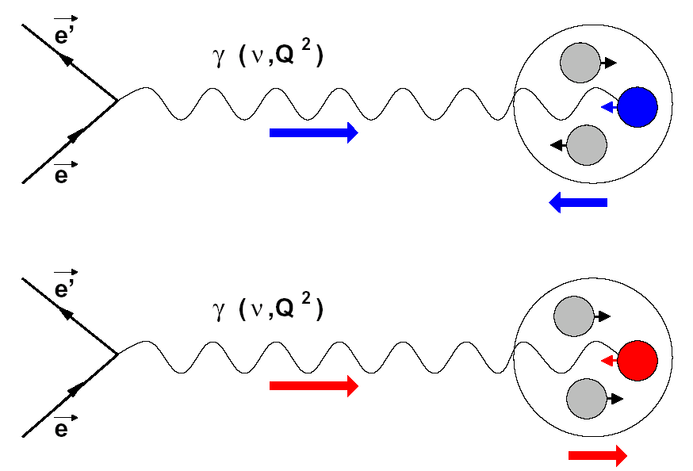
Polarized Deep Inelastic Scattering
Δq(x) = q(x)⁺ – q(x)–
q(x) = q(x)⁺ + q(x)–
^{+ quark ↑↑ nucleon}
^{– quark ↑↓ nucleon}
Inclusive asymmetry
fragmentation function
Semi-inclusive asymmetry

Slide 26
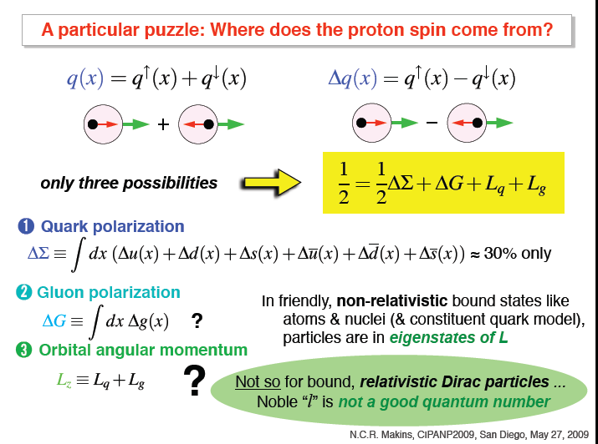

Slide 27
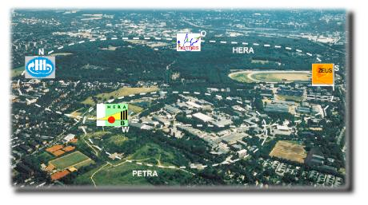
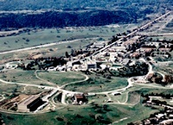
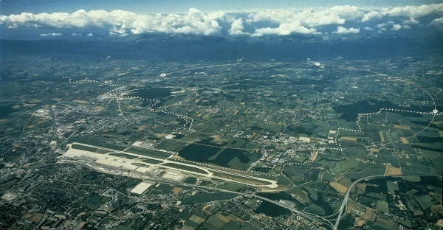
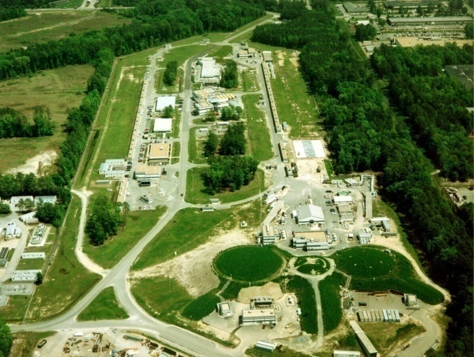
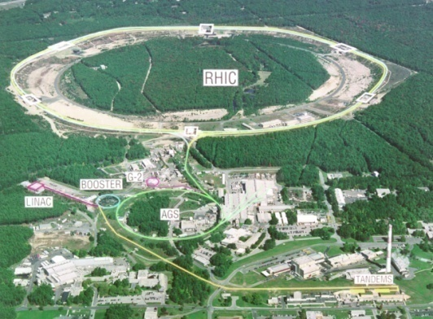
Many experiments…..
DESY:
HERMES
SLAC:
E80, E130,
E142, E154,
and others…
CERN:
EMC,SMC,
COMPASS
Brookhaven:
RHIC-Spin program
→ gluon spin
JLAB:
Hall A, Hall B

Slide 28
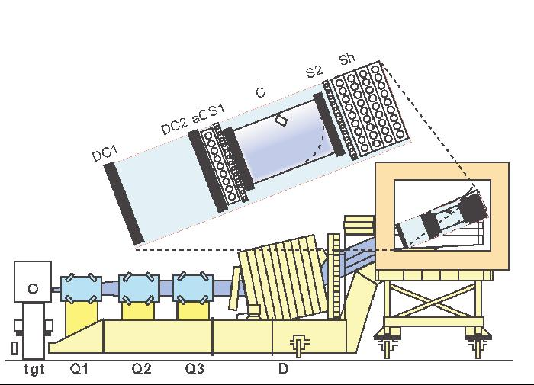
A relatively simple magnetic spectrometer
plastic scintillator arrays
electromagnetic
shower detector
aerogel Cerenkov
drift chambers
High Momentum
Spectrometer,
Hall C,
Jefferson Lab

Slide 29
Example of a standard setup (in Hall A at JLab)
(slide from Z. Meziani)
Polarized beam
  Energy: 0.86-5.1 GeV
  Polarization: > 70%
  Average Current: 5 to 15 µA
  Hall A polarized ³He target
  Pressure ~ 10 atm
  Polarization average: 35%
  Length: 40 cm with 100 µm thickness
Highest polarized luminosity: ~10³⁶cm⁻²s⁻¹
L
Hall A polarized ³He target
Electron beam
Spectrometers
set at 15.5º
R
Measurement of helicity dependent ³He cross sections
Extract g₁ and g₂ spin structure functions of ³He
Extract moments of spin structure functions of ³He and Neutron

Slide 30

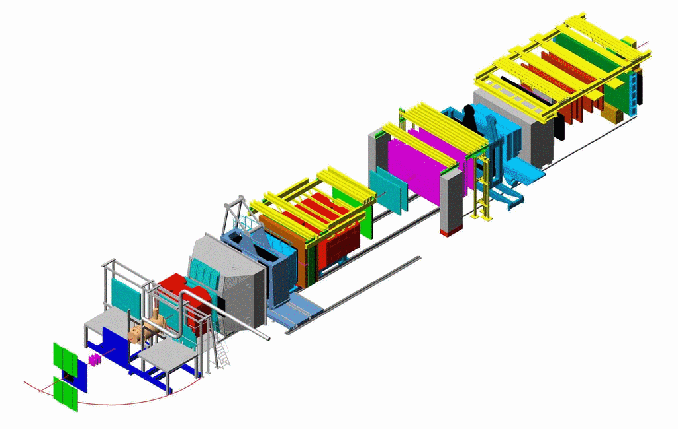
COMPASS
NIM A 577(2007) 455
Trigger Hodoscopes
ECALs & HCALs
MWPCs
50 m
SM2
RICH
SM1
Drift Chambers
μ Filters/
Walls
⁶LiD target
Straws
GEMs
Si
Micromegas
160 GeV μ
SciFi
veto
O. Kouznetsov, CIPANP 2009

Slide 31
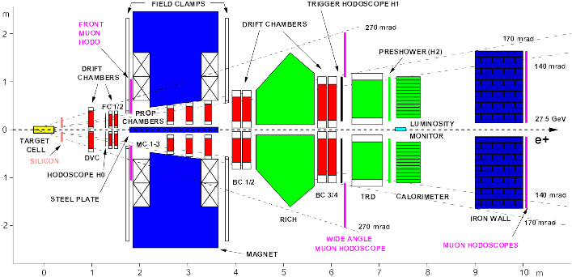
HERMES detector at DESY (Hamburg)

Slide 32
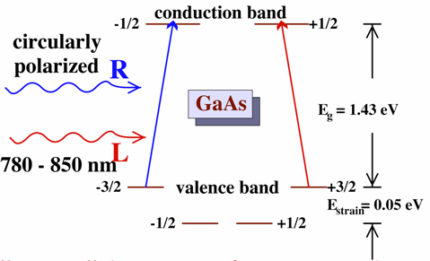
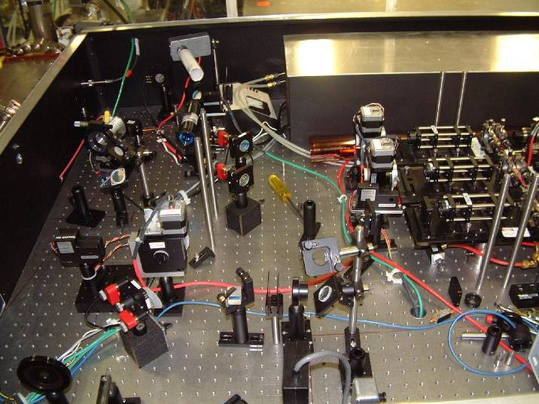
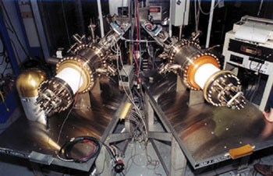
Polarized Electrons
D.T. Pierce et al., Phys. Lett. 51A (1975) 465.
Electron retains circular polarization of laser beam: P_{e} ~ 85%
Reverse pol’n of beam
at rate of 30 Hz
Feedback on laser intensity and position at high rate
See also Physics Today, Dec 2007

Slide 33
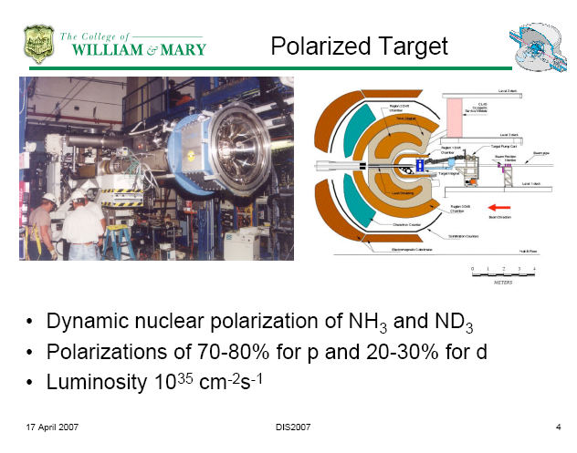
( In CLAS detector in Hall B at JLab,
slide from K. Griffeon, DIS2007)

Slide 34
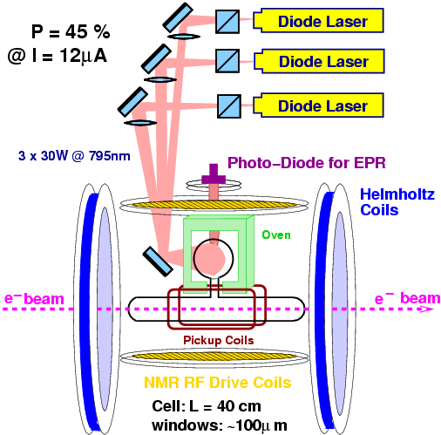
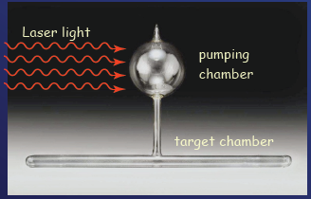
Polarized ³He
Spin –dependent scattering
looks like
p
p
n
photo from G. Cates, CIPANP 2009
used in Hall A at JLab

Slide 35
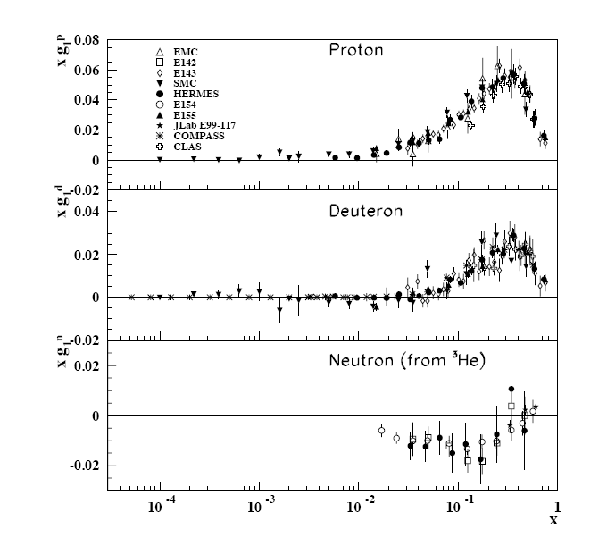
spin structure of the neutron and proton
from http://pdg.lbl.gov

Slide 36
spin structure of the proton
example: HERMES
A. Airapetian, et al.
PRD 71 (2005) 012003
Uses semi-inclusive scattering as
well to disentangle u,d,s and
valence/sea

Slide 37
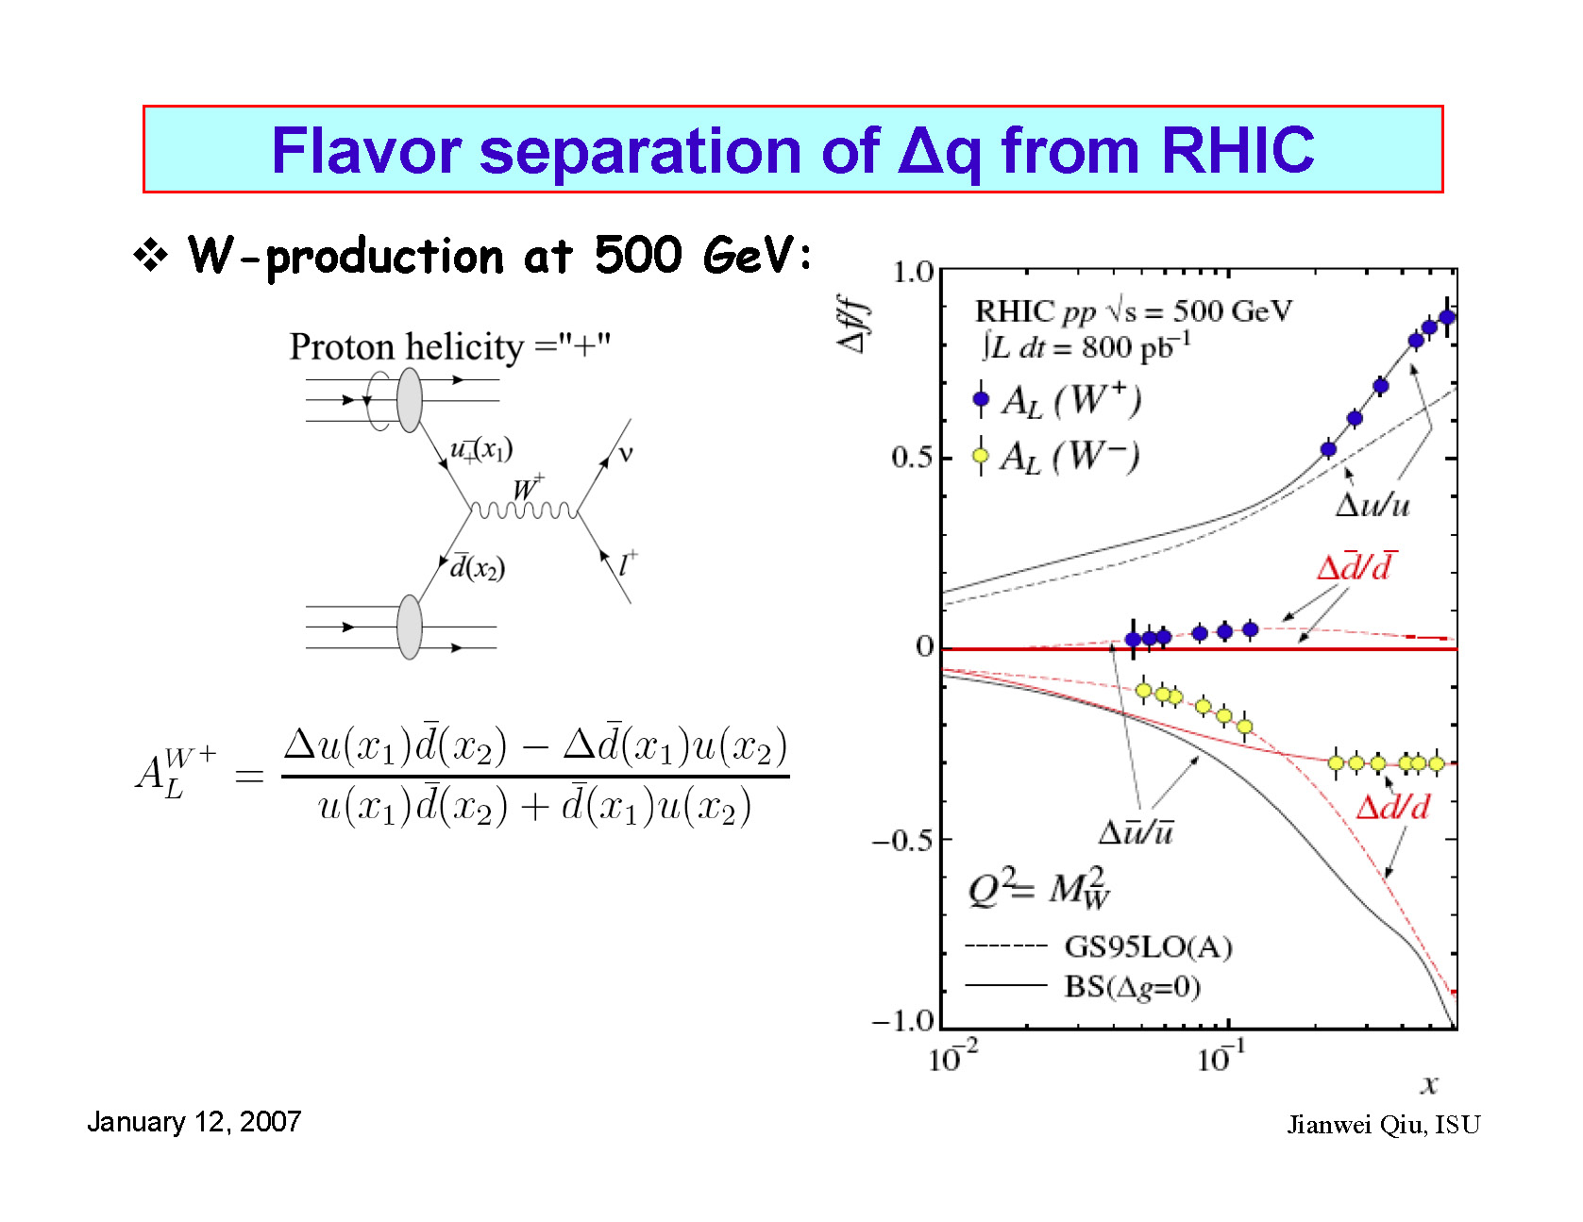
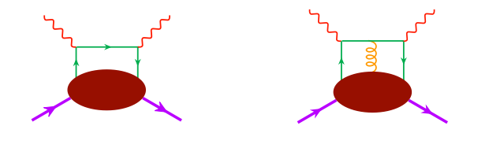


g₂ and Quark-Gluon Correlations
coming in the future….
Twist -2
Twist -3
a twist-2 term (Wandzura & Wilczek, 1977):
a twist-3 term with a suppressed twist-2 piece (Cortes, Pire & Ralston, 1992):
(QCD & Hadron Physics Town meeting, Rutgers)
q-g correlations
Transversity

Slide 38
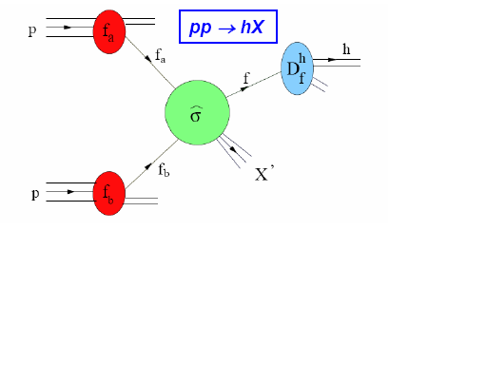
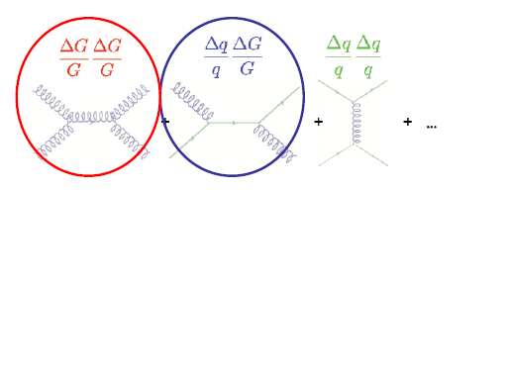
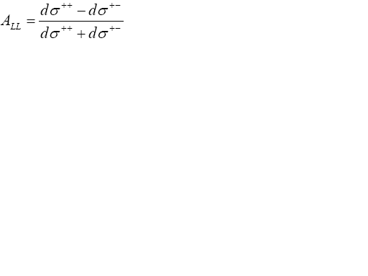
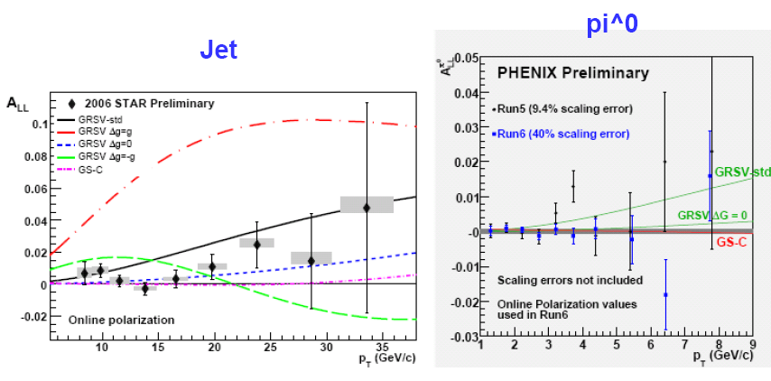
Measurement of the gluon polarization ΔG at RHIC
Dominates at low p_{T}
Dominates at high p_{T}
Courtesy of G. Bunce, S. Vigdor

Slide 39
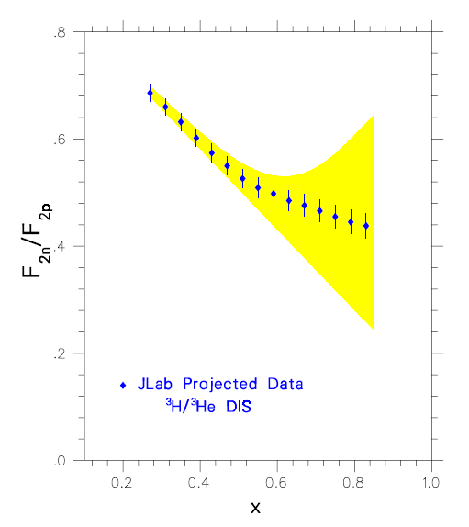
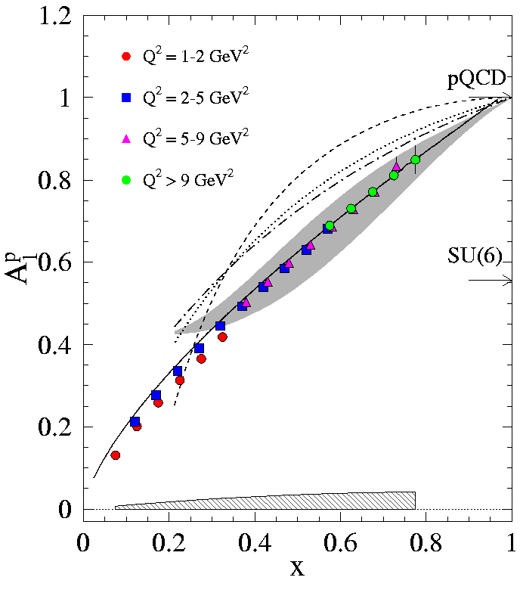
Structure of the nucleon – valence region
coming in the future….
SU(6)
d/u=1/2
Helicity
conservation
d/u = 1/5
Scalar diquark
dominance
d/u=0
proposed to be done at JLAB with 11 GeV beam
Courtesy of Z.-E. Meziani, K. Griffioen, S. Kuhn, G. Petratos

Slide 40
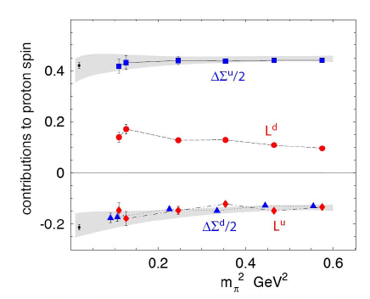
quark angular momentum
quark spins ∼ 30%
??
gluon polarization
small but still uncertain
lattice QCD (LHPC, QCDSF)
L_{u} + L_{d} small, but individual parts large

Slide 41
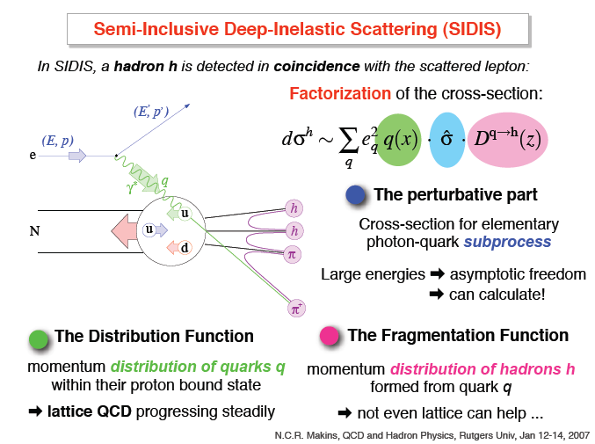

Slide 42
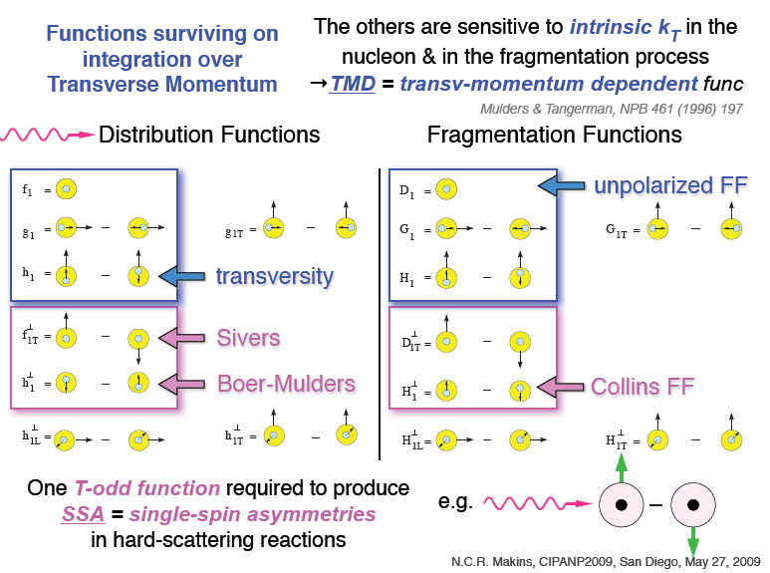

Slide 43
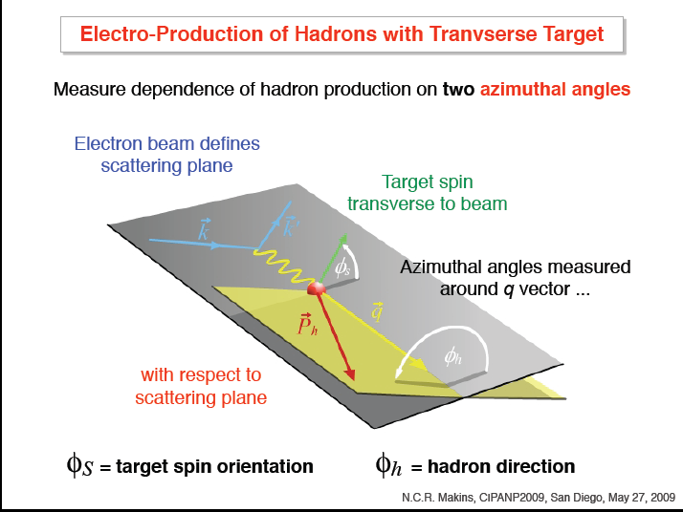

Slide 44


Slide 45
GPDs: Non-local, off-diagonal matrix elements
slide from F. Sabatie, CIPANP 2009
γ,ρ,π K,….
Mueller
(1995)
x + ξ
x - ξ
P - Δ/2
GPD (x, ξ ,t)
P + Δ/2
(x + ξ) and (x - ξ) : longitudinal momentum fractions of quarks
The structure of the nucleon can be described by 4 Generalized Parton Distributions :
~
Vector : H (x, ξ ,t)
Tensor : E (x, ξ ,t)
Axial-Vector : H (x, ξ ,t)
Pseudoscalar : E (x, ξ ,t)
~

Slide 46



Properties, applications of GPDs
slide from F. Sabatie, CIPANP 2009
They contain what we know already through sum rules and kinematical limits: Form Factors, parton distributions
forward limit : ordinary parton distributions
unpolarized quark distributions
polarized quark distributions
: do NOT appear in DIS … new information
first moments : nucleon electroweak form factors
Δ
Dirac
Pauli
P - Δ/2
P + Δ/2
axial
ξ-independence :
Lorentz invariance
pseudo-scalar

Slide 47



Generalized Parton Distributions
GPDs yield 3-dim quark structure of the nucleon
slide from F. Sabatie, CIPANP 2009
Burkardt (2000, 2003)
Belitsky, Ji, Yuan (2003)
Elastic Scattering
transverse quark
distribution in
coordinate space
DIS
longitudinal
quark distribution
in momentum space
DES (GPDs)
fully-correlated
quark distribution in
both coordinate and
momentum space

Slide 48









JLab at 12 GeV
new Hall
plan:
construction 2009-2013
begin physics 2014
Upgrade magnets and power supplies
CHL-2
Enhance equipment in existing halls

Slide 49




Overview of 12 GeV Physics Program
Hall D – exploring origin of confinement by studying exotic mesons
Hall B – understanding nucleon structure via generalized parton distributions
Hall C – precision determination of valence quark properties in nucleons and nuclei
Hall A – short range correlations, form factors, hyper-nuclear physics, future new experiments
Notes:
Note BSM not included in project

Slide 50




Equipment Upgrades for 12 GeV
new Hall D
C
9 GeV tagged polarized photons and a 4π hermetic detector
Super High Momentum Spectrometer (SHMS) at high luminosity and forward angles
B
A
CLAS upgraded
to higher (10³⁵ cm⁻²s⁻¹) luminosity and coverage
Retain HRS Pair for high resolution work. also specialized experiments

Slide 51


Slide 52
Summary of this section
Lepton scattering and parton distributions explicitly reveal the intracacies of hadron structure, and the inadequacy of the simple quark model
Decades of precision data now give a clear picture of flavor and spin, particularly in the regime where QCD is a perturbative theory.
Still to be understood are the “motional” dynamics (orbital motion), the full role of gluons, and how to numerically make the transition from a perturbative to a non-pertubative theory.

