Slide 1
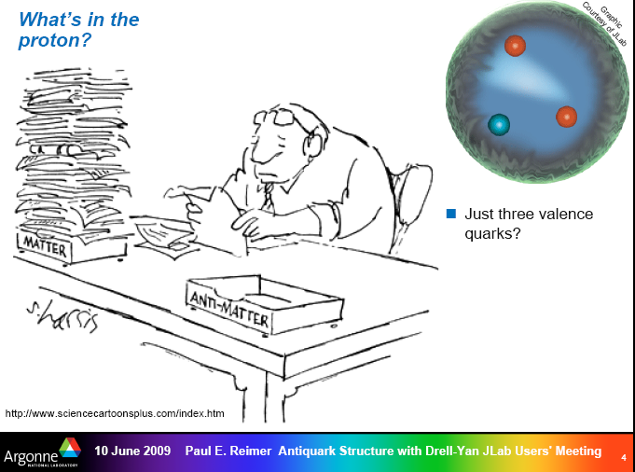
Paul Reimer showed these two slides at the Jlab User’s Group meeting: I have shamelessy copied them…..

Slide 2
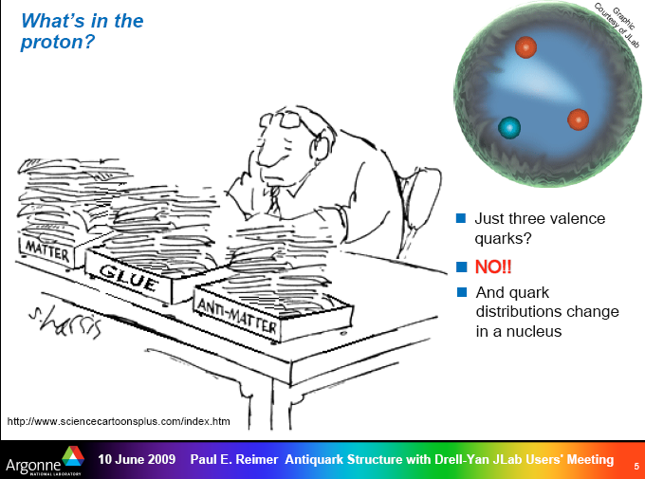

Slide 3
Hadron Physics
Topics I will attempt to cover:
Lecture #1: The quark model, QCD, and hadron spectroscopy
Lecture #2: Internal structure of hadrons: momentum and spin
Lecture #3: Internal structure of hadrons: charge, magnetism, polarizability
Lecture #4: Hadrons as laboratories (and other miscellaneous topics)

Slide 4
caveats
I am an experimentalist! I will focus on what we know and how we measure it
I will not give a rigorous presentation of the theory by any stretch.
I am not an expert on most of these topics: I will borrow heavily from the work of others. In particular presentations from recent conferences and past summer schools. Recent Conferences are:
Workshop of the APS Topical Group on Hadronic Physics (GHP): Denver, 2009
http://www.fz-juelich.de/ikp/ghp2009/Program.shtml
Conference on the Intersections between Nuclear and Particle Physics (CIPANP), San Diego 2009
http://groups.physics.umn.edu/cipanp2009/program.html
Jefferson Lab Users Annual Meeting, June 2009
http://conferences.jlab.org/ugm/program.html

Slide 5
some references
Halzen & Martin: Quarks and Leptons
F.E. Close: An Introduction to Quarks and Partons
Perkins: Introduction to High Energy Physics
Cahn and Goldhaber: The Experimental Foundations of Particle Physics
Xiangdong Ji: Graduate nuclear physics lecture notes
http://www.physics.umd.edu/courses/Phys741/xji/lecture_notes.htm
Lectures from the Hampton University Graduate School (HUGS): http://www.jlab.org/hugs/archive/
Lectures from past Nuclear Physics Summer Schools (most are available online)
and I have shamelessly borrowed material from wherever I could find it.
Special thanks to (for nice review slides)
Zein-Eddine Meziani, Temple University (spin, DIS)
Naomi Makins, University of Illinoisn (spin, transversity)
Volker Burkert, Jefferson Lab (N* physics)
Volker Crede, Florida State University (glueballs)

Slide 6
The big picture
What are the questions?
What are the connections between this topic and other areas of nuclear physics?

Slide 7

The Questions of the 2007 Long Range Plan
Quantum ChromoDynamics
  What are the phases of strongly interacting matter?
  What is the internal landscape of nucleons?
  What governs the transition of quarks and gluons into nucleons and pions?
Nuclei and Nuclear Astrophysics
  What is the nature of the nuclear force?
  What is the origin of simple patterns in complex nuclei?
  What is the origin of the elements in the cosmos?
Symmetries and Neutrinos
  What is the nature of neutrinos?
  Why is there now more visible matter than antimatter?
  … and of course more….
http://www.sc.doe.gov/np/nsac/nsac.html

Slide 8

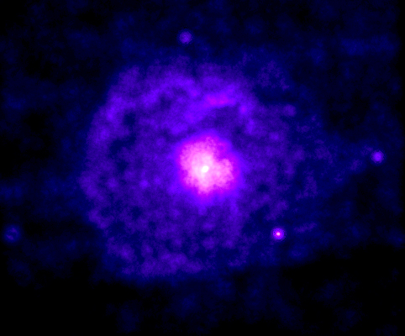
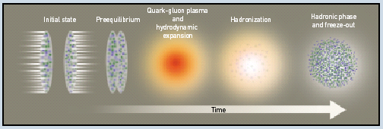
Landscape of Nuclear Physics
stable and
radioactive
beams
electron
scattering
relativistic
heavy ions
heavy
nuclei
few
body
quarks
gluons
vacuum
From W. Nazarewicz, ORNL

Slide 9
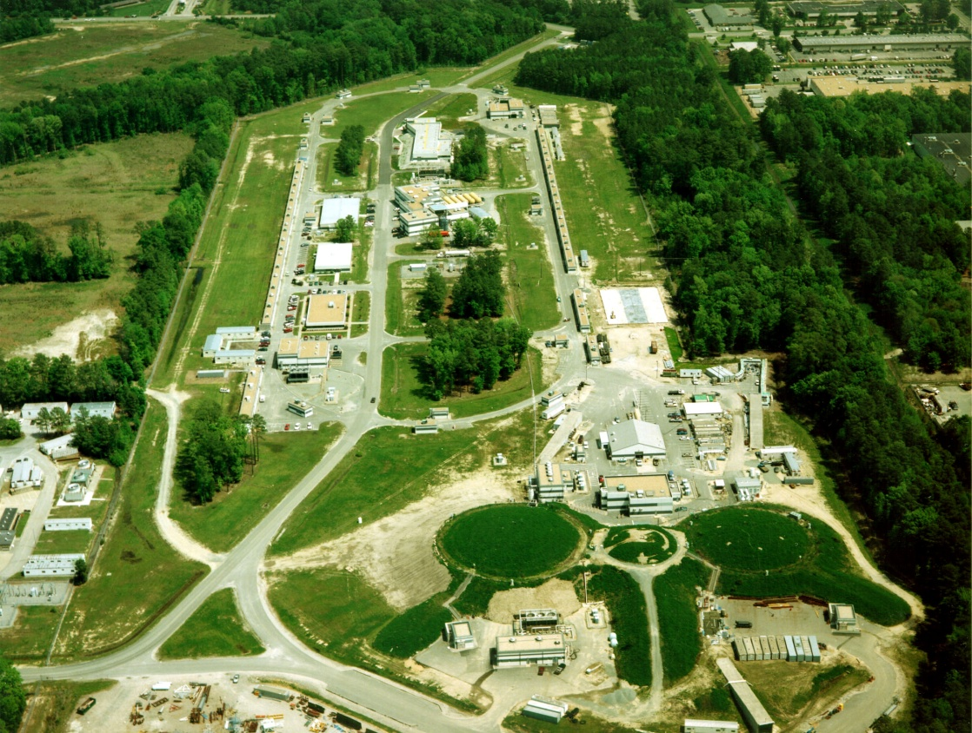
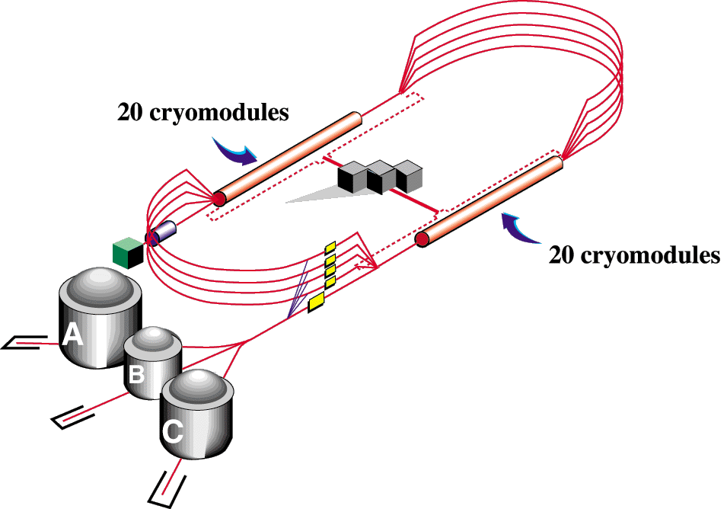
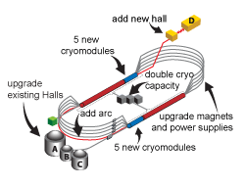
Jefferson Laboratory (Newport News, VA)
present
12 GeV Upgrade
E ~ 6 GeV
Continuous Polarized Electron Beam
> 100 μA
up to 85% polarization
concurrent to 3 Halls

Slide 10
Hadron Physics
Lecture #1: The quark model, QCD, and hadron spectroscopy
Lecture #2: Internal structure of hadrons: momentum and spin
Lecture #3: Internal structure of hadrons: charge, magnetism, polarizability
Lecture #4: Hadrons as laboratories (and other miscellaneous topics)

Slide 11
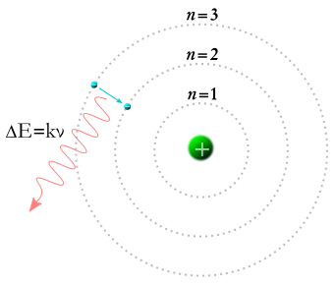
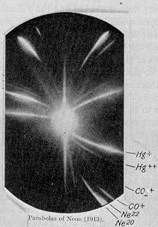
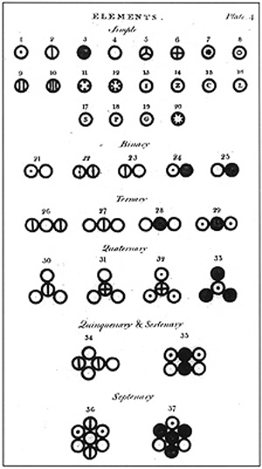
The atom
(slide from R. DeVita, AAAS meeting, Feb 2008)
Our present knowledge on the atomic structure of matter was obtained through a series of experimental observations and theoretical advances
In 1803 J. Dalton postulated the existence of chemical elements introduced to explain the variety of known compounds
Discovery of the electron by J.J. Thomson in 1867 and its studies on isotopes destroy the concept of the atom as indivisible particle
The “gold foil” experiment by E. Rutherford and the development of Quantum Mechanics led to the modern models of atomic structure
proton
neutron

Slide 12
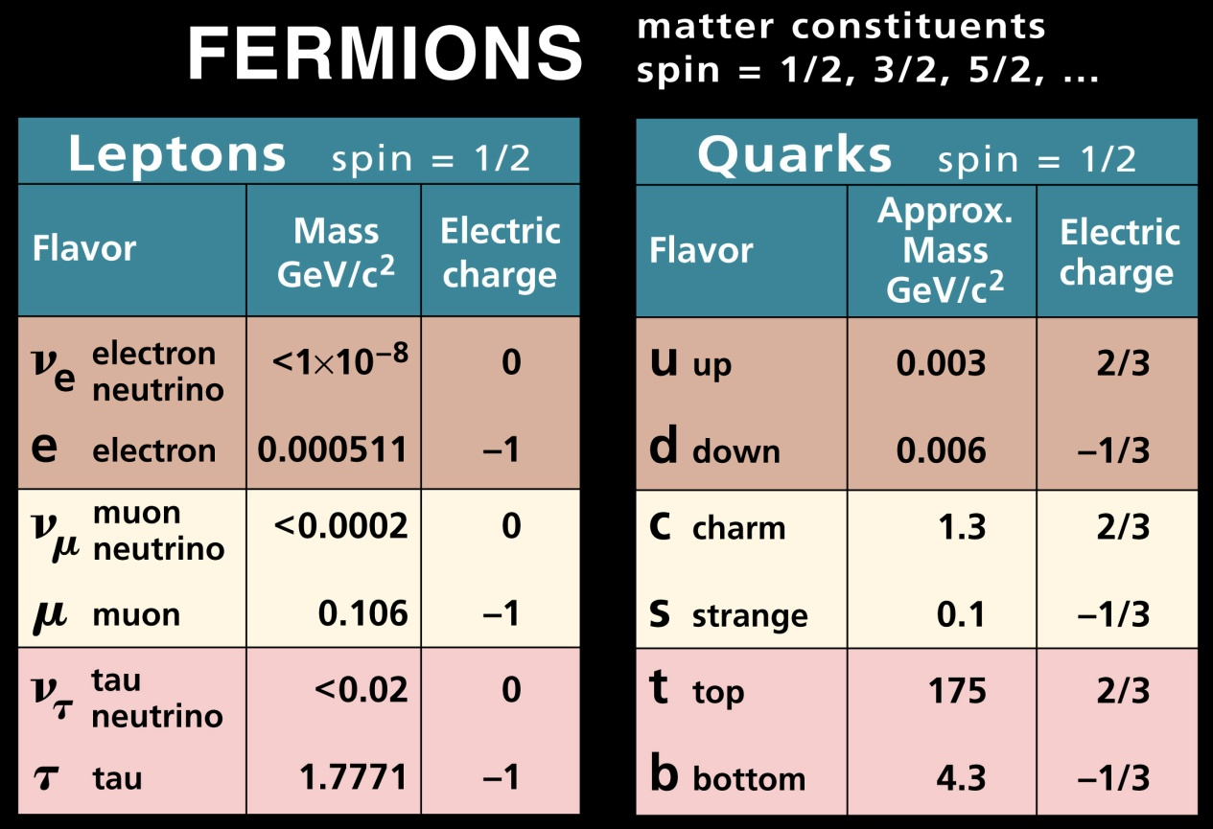
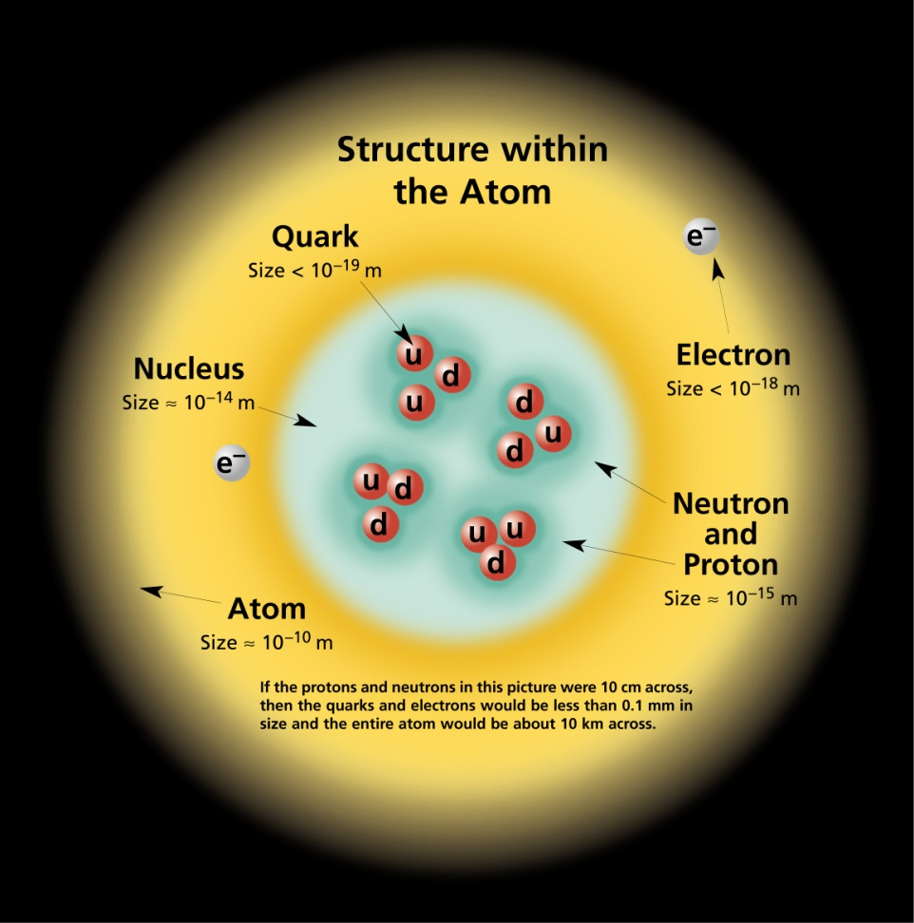
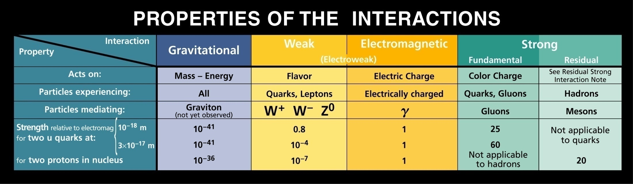
http://www.cpepweb.org

Slide 13

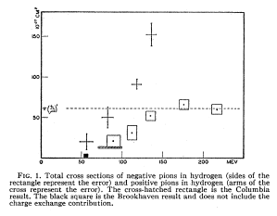
observation of hadron states
π+
π-
Chicago Cyclotron: beams of π+ and
π− from 50-180 MeV
ratio of production cross sections (9:2:1) consistent with all three processes going
through a single common resonance with Isospin 3/2. The authors suggest looking at the angular distribution in order to determine the state’s total angular momentum….

Slide 14

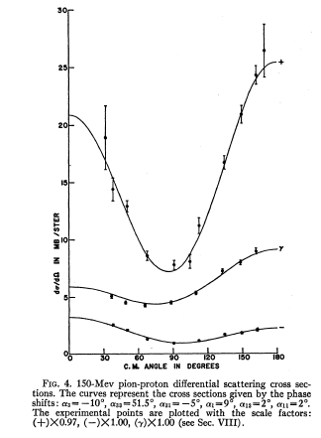
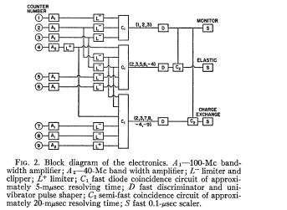
angular distributions
From “phase shift analysis”, assuming only S and P waves, found that resonance was associated with I=3/2, J=3/2
(early example of electronics diagram in a paper!)

Slide 15
strangeness: The V particle
(slide from R. DeVita, AAAS meeting, Feb 2008)
EVIDENCE FOR THE EXISTENC OF NEW UNSTABLE ELEMENTARY PARTICLES
G.D. Rochester and C.C. Butler, Nature 160 (1947) 855.
Tracks observed in a cloud chamber photographs, exposed to cosmic rays
2 photographs out of 5000 showed forked tracks
Surprisingly long life time (10⁻¹⁰ s)
compared w/ typical production reactions: → weak decay
masses of outgoing tracks could only be estimated, but < proton mass.
New property called strangeness was introduced: conserved in strong interactions but violated in weak interactions.
K⁰
π⁺
π⁻

Slide 16
Experiments
Experimental requirements for hadron spectroscopy:
energy (accelerators provide the luminosity)
mass/charge measurement: magnetic field
solid angle: need to detect all the outgoing products to completely reconstruct the decays
“hermetic” detector (cloud chamber, bubble chamber)
track resolution needed both for particle ID and for vertex reconstruction

Slide 17
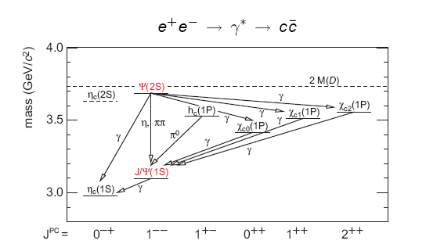
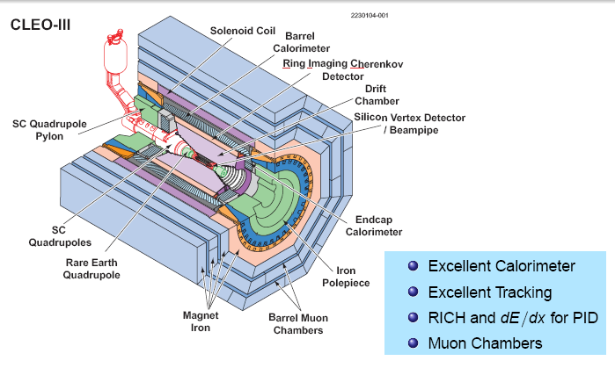
CLEO-c: charm quark spectroscopy at Cornell
(CESR: e⁺e⁻ collider)

Slide 18
the quark model
1950-1970:
explosion of discovery of new “particles”, including antibaryons
concepts of isospin, strangeness, baryon number, became useful as organizing/classification scheme
charge:
( hypercharge = B+S)
Quark hypothesis (Gell-Mann and Zweig, 1964): up, down, and strange
Flavor | B | J | I | I3 | S | charge
u | 1/3 | ½ | ½ | +1/2 | 0 | 2/3
d | 1/3 | ½ | ½ | -1/2 | 0 | -1/3
s | 1/3 | ½ | 0 | 0 | -1 | -1/3
what are the quark masses? Can we understand them from the spectrum of observed particles?

Slide 19
hadrons in QCD
The strong interaction is defined by the property “color”. This is required to produce bound states with the appropriate symmetry properties (fermion/boson statistics)
  The strong interaction is (approximately) flavor independent (same for all quarks, thus, e.g., same for n and p)
  There are 3 types of “color”
  The bound states of QCD are only “color neutral”: individual constituents cannot be observed → confinement
  The exchange particles (gluons) carry the property of color (and thus can interact with themselves)
  The interaction strength decreases with increasing energy
      → asymptotic freedom

Slide 20
u and d only: SU(2) flavor symmetry
symmetric
antisymmetric
symmetric
mixed symmetry: combine with spin part of wave fn to get antisymmetric
state: p and n
e.g.,
color “neutral”: antisymmetric
symmetric

Slide 21
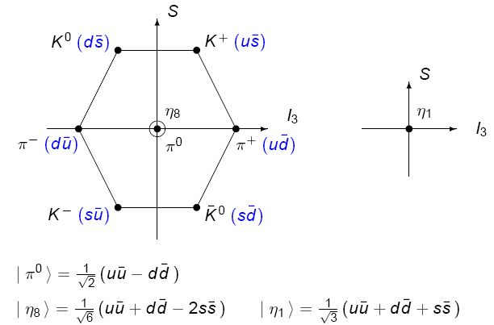
SU(3) and s quarks
Mesons: qq
figure from V. Crede, FSU
Baryons: qqq
Δ⁻, Δ⁰, Δ⁺, Δ⁺⁺
p, n
Σ^{∗−}, Σ^{∗0}, Σ^{∗+}
Σ⁻, Σ⁰, Σ⁺
Λ⁰
S
Ξ^{∗−} , Ξ^{∗0}
(uds)
Ξ⁻ , Ξ⁰
Ω─
(sss)
J^{P}=3/2+
J^{P}=1/2+

Slide 22
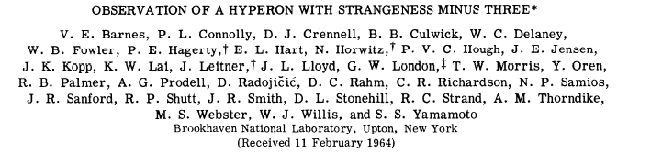
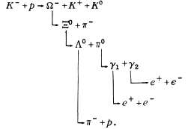
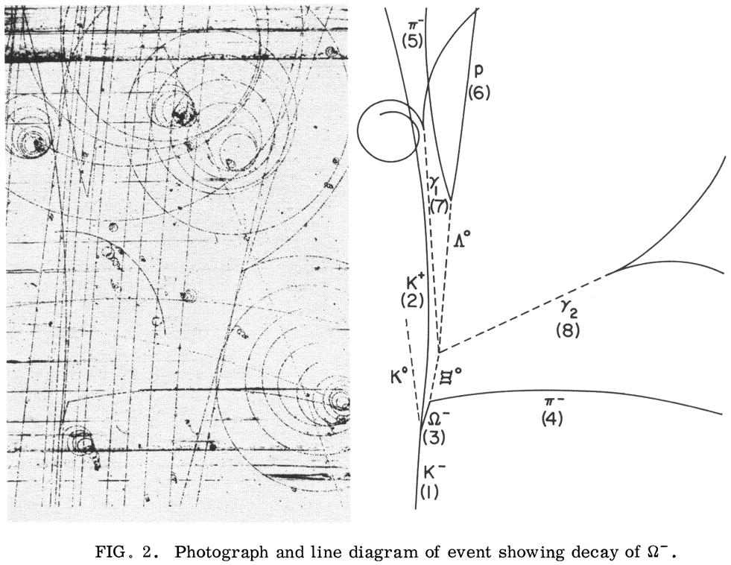
sss: the Ω⁻
Phys. Rev. Lett. 12, 204 (1964)
K⁺
π–
p
e⁻
e⁺
e⁺
γ
K⁰
Λ ⁰
e⁻
γ
Ξ⁰
π
Ω –
K–
slide from V. Burkert, JLab

Slide 23
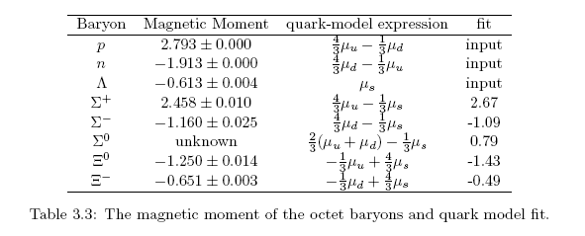
masses and magnetic moments
The “constituent quark” model can predict these pretty well.
p, n
Σ⁻, Σ⁰, Σ⁺
Λ⁰
Ξ⁻ , Ξ⁰
(uds)
Similar relationships for the J^{P}=3/2+ baryons. These get modified a little by q-q hyperfine structure. Result in “constituent quark” masses:

Slide 24
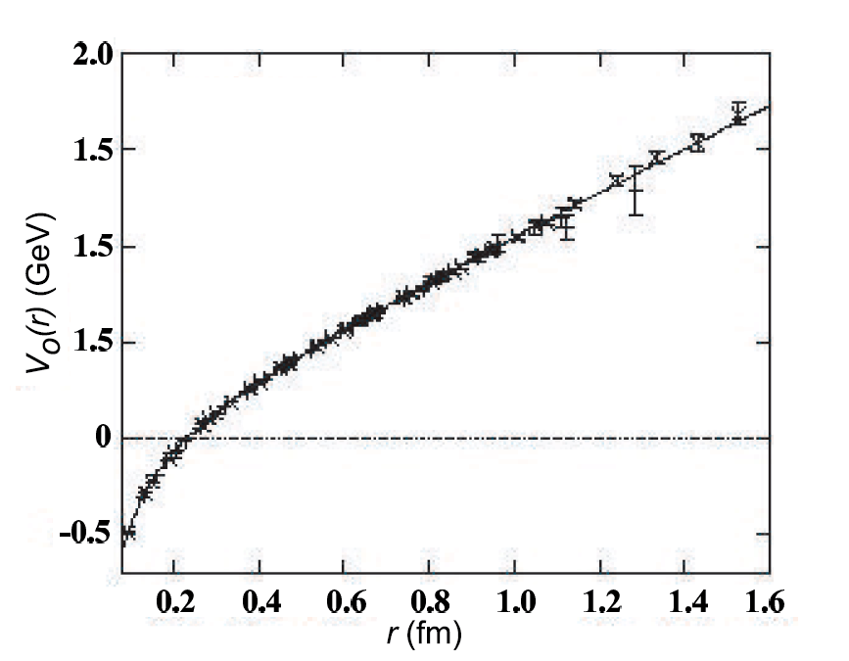
heavy quark bound states
quark analog of positronium
short range
nonrelativistic
perturbative QCD is not bad
e.g. Charmonium: (J/Ψ)
states are very narrow
excellent lab to search for
exotic and hydbrid bound states
(very active: BaBar, Belle, CDF, D0, …)
“Coulombic”
confining
Notes:
Particular state X(3872), interpretation still unclear: see talk of G. Cibinetto at CIPANP 2009 for many details.

Slide 25
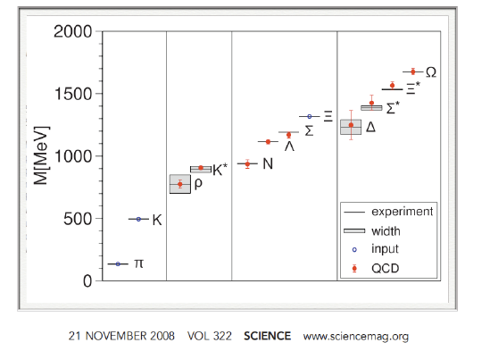

Lattice QCD
Flux tubes in LQCD
ab initio computation of Baryon masses
S. Dürr, et al Science 21 November 2008: 1224-1227.
G. Bali

Slide 26
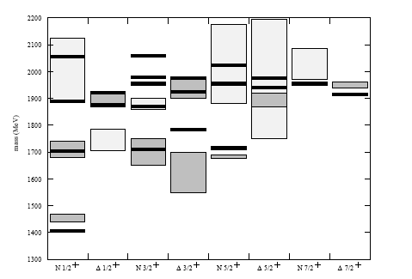
Excited baryons
simple quark model: harmonic oscillator + some hyperfine splitting…
more states predicted
than have been found. Are
these the correct degrees of
freedom?
predicted
PDG 3-4 ***
PDG 1-2 ***
see X. Ji, U Md Phys 741
lecture notes
see also Capstick& Roberts
PRD 58 (1998) 074011

Slide 27
“Missing” Baryon States
Quark models with underlying SU(6)xO(3) symmetry predict many states, not observed in either hadronic experiments or in meson photo- and electro-production.
Possible solutions:
States don’t exist, e.g. di-quark model predicts
fewer states, with different underlying symmetry
group
|q²q>
2. States exist but have not been found.
Possible reason: they do not couple to πN final states…
Maybe they decay to other channels:
KΛ, KΣ, pω
|q³>
adapted slide from V. Burkert, JLab
Notes:
In recent years a number of alternatives to the "standard" constituent quark model have been proposed, in large measures to fix some of the real or perceived shortcomings of that model, especially to explain the absence of many states predicted in that model. Several talks at this conference are dedicated to these new approaches. One of the oldest alternative models is the quark-diquark model, where two of the quarks form an elementary object. This model has the advantage that due to the fewer excitation degrees of freedom a much smaller number of states are predicted which corresponds more to what we see in the data...
The various alternatives correspond to quite different underlying quark symmetries and interactions, search for at least some of the states predicted in the standard model, but not in the alternative models is imperative.
A series of P13 states with coupling to the omega channel are predicted in the standard model but not in the quark-diquark model..... .
Electromagnetic production of omegas suffers from strong diffractive or t-channel contributions, leading to strong forward peaking which complicates the analysis. However, diffractive production is reduced with increasing Q2.
While the diffractive or t-channel contribution gives the forward peaking, s-channel resonance production produces a more symmetric angular dependence with significant large angle production.
(next) The data exhibit ..

Slide 28
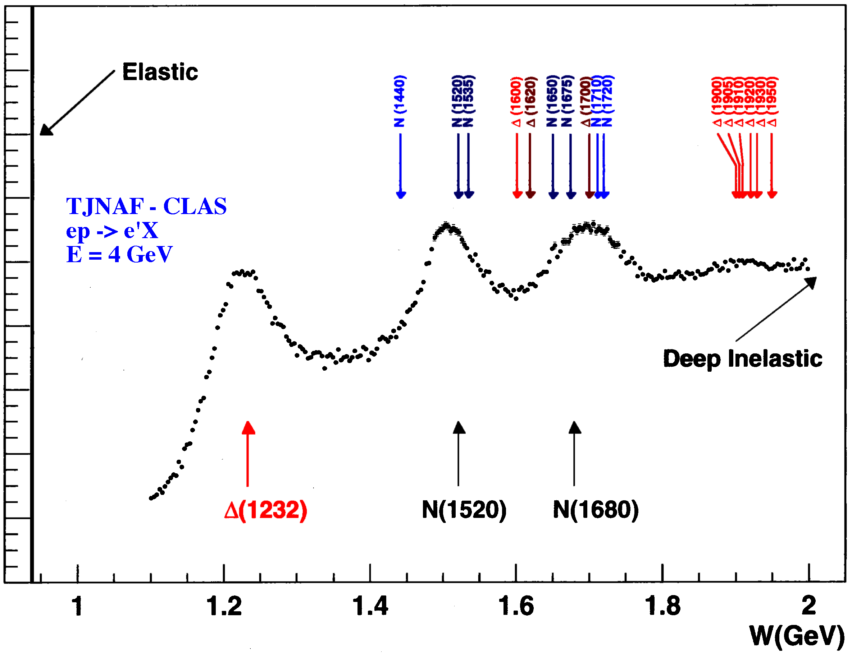
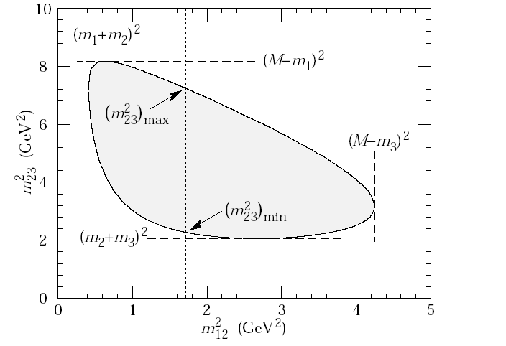
Searches for resonances
2-body decay: look at the invariant mass distribution.
p₁, m₁
P, M
p₂, m₂
W² = M ² = (p₁ + p₂)²
doesn’t tell you about the quantum #’s
Sometimes they overlap
3-body decay: Dalitz plot
p₁, m₁
P, M
p₂, m₂
p₃, m₃
beware of artifacts…..
slide from V. Burkert, JLab

Slide 29
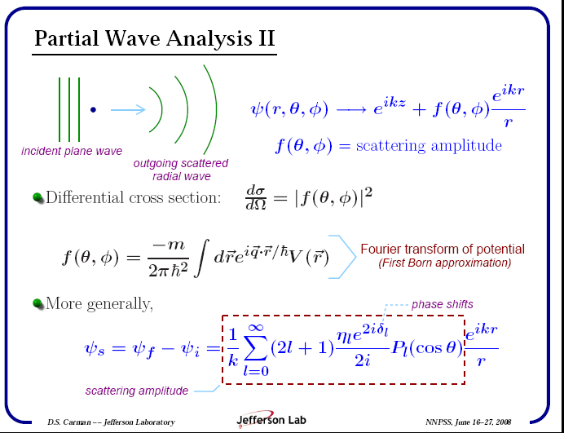
Partial Wave Analysis
See Dan Carman’s seminar from
see last year’s Summer School

Slide 30
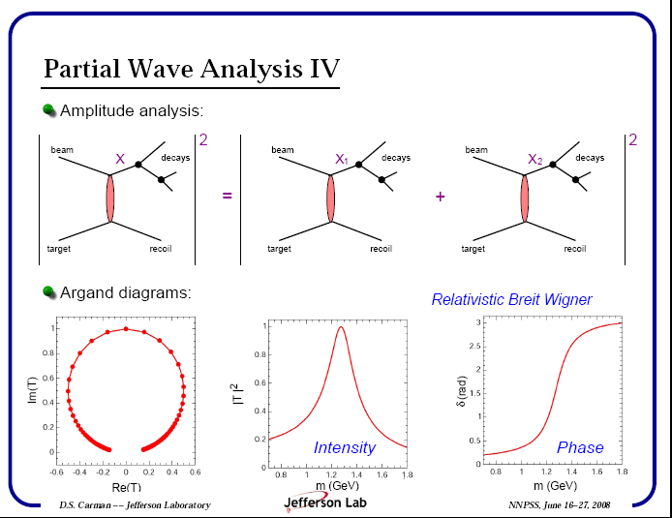
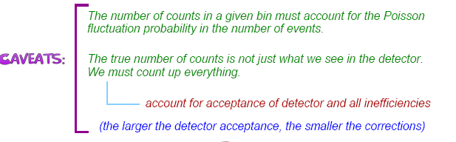
See Dan Carman’s seminar from
see last year’s Summer School

Slide 31
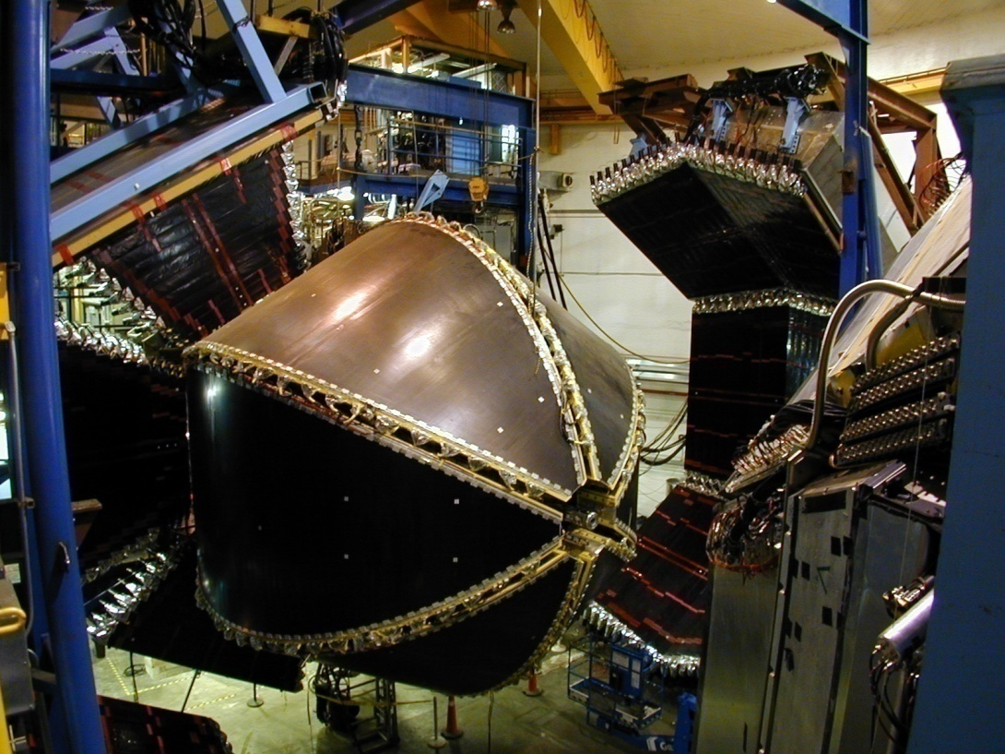
The CLAS Detector at JLab

Slide 32
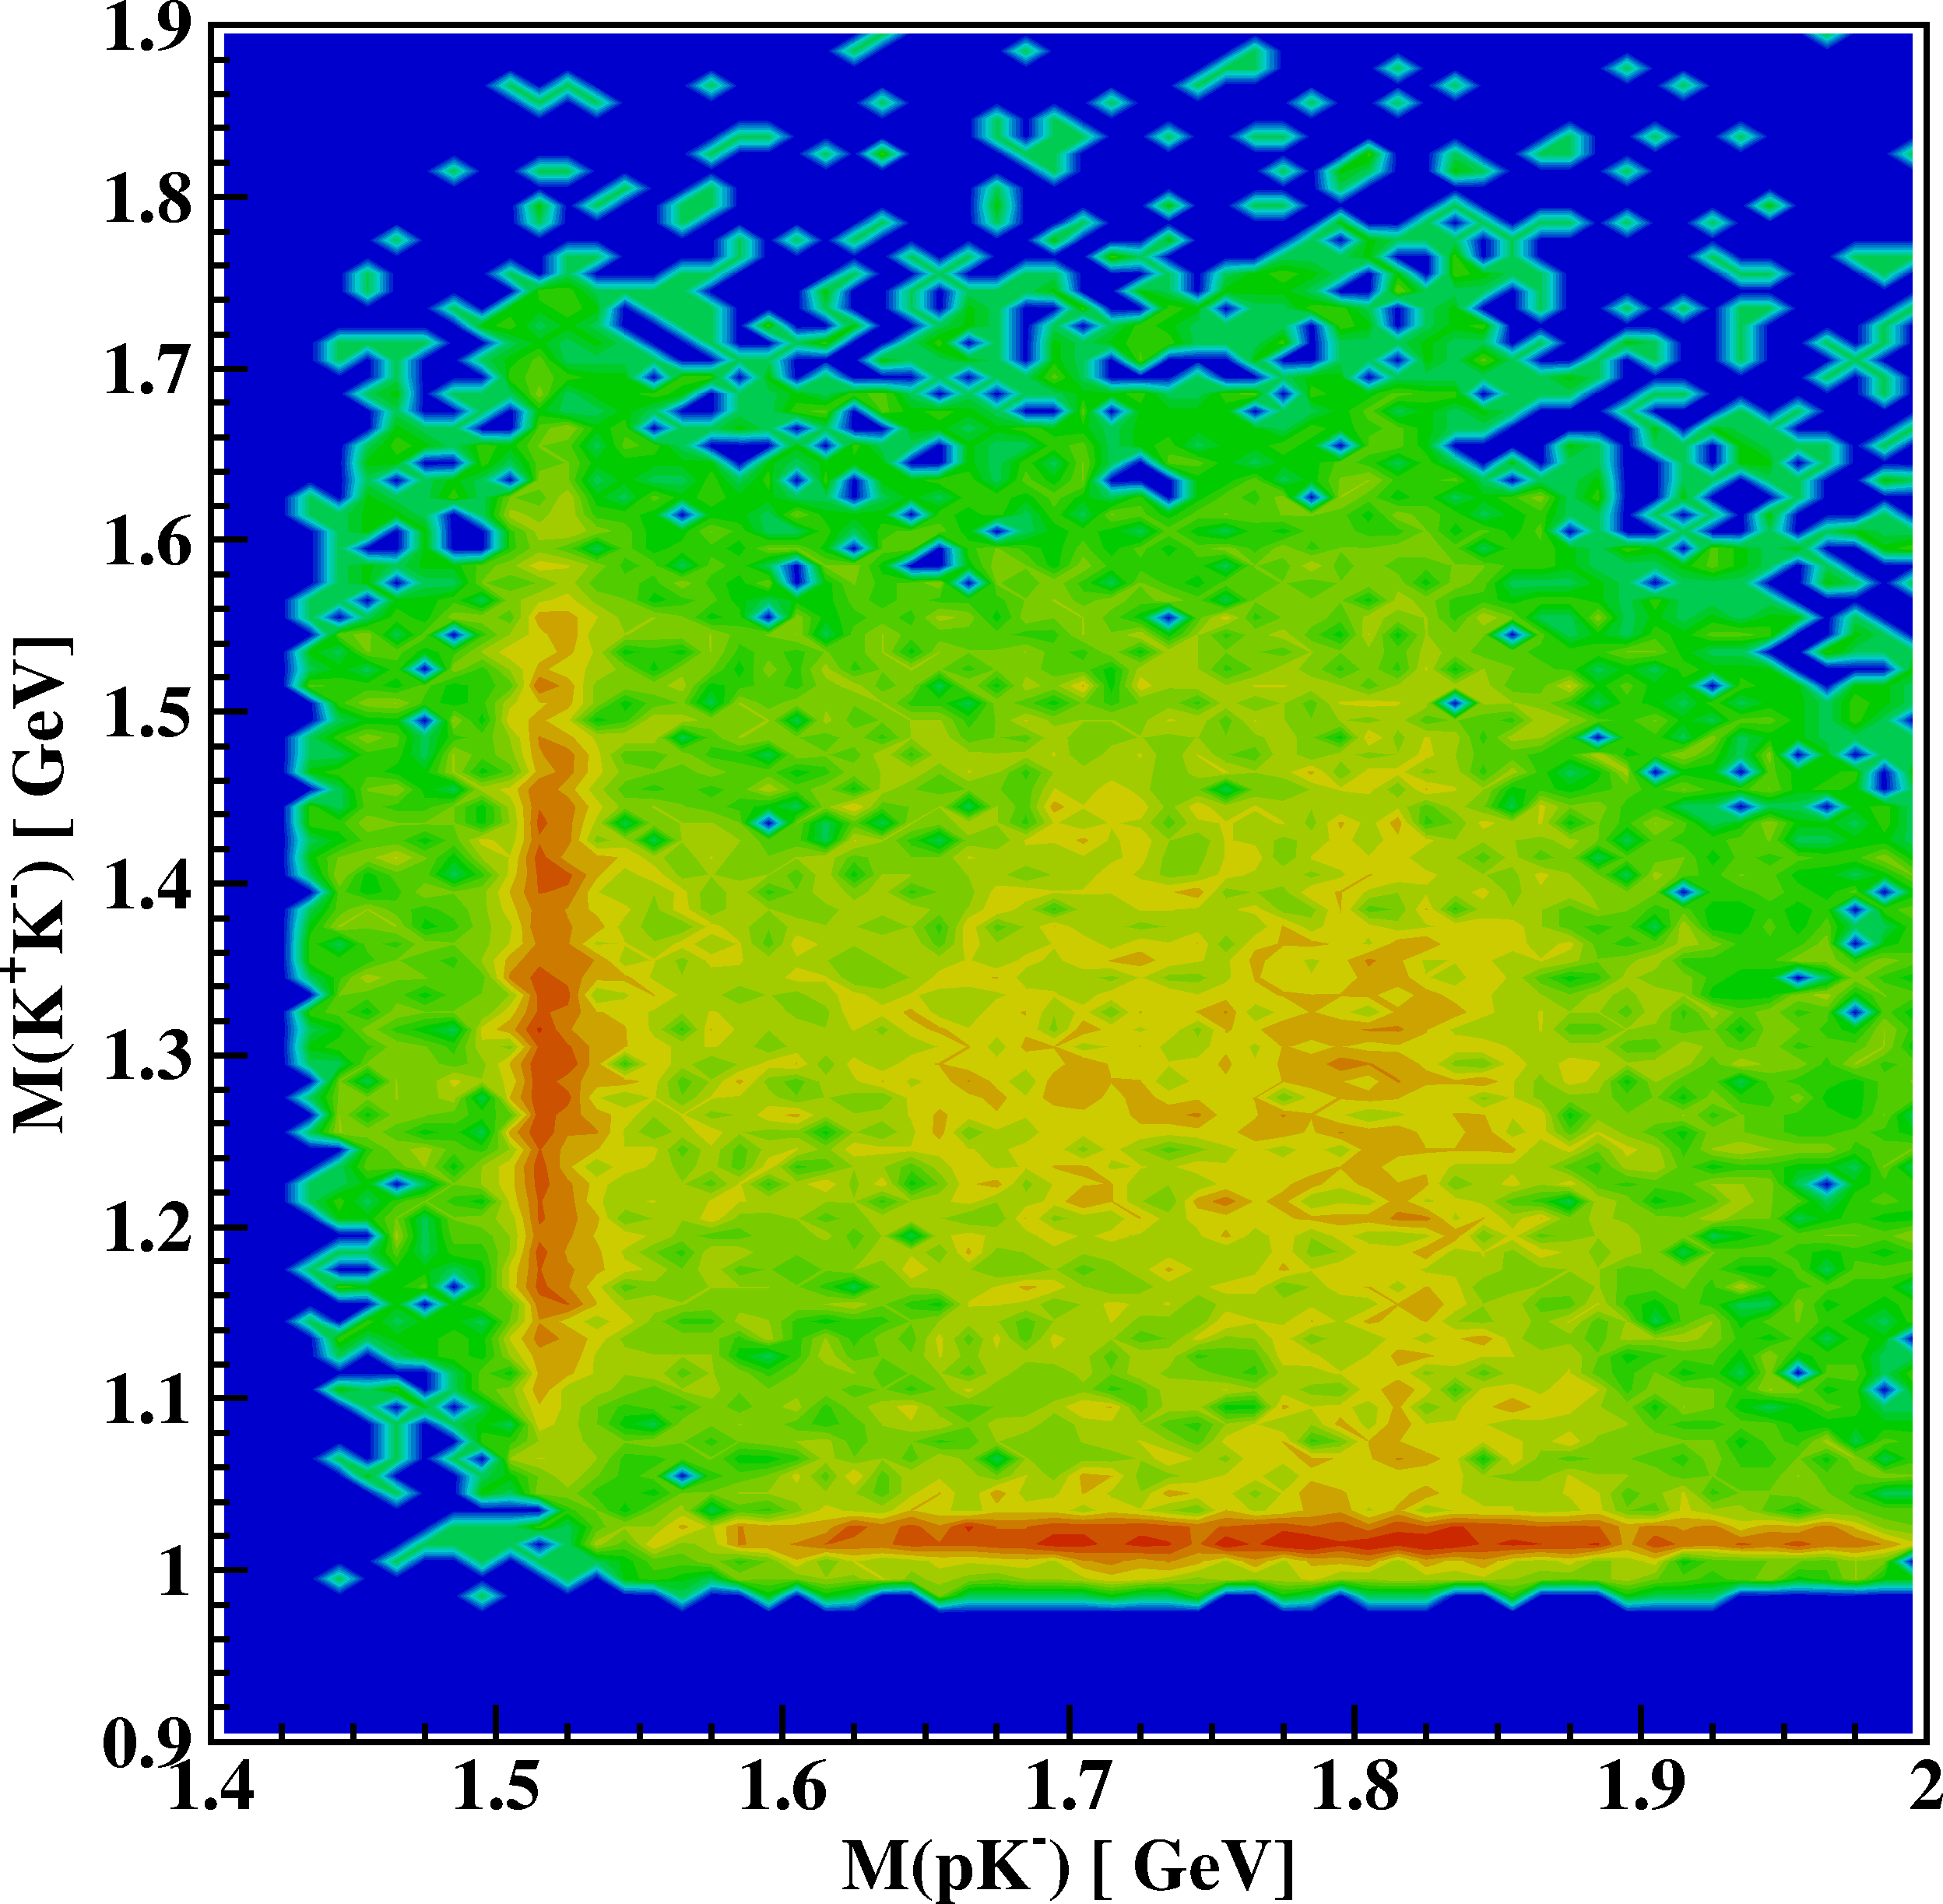
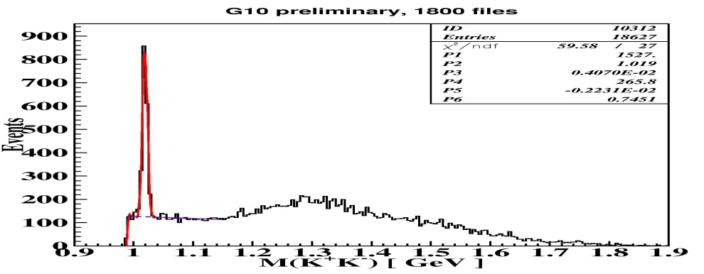
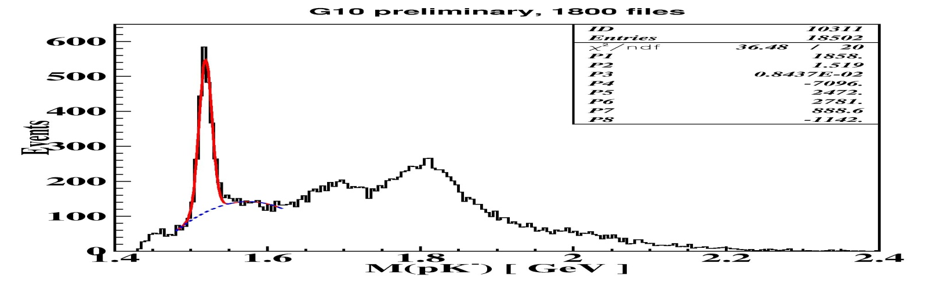
example of Dalitz Plot:
γp pK⁺K⁻
Eγ = 1.6-3.5 GeV
Φ(1020)
Λ(1520)
from the CLAS
detector in
Hall B at JLab
Λ(1690)
Λ(1820)
slide from V. Burkert, JLab

Slide 33
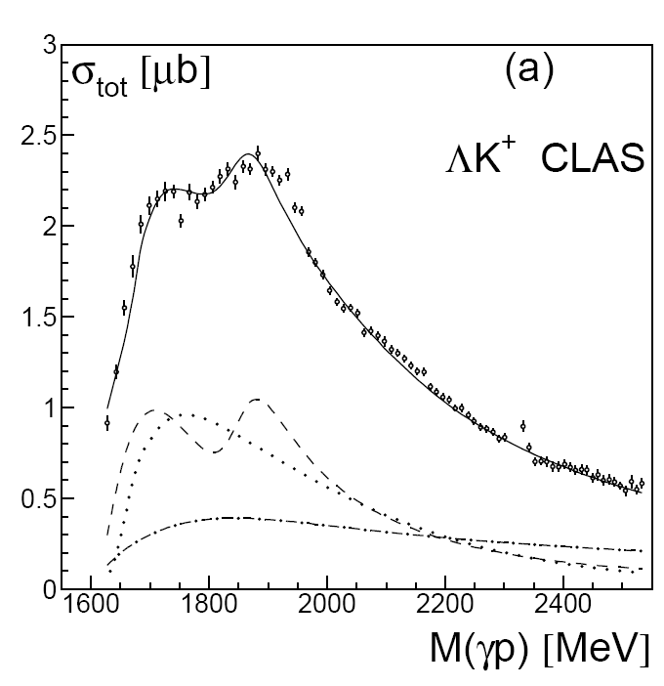
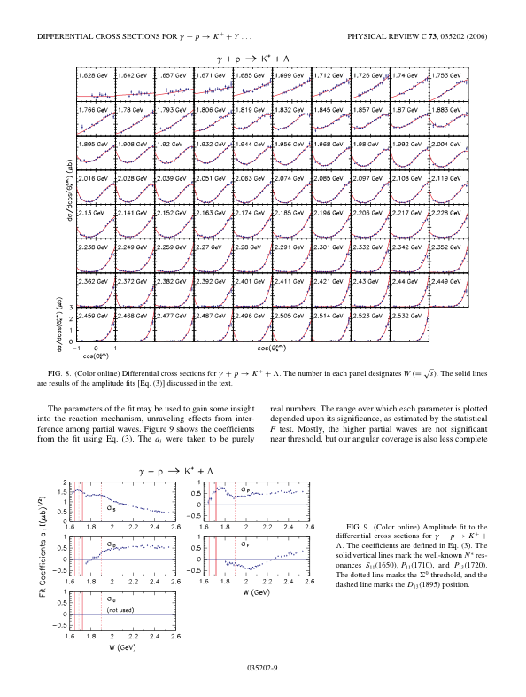
Differential & total cross section of γp→K⁺Λ
CLAS
P₁₁, P₁₃, D₁₃, S₁₁?
K exchange
P₁₁
P₁₃
Needs polarization observables and measurement in other channels for more definite conclusions.
Notes:
A large number of cross section data on k-Lambda and K-Sigma have been published and are being used by various groups for phenomenological analyses. This shows the integrated cross section from CLAS used in a fit by the Bonn-Gatchina group. This group finds significant contributions from a P13(1900) 2* state in the PDG. The strongest constraints however come from the polarization data using a circularly polarized photon beam, as is shown in the graph I have taken from their preprint ….

Slide 34
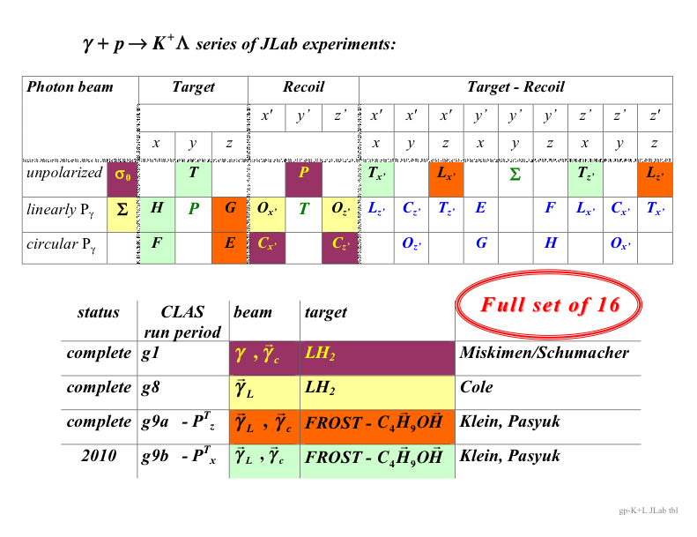
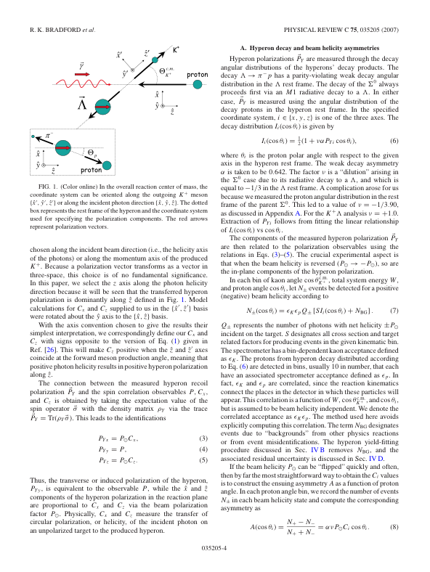
Complete experiment γp→K⁺Λ
CLAS
Pseudoscalar meson production is described by 4 complex amplitudes
8 measurements are needed to determine amplitudes.
16 observables will be measured in CLAS for hyperon production allowing many cross checks.
8 observables measured in reactions without recoil polarization.
Λ weak decay has large analyzing power
Notes:
The K-Lambda channel is ideal for a complete measurement as the Lambda decays weakly tp pi- p with large analyzing power.

Slide 35
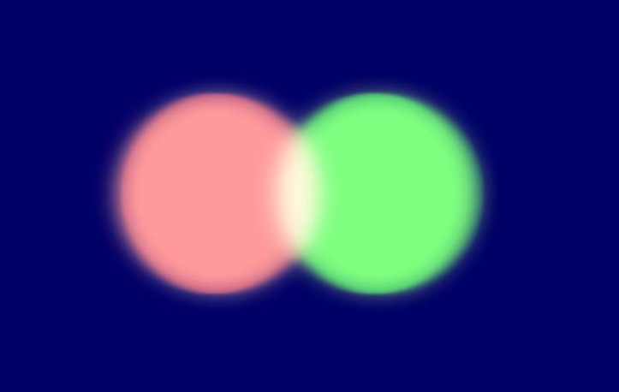



Beyond the Quark Model: Hybrids and Exotics
slide from R. deVita, AAAS meeting, Feb 2008
Quarks combine to “neutralize” color force
q
q
q
q
q
mesons
baryons
Other quark-gluon configurations can give colorless objects
q
q
q
q
q
q
q
q
q
q
molecule
tetraquark
glueball meson
hybrid meson

Slide 36
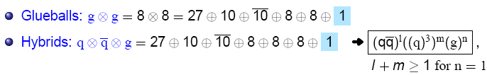

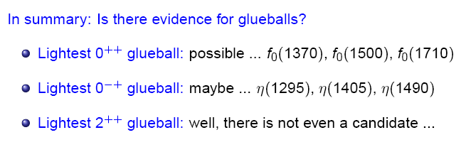
pure glue
from V. Crede, FSU

Slide 37
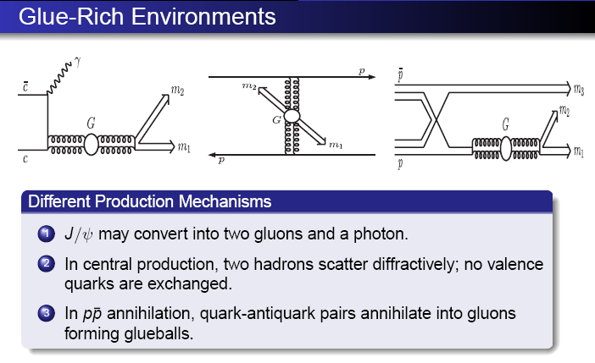
from V. Crede, FSU

Slide 38
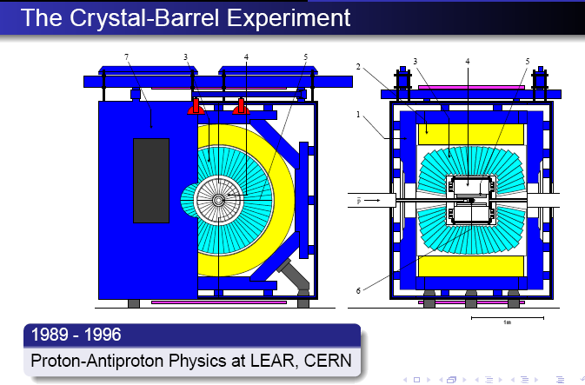
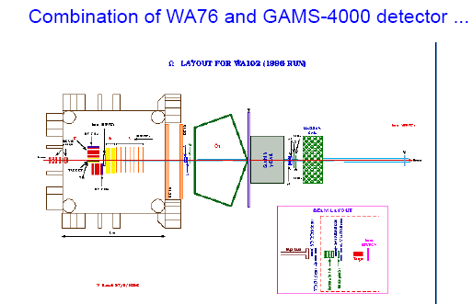
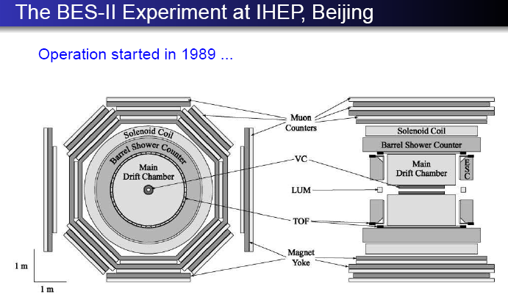
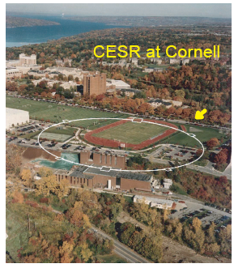
from V. Crede, FSU
p+p
p+p
e⁺ + e⁻

Slide 39
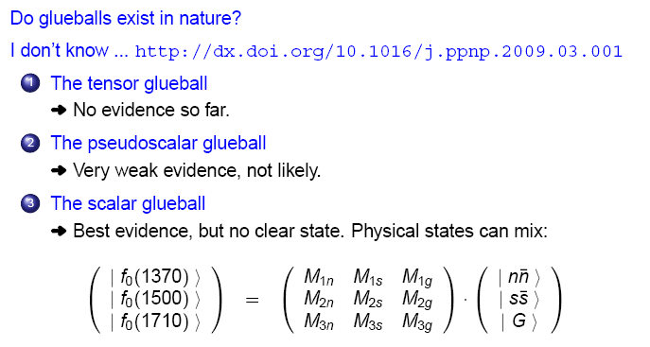
from V. Crede, FSU

Slide 40
Beyond the Quark Model: Hybrids and Exotics
slide from R. deVita, AAAS meeting, Feb 2008
Quarks combine to “neutralize” color force
q
q
q
q
q
mesons
baryons
Other quark-gluon configurations can give colorless objects
q
q
q
q
q
q
q
q
q
q
molecule
tetraquark
glueball meson
hybrid meson

Slide 41
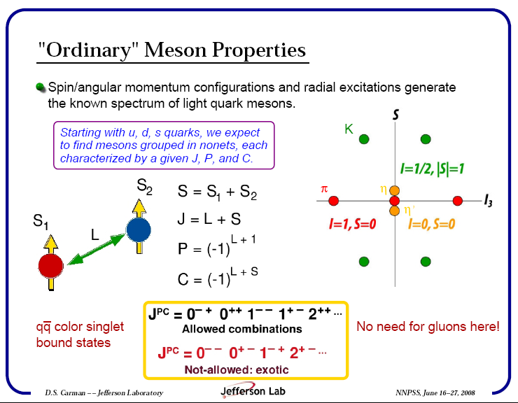
See Dan Carman’s seminar from
see last year’s Summer School

Slide 42
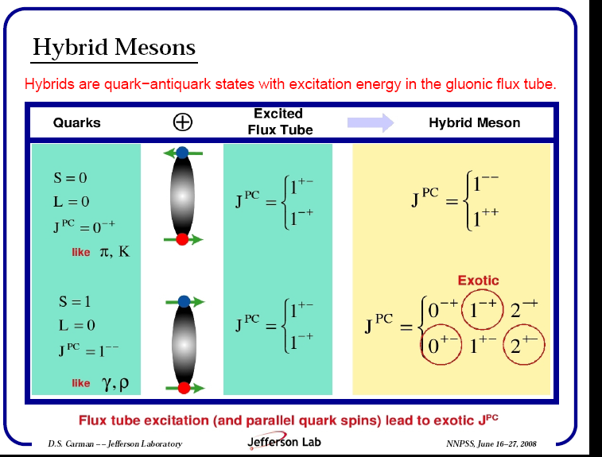
See Dan Carman’s seminar from
see last year’s Summer School

Slide 43

See Dan Carman’s seminar from
see last year’s Summer School

Slide 44

Exotic Mesons
See Dan Carman’s seminar from
see last year’s Summer School

Slide 45

The GlueX Experiment (w/ JLab 12 GeV upgrade)
Curtis Meyer NNPSS 2006

Slide 46

See Dan Carman’s seminar from
see last year’s Summer School

Slide 47


CLAS12
Central
Detector
Forward
Detector

Slide 48


GSI Helmholtz Center and FAIR
PANDA

Slide 49

PANDA Physics Program at the FAIR Facility in Germany
Charmonium spectroscopy
Exotics: charmed hybrids & heavy glueballs
Time-like
form factors
Medium modifications
of charmed mesons
Drell-Yan
processes
CP-violation
(D & Λ - sector)
Hard exclusive
processes
Hypernuclei
D. Bettoni, GHP 2009

Slide 50
PANDA detector
Detector Requirements
(Nearly) 4π solid angle coverage
(partial wave analysis)
High-rate capability
(2×10⁷ annihilations/s)
Good PID (γ, e, µ, π, K, p)
Momentum resolution (≈ 1 %)
Vertex reconstruction for D, K⁰_{s}, Λ
Efficient trigger
Modular design
Pointlike interaction region
Lepton identification
Excellent calorimetry
  Energy resolution
  Sensitivity to low-energy
  photons
http://www.gsi.de/panda

Slide 51
Summary of this section
The quark model laid the groundwork for QCD.
The basic spectroscopy of the more easily identifiable
bound states of meson and baryon can be characterized by
a set of quantum #’s described by the quark model.
Searching for new bound states tests the limits, perhaps revealing something deeper about QCD and confinement.
Difficult task! Need lots of data taken together with close
connection to theory.
Opportunities are abundant!

Slide 52
Hadron Physics
Lecture #1: The quark model, QCD, and hadron spectroscopy
Lecture #2: Internal structure of hadrons: momentum and spin
Lecture #3: Internal structure of hadrons: charge, magnetism, polarizability
Lecture #4: Hadrons as laboratories (and other miscellaneous topics)

Slide 53
Differential & total cross section ofγp→K⁺Λ
CLAS
P₁₁, P₁₃, D₁₃, S₁₁?
K exchange
P₁₁
P₁₃
Needs polarization observables and measurement in other channels for more definite conclusions.
Notes:
A large number of cross section data on k-Lambda and K-Sigma have been published and are being used by various groups for phenomenological analyses. This shows the integrated cross section from CLAS used in a fit by the Bonn-Gatchina group. This group finds significant contributions from a P13(1900) 2* state in the PDG. The strongest constraints however come from the polarization data using a circularly polarized photon beam, as is shown in the graph I have taken from their preprint ….

Slide 54

Coupled channel fit including γp→K⁺Λ
CLAS
→
→
w/o P₁₃(1900)
with P₁₃(1900)
quark-diquarkmodel
(E. Santopinto, 2005)
no P13
Includes *** / **** states
Fit: BG Model - A.K. Nikonov et al.. Phys.Lett.B662:245-251,2008.
Fit shows preference for P₁₃(1900) state, needs confirmation.
Existence of state would be evidence against the quark-diquark model.
Notes:
And is shown here…. The evidence for the P13 is quite strong as can be seen in the comparison between the left and right hand side one w/o the P13 and the other with the P13 in the fit. If this state can be confirmed it will be strong evidence against a diquark –quark model that has no room for such a state.

Slide 55
Complete experiment γp→K⁺Λ
CLAS
Pseudoscalar meson production is described by 4 complex amplitudes
8 measurements are needed to determine amplitudes.
16 observables will be measured in CLAS for hyperon production allowing many cross checks.
8 observables measured in reactions without recoil polarization.
Λ weak decay has large analyzing power
Notes:
The K-Lambda channel is ideal for a complete measurement as the Lambda decays weakly tp pi- p with large analyzing power.

Slide 56



Examples of polarization observables
CLAS
↝
↝
→
γp → K⁺Σ⁰
γp → K⁺Λ
Σ
Eγ=1.95GeV
O_{x’}
PRELIMINARY
Σ
Eγ=1.475GeV
New data are much more precise and have more complete angle & energy coverage.

Slide 57
Dalitz Plot for 3-body decay (e.g. pπ⁺K⁰)
p₁, m₁
3-body decay
P, M
p₂, m₂
p₃, m₃
Resonance at:
m₁₂ = 1.8 GeV
Resonance at:
m₂₃ = 2.0 GeV
A narrow resonance at
m₁₂ = 2.0 GeV may
appear like a broad
enhancement in m₂₃
(kinematical reflection).

Slide 58

CEBAF Large Acceptance Spectrometer
Torus magnet
6 superconducting coils
Large angle calorimeters
Lead/scintillator, 512 PMTs
Liquid D₂ (H₂)target +
γ start counter; e minitorus
Drift chambers
argon/CO₂ gas, 35,000 cells
Gas Cherenkov counters
e/π separation, 216 PMTs
Electromagnetic calorimeters
Lead/scintillator, 1296 PMTs
Time-of-flight counters
plastic scintillators, 684 PMTs

