Slide 1
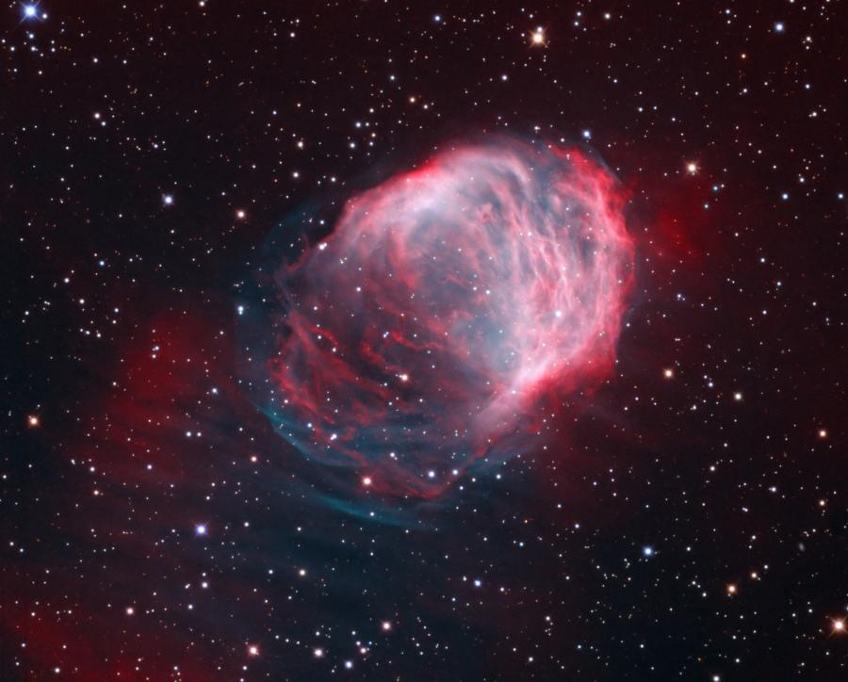
The Matter of Our Matter:
Tales from Nuclear Science
Betsy Beise
The Medusa Nebula (NASA’s Astronomy picture of the day Oct 25, 2012)
copyright K. Crawford (Rancho del Sol Observatory)
Notes:
Astronomy picture of the day Oct 25, 2012. The Medusa Nebula. Also known as Abell 21, this Medusa is an old planetary nebula some 1,500 light-years away in the constellation Gemini. Like its mythological namesake, the nebula is associated with a dramatic transformation. The planetary nebula phase represents a final stage in the evolution of low mass stars like the sun, as they transform themselves from red giants to hot white dwarf stars and in the process shrug off their outer layers.

Slide 2
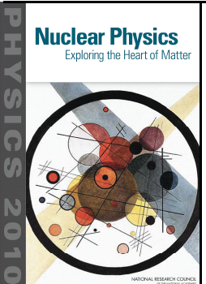
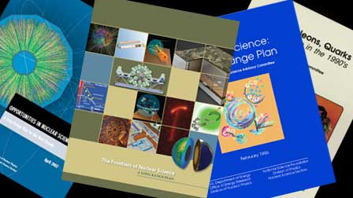
Identifying the big questions and the tools to answer them
National Academies
2012
Nuclear Science Advisory Committee (NSAC)
Long Range Plan 2007
http://science.energy.gov/np/nsac/
http://www.nap.edu/catalog.php?record_id=13438

Slide 3
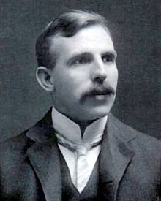
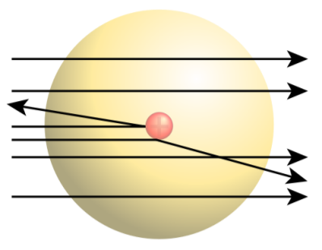
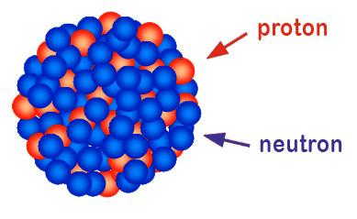
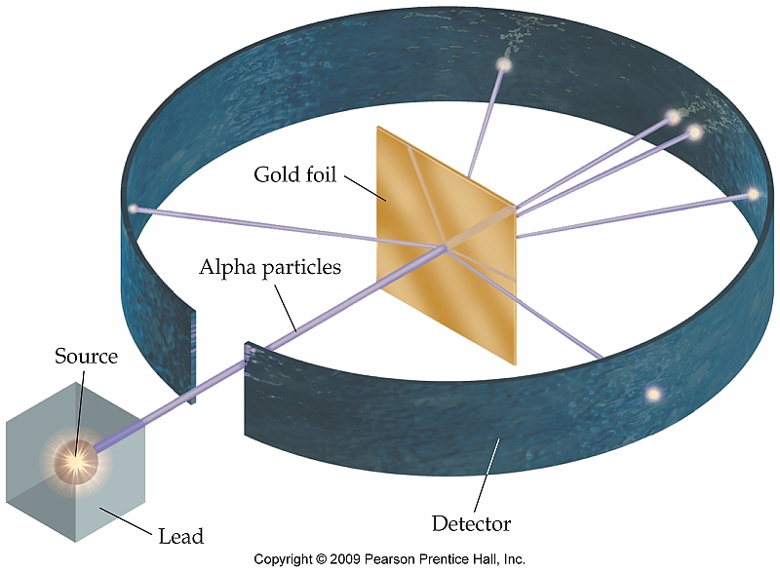
100 years of nuclear science
Ernest Rutherford
1871-1937
Nobel Prize in Chemistry, 1908
"for his investigations into the disintegration of the elements, and the chemistry of radioactive substances".
atomic nucleus identified in 1911
Notes:
Rutherford discovered heavy, apparently pointlike entities at the centers of atoms. He was correct to conclude that nuclei contain most of the mass of an atom, but little did he know how intricate their composition and structure would turn out to be.
Nobel Prize in chemistry 1908, Rutherford scattering experiment in

Slide 4
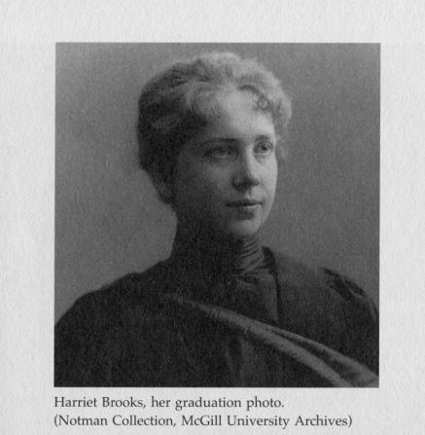
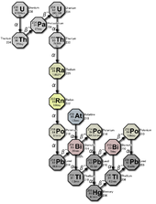
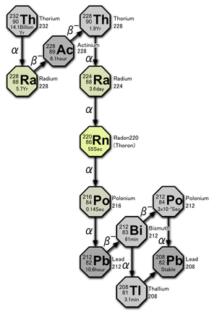
naturally occurring Uranium
Radon gas
Thorium
Harriet Brooks
1876-1933
beta decay
(neutron turns into a proton, releases an electron … and antineutrino)
more protons
more neutrons
Notes:
Its most stable isotope, ²²²Rn, has a half-life of 3.8 days. Radon is one of the densest substances that remains a gas under normal conditions. It is also the only gas under normal conditions that only has radioactive isotopes, and is considered a health hazard due to its radioactivity. Intense radioactivity has also hindered chemical studies of radon and only a few compounds are known.
Radon is formed as one intermediate step in the normal radioactive decay chains, through which thorium and uranium slowly decay into lead. Thorium and uranium are the two most common radioactive elements on earth; they have been around since the earth was formed. Their naturally occurring isotopes have very long half-lives, on the order of billions of years. Thorium and uranium, their decay product radium, and its decay product radon, will therefore continue to occur for tens of millions of years at almost the same concentrations as they do now
(text from Wikipedia)

Slide 5

The tale of visible matter
How were the elements such as gold, platinum, uranium (or anything heavier than iron) created ?
Why are certain elements stable and others unstable?
first few
microseconds
first few
minutes
once upon
a time….
billions of
years later ….
Notes:
Nuclear physics in the universe. Over 99.9 percent of the mass of all the matter in all the living organisms, planets, and stars in all the galaxies throughout our universe comes from the nuclei found at the center of every atom. These nuclei are made of protons and neutrons that themselves formed a few microseconds after the big bang as the primordial liquid known as quark gluon plasma cooled and condensed. The lightest nuclei (those at the centers of hydrogen, helium, and lithium atoms) formed minutes after the big bang. Other elements were formed later in nuclear reactions occurring deep within the early stars. Cataclysmic explosions of these early stars dispersed these heavy nuclei throughout the galaxy, so that as the solar system formed it contained nuclei of carbon, nitrogen, oxygen, silicon, iron, uranium and many more elements, which ended up forming our planet and ourselves.

Slide 6
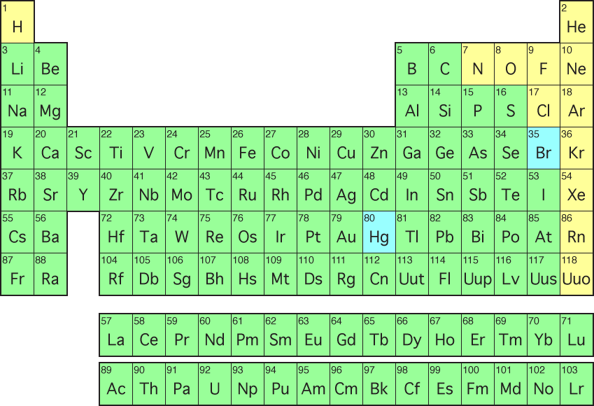

The Periodic Table of Elements
1963
8
O
Oxygen
16
Maria
Goeppert-Mayer
http://education.jlab.org/itselemental
Notes:
yellow = gas, blue = liquid, green = solid
https://seaborg.llnl.gov/research-super-heavy-element-discovery.php
In 2010, the LLNL-Dubna team established the existence of element 117
Continuing to collaborate, this international team has discovered up to 6 new elements — 113, 114, 115, 116, 117, and 118.
https://www.llnl.gov/news/newsreleases/2011/Dec/NR-11-12-01.html
114: Flerovium (Flerov Laboratory of Nuclear Reactions)
116: Livermorium
The creation of elements 116 and 114 involved smashing calcium ions (with 20 protons each) into a curium target (96 protons) to create element 116. Element 116 decayed almost immediately into element 114. The scientists also created element 114 separately by replacing curium with a plutonium target (94 protons).

Slide 7
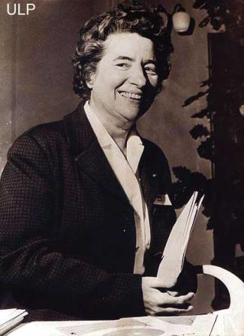
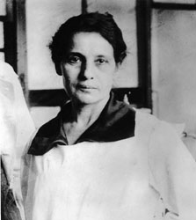
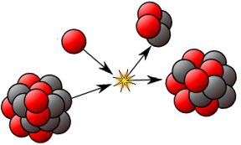
Tales of heavy nuclei
91
Pa
Protactinium
231
87
Fr
Francium
223
1921→discovered Protactinium
1939 → discovered Francium
Marguerite Perey
1909 – 1975
109
Mt
Meitnerium
278
Lise Meitner
1878 - 1968
first produced in 1982
1939 → explanation of nuclear fission

Slide 8
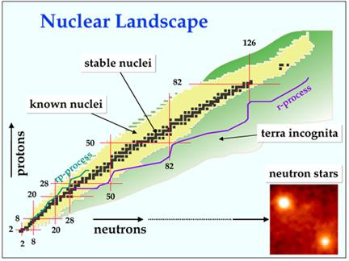
Notes:
1: The nuclei of certain elements are known as “magic”

Slide 9
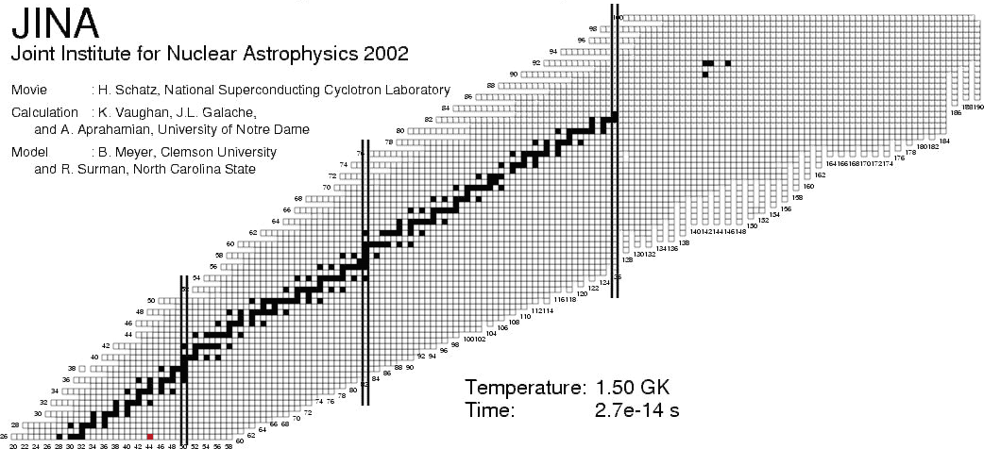
Creation of heavy elements: rapid capture of neutrons
Sn
Ni
many elements made from beta decay
Heaviest elements thought to be
made from rapid neutron capture (r-process)
Where are they made? How?
simulation based on measured nuclear masses and beta-decay rates
(courtesy A. Aprahamian, Notre Dame)
Notes:
What is the nuclear physics
SAY: equilibrium process, then freezeout
Need wide range of nuclei (broad path) all the way to near the drip line

Slide 10
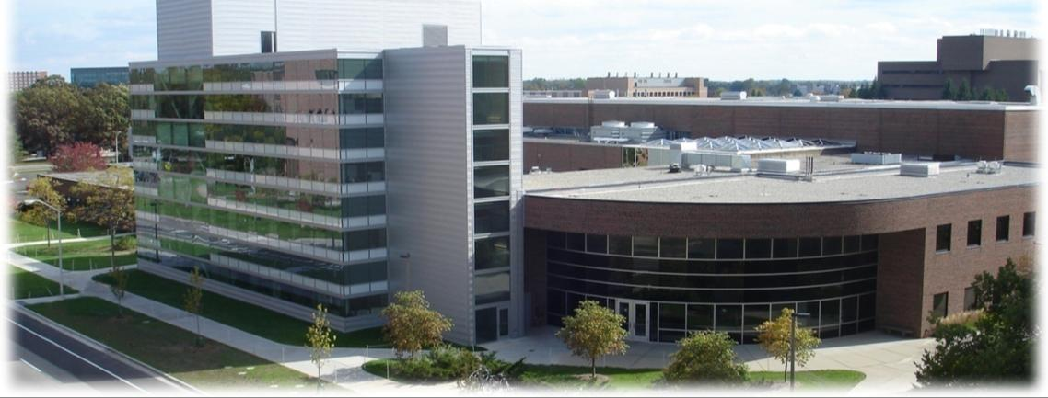
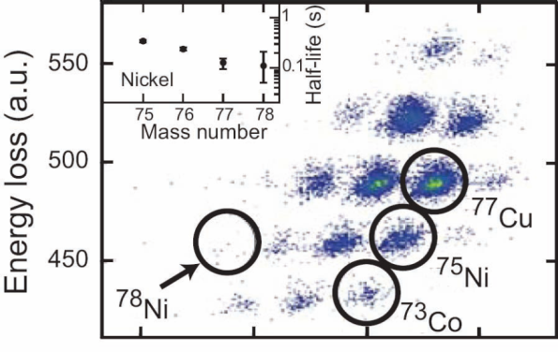
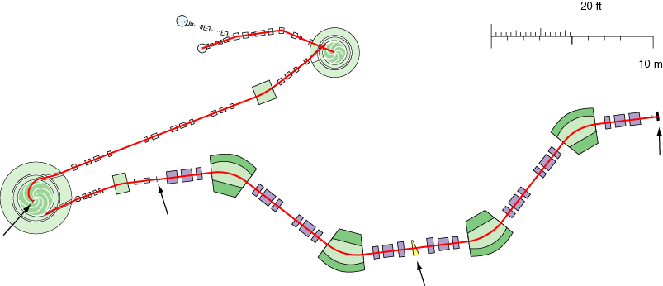
The National Superconducting Cyclotron Laboratory (NSCL) at Michigan State University
Example:
⁸⁶Kr → ⁷⁸Ni
ion sources
K500
coupling
line
⁸⁶Kr¹⁴⁺,
12 MeV/u
A1900
transmission
of 65% of the
produced ⁷⁸Ni
production
target
Δp/p = 5%
⁸⁶Kr³⁴⁺,
140 MeV/u
production

Slide 11
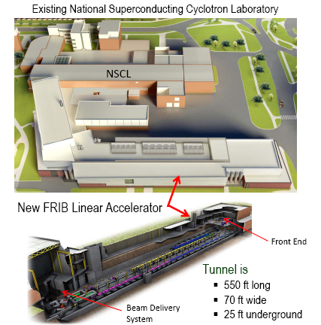
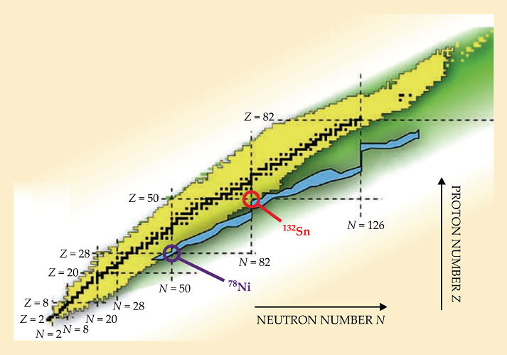
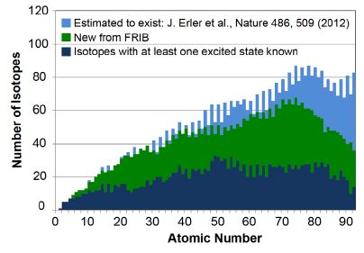
Facility for Rare Isotope Beams (FRIB)
Preparing for construction at MSU
number of protons

Slide 12
Tales of creation
What were the properties of matter in the earliest stages of the universe, just after the quarks and gluons were created?
How did the quarks and gluons combine to form protons and neutrons?
first few
microseconds
first few
minutes
once upon
a time….
billions of
years later ….
Notes:
Nuclear physics in the universe. Over 99.9 percent of the mass of all the matter in all the living organisms, planets, and stars in all the galaxies throughout our universe comes from the nuclei found at the center of every atom. These nuclei are made of protons and neutrons that themselves formed a few microseconds after the big bang as the primordial liquid known as quark gluon plasma cooled and condensed. The lightest nuclei (those at the centers of hydrogen, helium, and lithium atoms) formed minutes after the big bang. Other elements were formed later in nuclear reactions occurring deep within the early stars. Cataclysmic explosions of these early stars dispersed these heavy nuclei throughout the galaxy, so that as the solar system formed it contained nuclei of carbon, nitrogen, oxygen, silicon, iron, uranium and many more elements, which ended up forming our planet and ourselves.

Slide 13
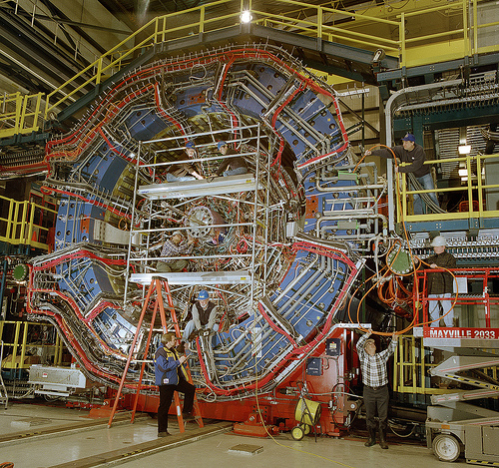

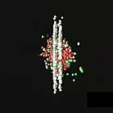
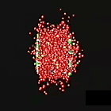
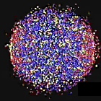
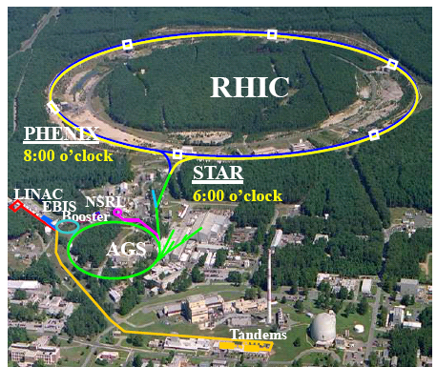
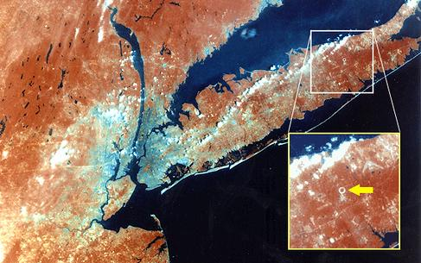
The Relativistic Heavy Ion Collider
Brookhaven National Laboratory, (Long Island, NY)
STAR detector

Slide 14
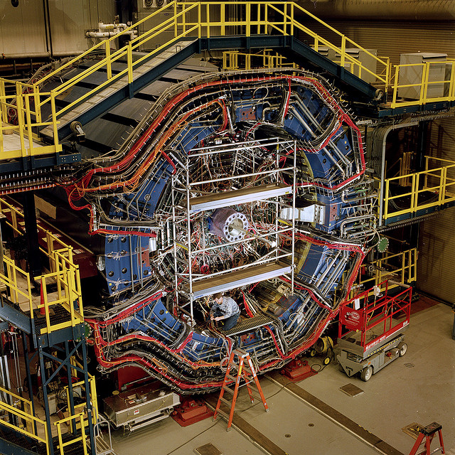
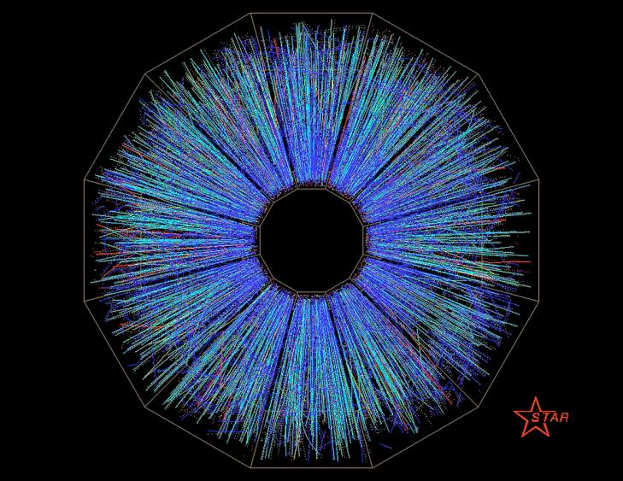
Colliding Gold nuclei at RHIC
STAR detector event

Slide 15
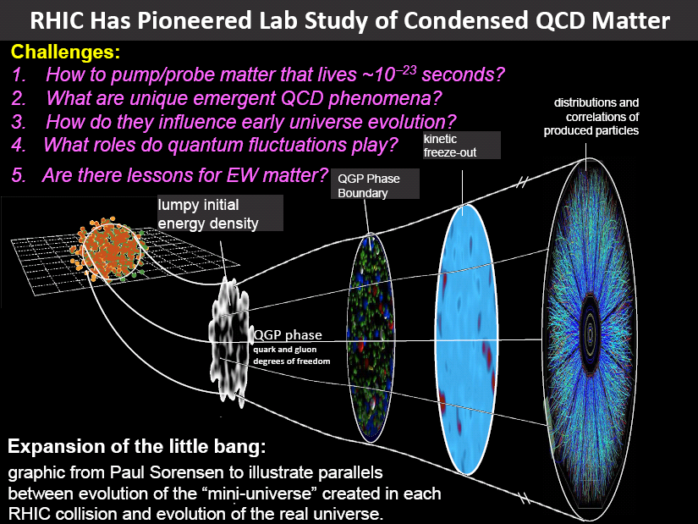
Quark-gluon plasma seems to be nature’s most perfect liquid

Slide 16
the tale of formation
How do we describe the properties of neutrons and protons based on the fundamental force that holds them together?
first few
microseconds
first few
minutes
once upon
a time….
billions of
years later ….
Notes:
Nuclear physics in the universe. Over 99.9 percent of the mass of all the matter in all the living organisms, planets, and stars in all the galaxies throughout our universe comes from the nuclei found at the center of every atom. These nuclei are made of protons and neutrons that themselves formed a few microseconds after the big bang as the primordial liquid known as quark gluon plasma cooled and condensed. The lightest nuclei (those at the centers of hydrogen, helium, and lithium atoms) formed minutes after the big bang. Other elements were formed later in nuclear reactions occurring deep within the early stars. Cataclysmic explosions of these early stars dispersed these heavy nuclei throughout the galaxy, so that as the solar system formed it contained nuclei of carbon, nitrogen, oxygen, silicon, iron, uranium and many more elements, which ended up forming our planet and ourselves.

Slide 17
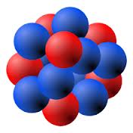
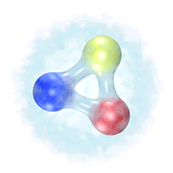
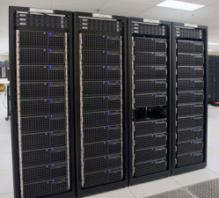
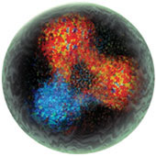
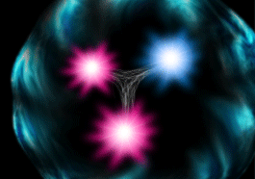
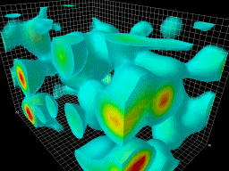
quarks and gluons in protons and neutrons
1
H
Hydrogen
1.00794
Proton = up + up + down
charge = 2/3 + 2/3 – 1/3 = 1
neutron = up + down + down
charge = 2/3 – 1/3 – 1/3 = 0
nucleus
almost all the mass comes from the gluons – the energy field – not the 3 quarks
Theory and Computation

Slide 18
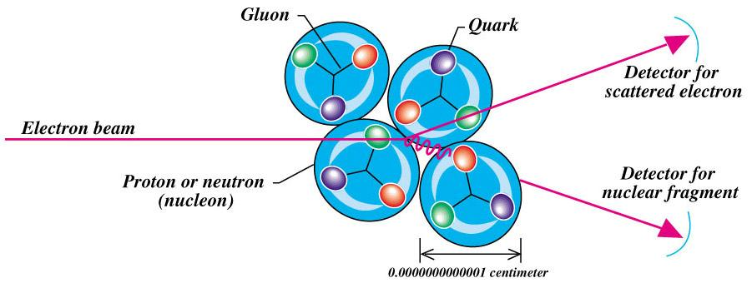
Looking inside through scattering
(a la Rutherford)
microscope
Particles sometimes act like waves
The higher the momentum, the smaller the wavelength, the shorter distances can be seen.

Slide 19
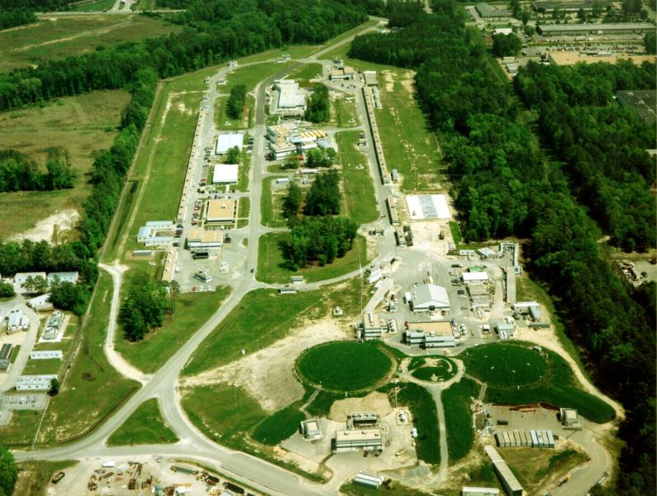
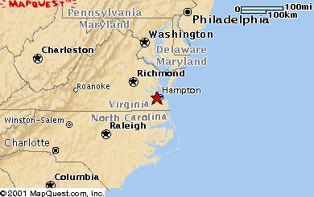
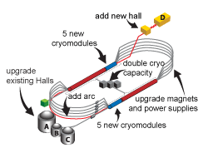
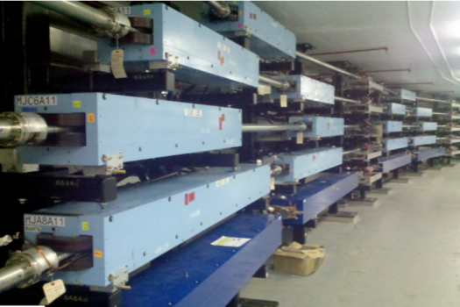
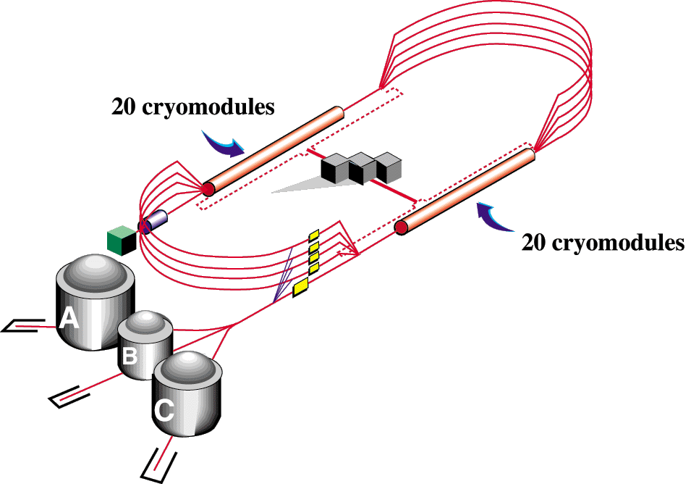
Jefferson Laboratory (Newport News, VA)
Energy doubling upgrade in progress underway
East Arc Tunnel Magnets

Slide 20

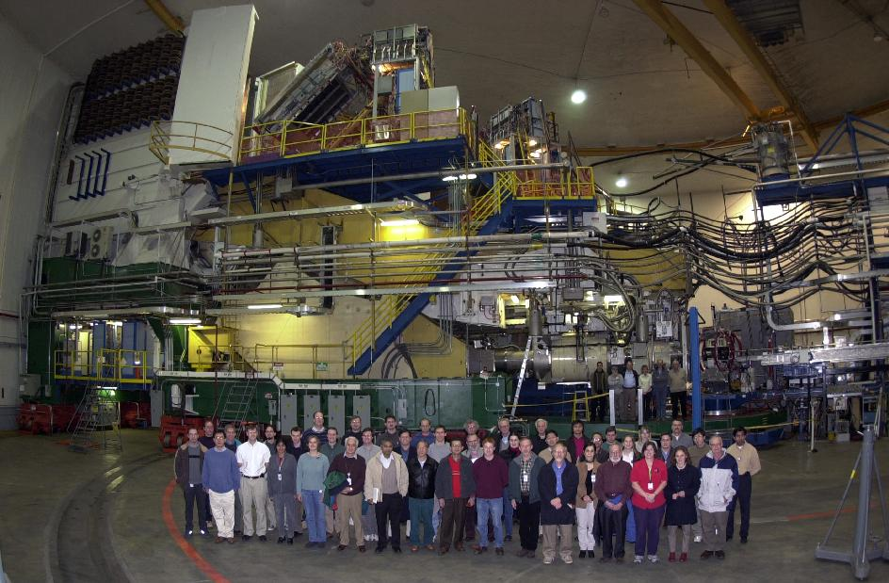
detector
beam
target

Slide 21
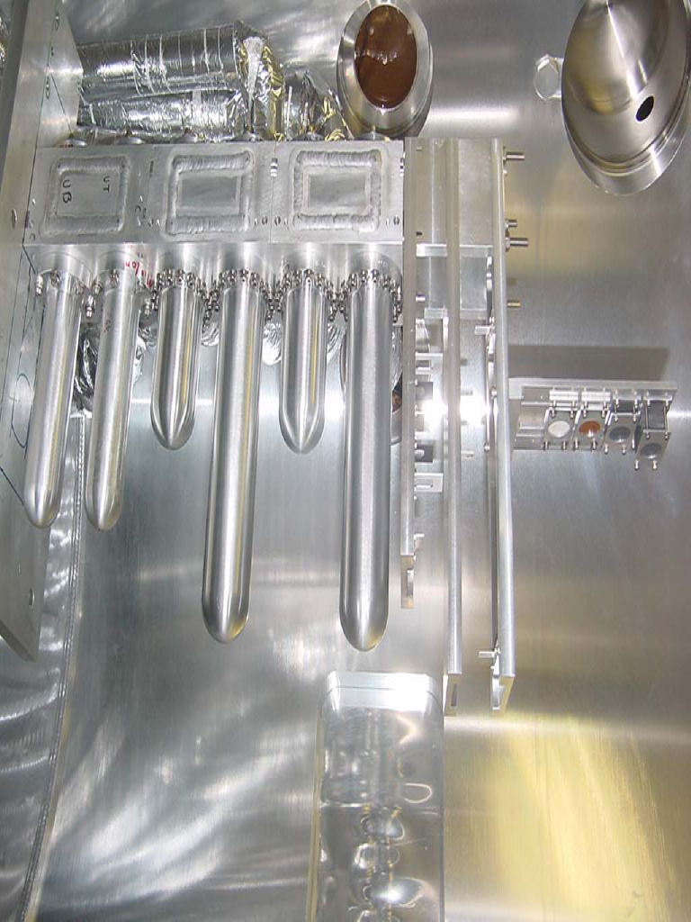
Cryogenic Targets
Hall C targets
liquid Hydrogen
liquid deuterium
solid targets
G0 target

Slide 22
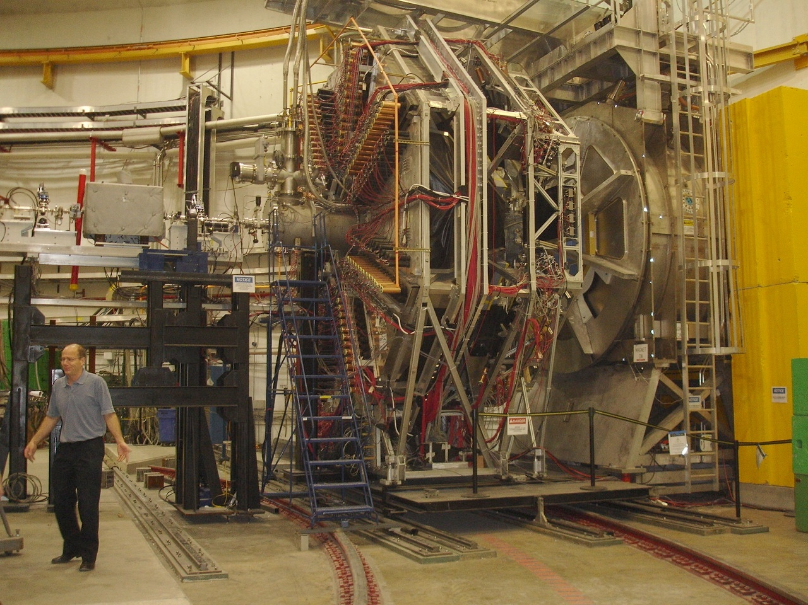
G0 Detector in Hall C
at Jefferson Lab
Superconducting Magnet
(SMS)
Target module
G⁰ beam girder
FPDs
CED+Cherenkov
Spokesman

Slide 23
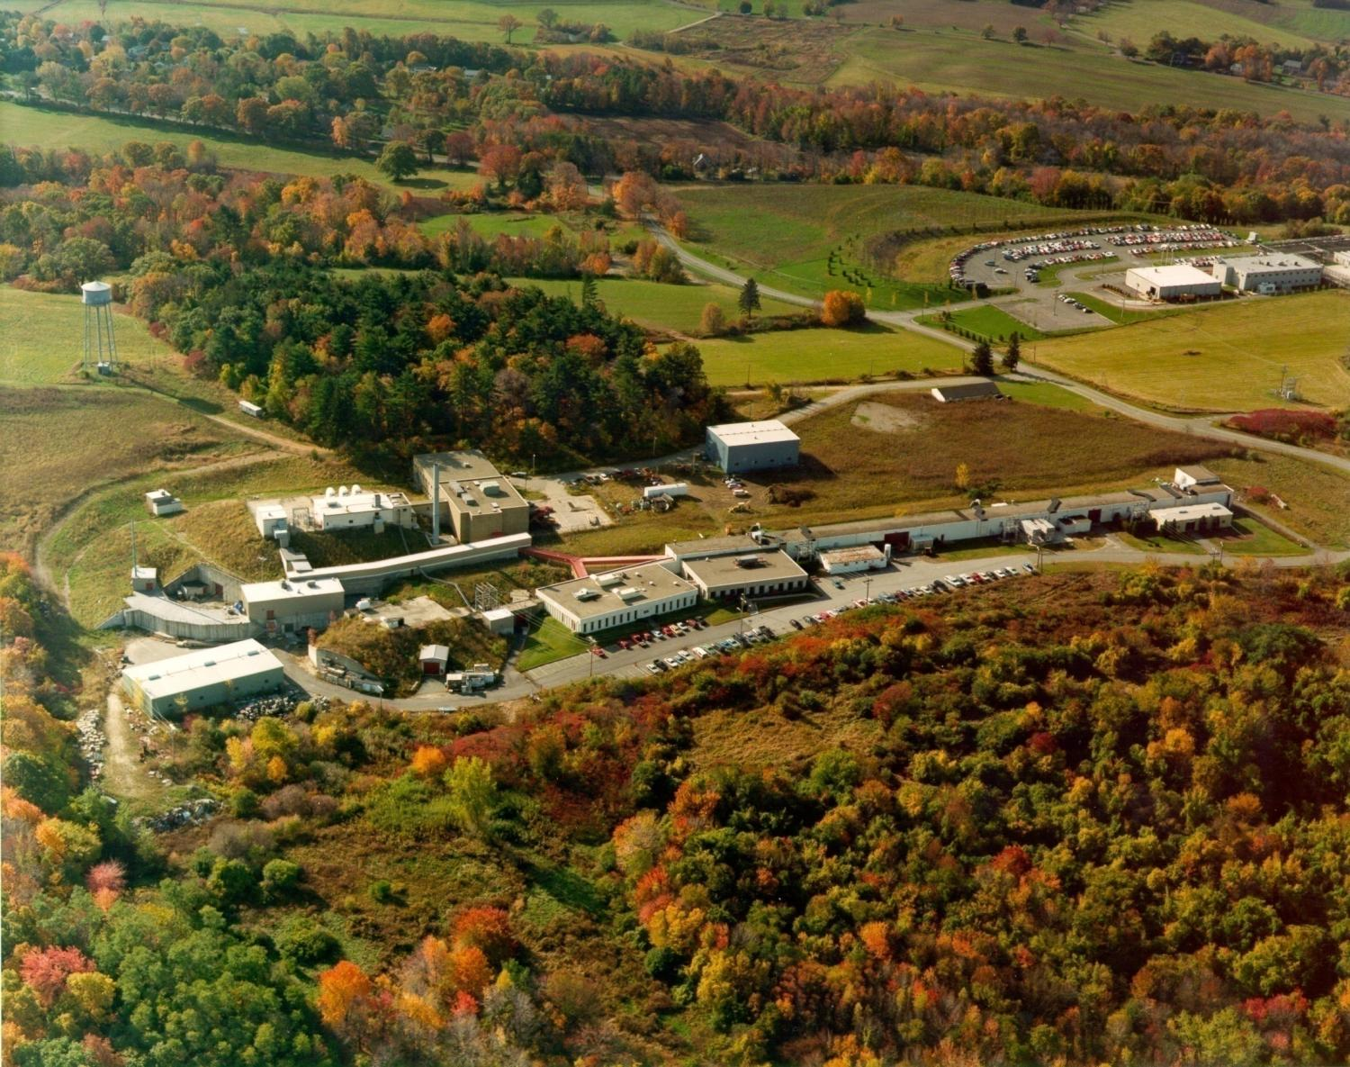
MIT-Bates linear accelerator, Middleton, MA
my PhD Thesis experiment
county jail
North Hall

Slide 24
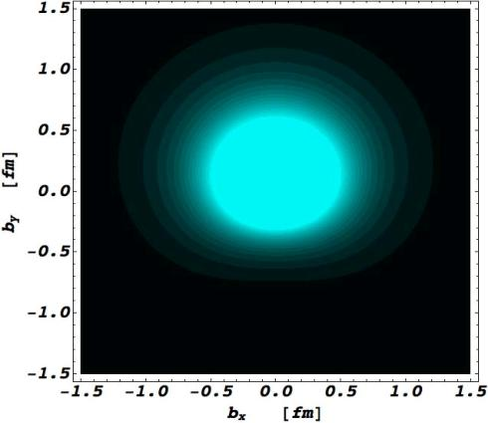
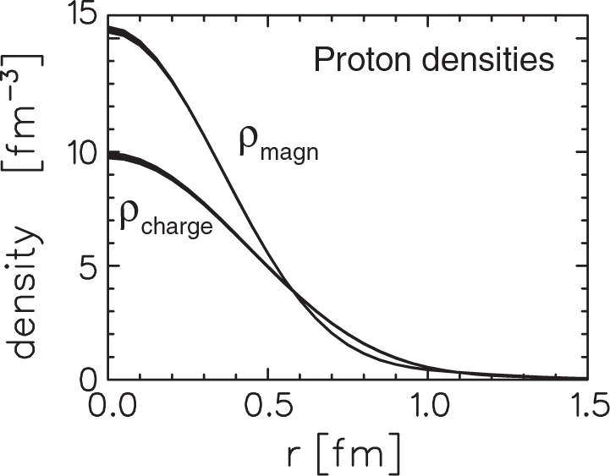
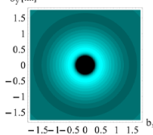

Proton charge and magnetism
Before JLab
Since JLab
proton
smaller distances →
Proton’s charge and magnetism distributions are very different
neutron
Carlson & Vanderhaeghen, Phys. Rev. Lett. 100 (2008) 032004

Slide 25



Societal Applications
Energy
Border Protection
medical imaging
isotope production
Nuclear Forensics
Safety and securing of nuclear weapons
accelerator technology
High Performance Computing
Notes:
more than 23 million nuclear medicine procedures annually in the U.S.

Slide 26



Positron Emission Tomography
Radioactive ¹⁸F embedded in a molecule with glucose, can be readily absorbed by the brain
(fludeoxyglucose – 18F-FDG)
Brain image from D. Wilson, British Columbia Cancer Agency
Notes:
over 100 different nuclear imaging procedures available for cancer, cardiovascular diseases and neurological disorders
Half-life of 18F is 1.8 hours, means high activity but goes away fast (no residual effects)
But requires local accelerator for producing it

Slide 27


Magnetic Resonance Imaging with polarized gas
nuclear spin of ³He gas aligned in magnetic field
p
p
n
lung image from Univ. of Virginia
MRI magnetic field sees the gas in patient’s lungs: real time lung function

Slide 28



Detecting very low levels of radioactivity
Fukushima Earthquake, March 2011
In Seattle, Washington
J. Diaz et al., Jour. Env. Radioactivity, 102, 2011
Notes:
131 Iodine was the strongest signal. Relative strengths of different isotopes (131 I and 132 Te) was clear evidence that the radioactivity was from the reactor and not from the spent fuel. No signature of 133 I means that the reactor had shut down at about the time of the earthquake.
The activity seen in the air in Seattle was about 1000 times less than naturally occurring in the human body (from 40K → 4400 Bq).

Slide 29





LUX:
Dark Matter search
EXO: 0νββ search
UMD-NIST collaboration

Slide 30













