Slide 1
Hadron Physics
Lecture #1: The quark model, QCD, and hadron spectroscopy
Lecture #2: Internal structure of hadrons: momentum and spin
Lecture #3: Internal structure of hadrons: charge, magnetism, polarizability
Lecture #4: Hadrons as laboratories (weak interactions, fundamental symmetries, and other miscellaneous topics)
(much of this material is from my seminar at NNPSS 2008)

Slide 2
Hadrons as Laboratories
Weak interactions inside the nucleon
Weak NN interactions
Fundamental symmetry tests with A=1 (Z=1 or 0)
→ see also seminars by Tim Chupp, John Hardy

Slide 3
references for this section
General:
  “Subatomic Physics 3rd edition”, Henley & Garcia (2007)
  “Quarks & Leptons”, Halzen & Martin
  “Experimental Foundations of Particle Physics”, Cahn & Goldhaber
PV electron scattering:
  M.J. Musolf et al., Phys. Rep. 239 (1994) 1.
  E. Beise, M.L. Pitt and D.T. Spayde, Prog. Part. Nucl. Phys. 54 (2005) 289.
  M. Pitt, NNPSS 2004 Lecture notes (Bar Harbor, ME)
Neutrons:
  J. Nico and W.M. Snow, Ann. Rev. Nucl. Part. Sci. 55 (2005) 27.
  M.J. Ramsey-Musolf & S. Page, Ann. Rev. of Nucl. Part. Sci. 56 (2006) 1.
  NNPSS 2007 Lecture notes, G. Greene.
Thanks for slides, photos, etc.: B. Filippone, P. Mumm, J. Nico, K. Pashke, M. Pitt, X. Zheng, P. Reimer, H. Gao, J. Martin, and many others

Slide 4
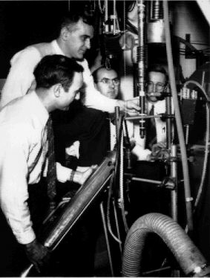
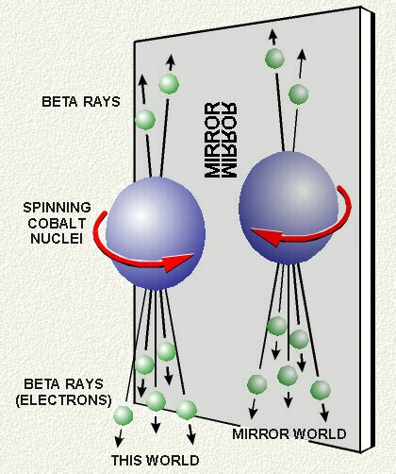
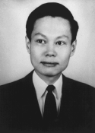


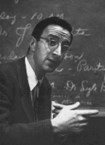
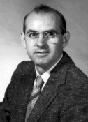
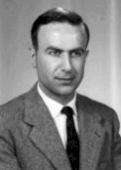
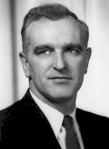
“The Fall of Parity”
from the NIST virtual museum
http://physics.nist.gov/GenInt/Parity/cover.html
T.D. Lee & C.N. Yang,
Phys. Rev. 104 (1956) 254.
(October 1956)
C.-S. Wu, E. Ambler, R. W. Hayward, D. D. Hoppes, and R. P. Hudson,
Phys Rev 105 (1957) 1413. (January 1957)

Slide 5
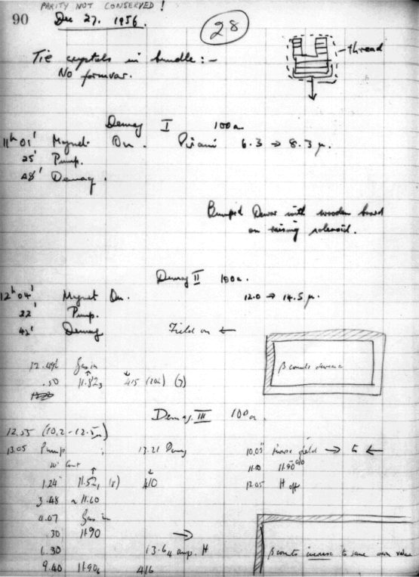
The ⁶⁰Co experiment
(see the NIST museum!)
pseudoscalar
<J> = average nuclear polarization of ⁶⁰Co
(in B-field and low T (0.01K)
anisotropy of γ’s measures the
degree of pol’n of ⁶⁰Ni (now used for
thermometry – see F. Pobell, “Matter and Methods at Low Temperature”)

Slide 6
Weak interactions involving nucleons
(and electrons)
electron scattering
neutron decay
u
d
p
u
u
d
e⁻
d
W⁻
n
ν_{e}
use well-understood target (nucleon) to perform precision test of EW physics
weak NN interactions
OR
Z,W
use weak force to probe new aspects of strong interaction
EXPERIMENTAL SIGNATURE IS VIOLATION OF PARITY

Slide 7
Neutral current e-quark interactions
A x V
V x A
product of V and A violates parity
C_{iq}’s are “weak charges” of quarks (1=“vector”, 2=“axial”)
If scattering directly from quarks, can measure these, e.g.
If scattering from a nucleon, have to take into account that quarks are bound inside nucleon via strong interaction to disentangle the C_{iq}’s: these are typically embedded in nucleon “form factors”

Slide 8
Elastic electron (electromagnetic) scattering from nucleons
τ = Q²/4M²
ε = [1+2(1+τ)tan²(θ /2)]⁻¹
quark “charges” are buried in nucleon form factors
contributions to charge,
similar for magnetism
G_{E} and G_{M} for both proton and neutron are now very well known
via precision electron scattering exps. But not enough information to disentangle individual quark pieces from these alone.

Slide 9
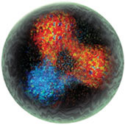
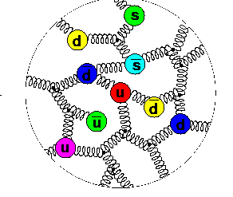
Inside the Nucleon
Effective Degrees of Freedom
t
100 GeV
b
c
M_{p}
1 GeV
NN force &
pion cloud
quark model
pQCD
s
u,d
0.01 GeV
Λ_{QCD} ≈ 213 MeV
(from R. Ent)

Slide 10
Weak nucleon form factors
pointlike fermions:
nucleons:
time reversal violating
ignore

Slide 11
Weak nucleon form factors
point-like fermions:
nucleons:
combine weak and EM information to separate (u,d,s) contributions to proton’s charge and magnetism
axial part is
related to proton’s spin
ignore

Slide 12
Strange Quark Observables
momentum:
  2 muons from charm quark
  production ν_{μ} + s → c + X + μ⁻
μ⁺ + ν_{μ}
20% of non-strange sea
2% of total
mass:
  π-N scattering
  (and Λ, Ξ masses)
10-30% of proton’ s mass
(for recent theory update see R. Young, CIPANP 2009)
spin:
Polarized deep-inelastic inclusive scattering
  ν-p elastic scattering (BNL E-734)
Polarized semi-inclusive DIS (HERMES 2005)

Slide 13
Parity Violating Electron-Proton Scattering
polarized electrons, unpolarized target
∼ few parts per million
and want to measure to ~ 5%
Statistics : 10¹³-10¹⁴ counts for precision measurement
high beam intensity, very thick targets, large acceptance detector
(sometimes can’t count individually scattered particles....)
Systematic Effects:
  High quality beam (intensity, position, energy) over a long time
  Minimize systematic effects in detection that depend on initial beam state (feedback on energy, position, angle and intensity of incident beam)

Slide 14
Parity Violating elastic e-N scattering
polarized electrons, unpolarized target
forward, H
back, H
back, D
 | η (ppm) | ξ (ppm) | χ (ppm) | ψ (ppm)
A_{F} | -23.6 | 79.5 | 42.9 | 2.5
A_{B} | -38.9 | 22.2 | 62.7 | 12.1
A_{d} | -50.0 | 18.5 | 13.1 | 14.2
e.g.: G0 at 687 MeV (Q²= 0.6 GeV²)

Slide 15
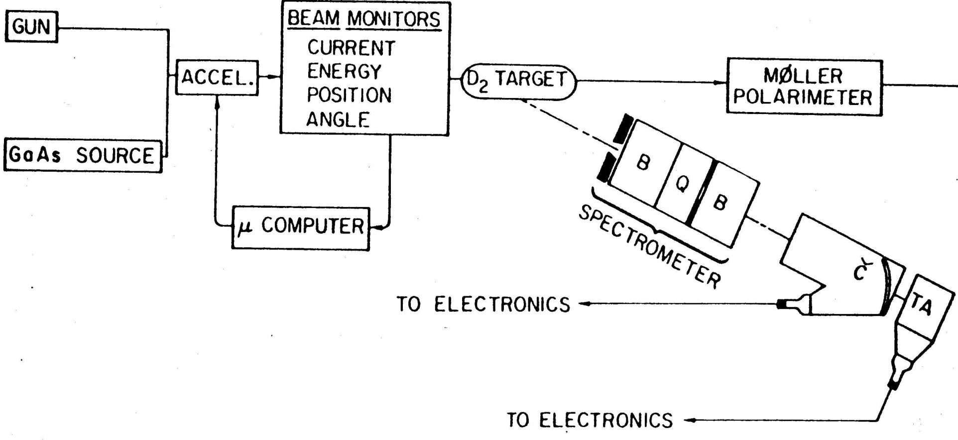
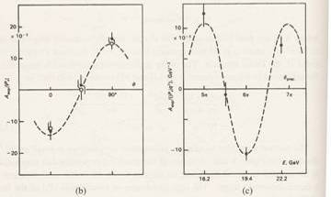
Deep inelastic e-D scattering
C.Y. Prescott, et al, PL 77B (1978) 347
SLAC 1978: e + d (DIS) : A ~ −60 ± 10 ppm
led to correct description of neutral weak force: sin² θ_{W} = 0.20 ± 0.03
reverse handedness of
electron beam
reverse beam via
g-2 precession

Slide 16

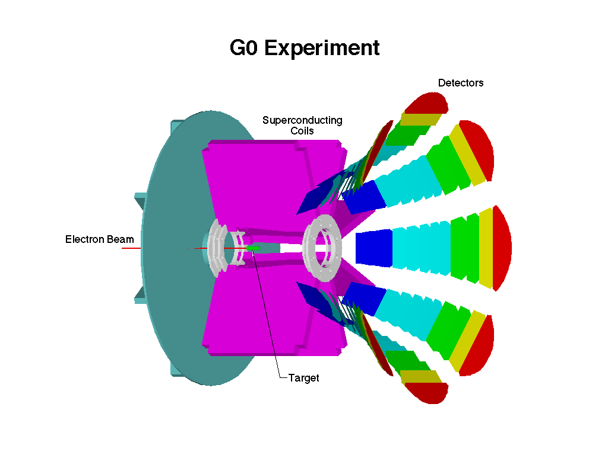
SLAC 1978 and JLab 2006
1.5 μs/pulse, 120 Hz
Prescott et al., SLAC DIS e-d:
P = 37%
L = (7 μA, pulsed) x (30 cm target)
ΔΩ = 5 x 10⁻⁴ sr
1000 scattered electrons/pulse
→ integrate
JLAB G0 Experiment (representative):
P = 83%
L = (60 μA, CW) x (20 cm target)
ΔΩ = 2 sr
rate ~ maximum few MHz per detector
→ count
P² (L) (ΔΩ) = (JLAB/SLAC) = 10⁵

Slide 17
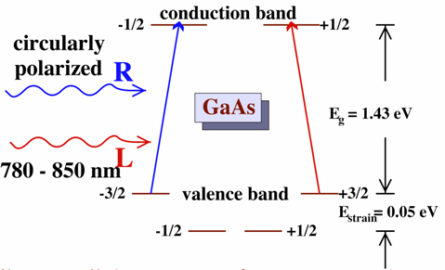
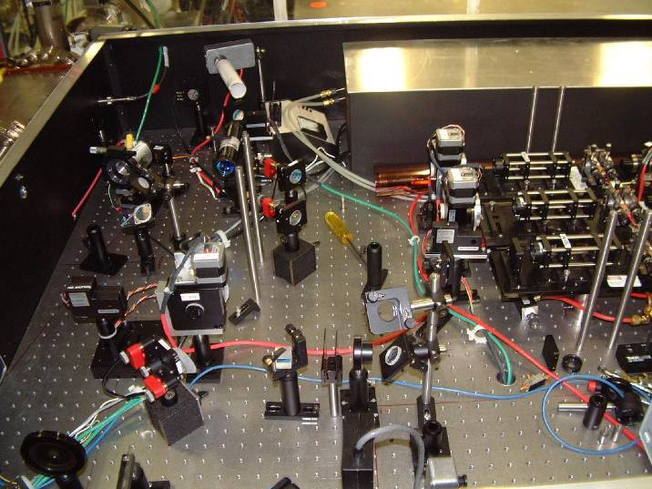
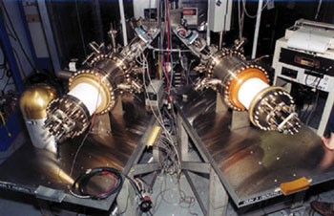
Polarized Electrons
D.T. Pierce et al., Phys. Lett. 51A (1975) 465.
Electron retains circular polarization of laser beam: P_{e} ~ 85%
Reverse pol’n of beam
at rate of 30 Hz
Feedback on laser intensity and position at high rate
See also Physics Today, Dec 2007

Slide 18
A Typical beam line for PV experiments
Polarized
Injector
Beam position
feedback
Luminosity
Monitors
Beam current
feedback
Wien
filter
Position,
Angle,
Charge
Halo
Beam
Current
Detector
Accelerator
Beam pol’n
measurement
Energy
Fast phase shift
(energy) feedback

Slide 19
False asymmetries from the beam
detector sensitivity
beam property
(x,θ,E,intensity)
At the injector:
Δx < 1 micron
Measurement at > 1 km: Δx ~5 – 10 nm

Slide 20
JLab polarized beam : 2005
G0 beam:
strained GaAs (P_{B} ~ 73%)
32 ns pulse spacing
40 μA beam current
HAPPEX-II beam:
superlattice (P_{B} > 85%)
2 ns pulse spacing
35 μA beam current
Beam Parameter | G0 beam | HAPPEX beam
Charge asymmetry | −0.14 ± 0.32 ppm | −2.6 ± 0.15 ppm
Position difference | 4 ± 4 nm | −8 ± 3 nm
Angle difference | 1.5 ± 1 nrad | 4 ± 2 nrad
Energy difference | 29 ± 4 eV | 66 ± 3 eV
Total correction to Asymmetry | −0.02 ± 0.01 ppm | 0.08 ± 0.03 ppm

Slide 21
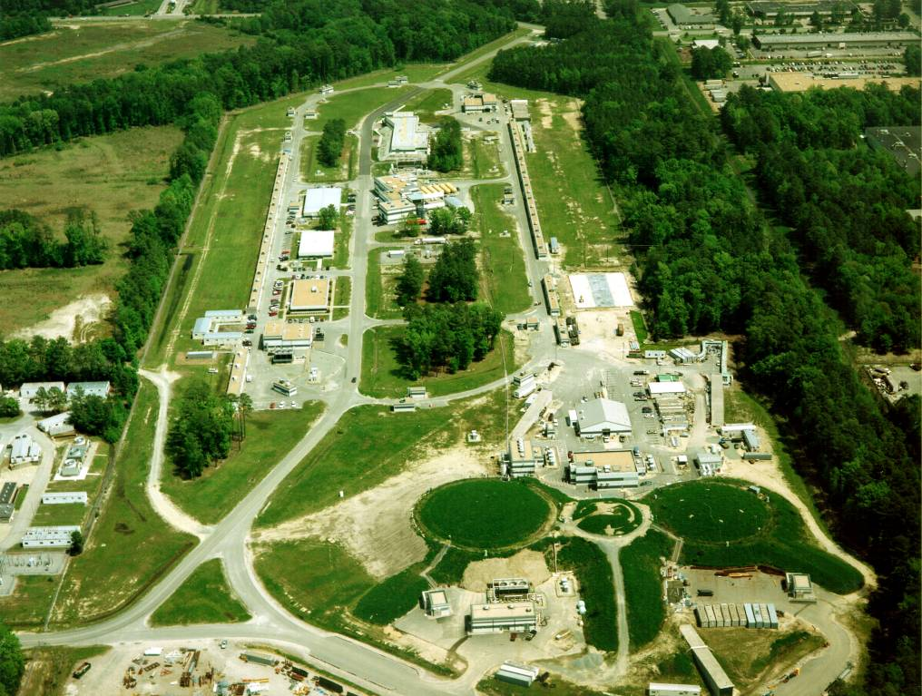
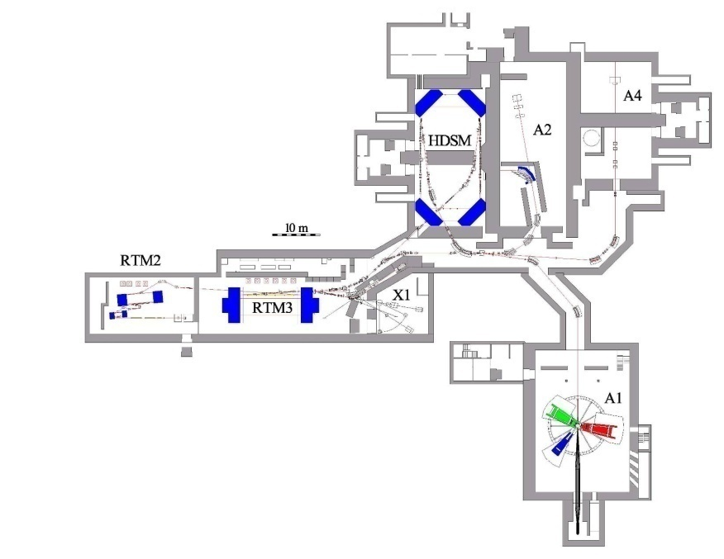
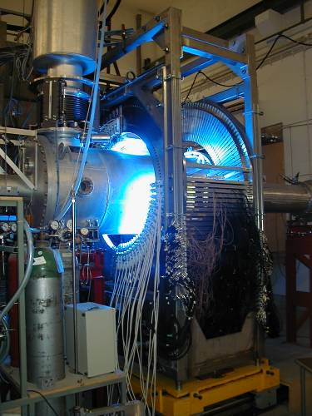
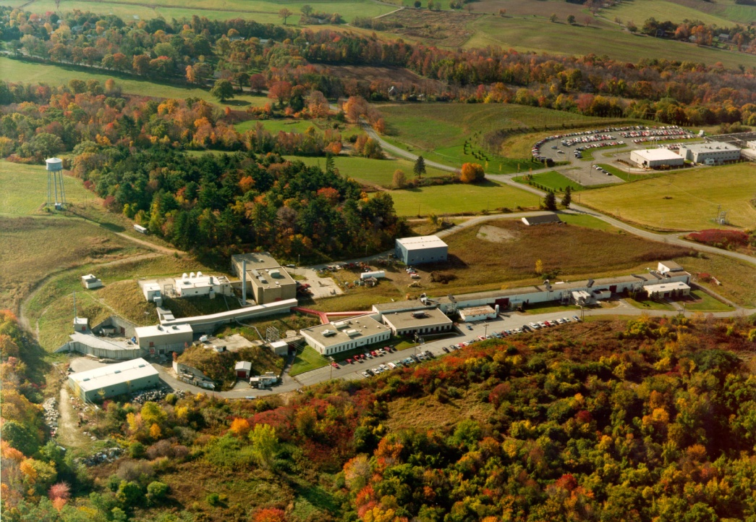
Electron accelerators (for nuclear physics)
Jefferson Lab,
Newport News, VA
Mainz Microtron
(Germany)
A
B
C
PVA4
MIT-Bates Lab,
Middleton, MA
JLab: 6 GeV beam, getting ready
for upgrade to 12 GeV
SAMPLE exp
Also, parity-violating Moller scattering
(E158) carried out at SLAC….
now the MIT R&E center

Slide 22
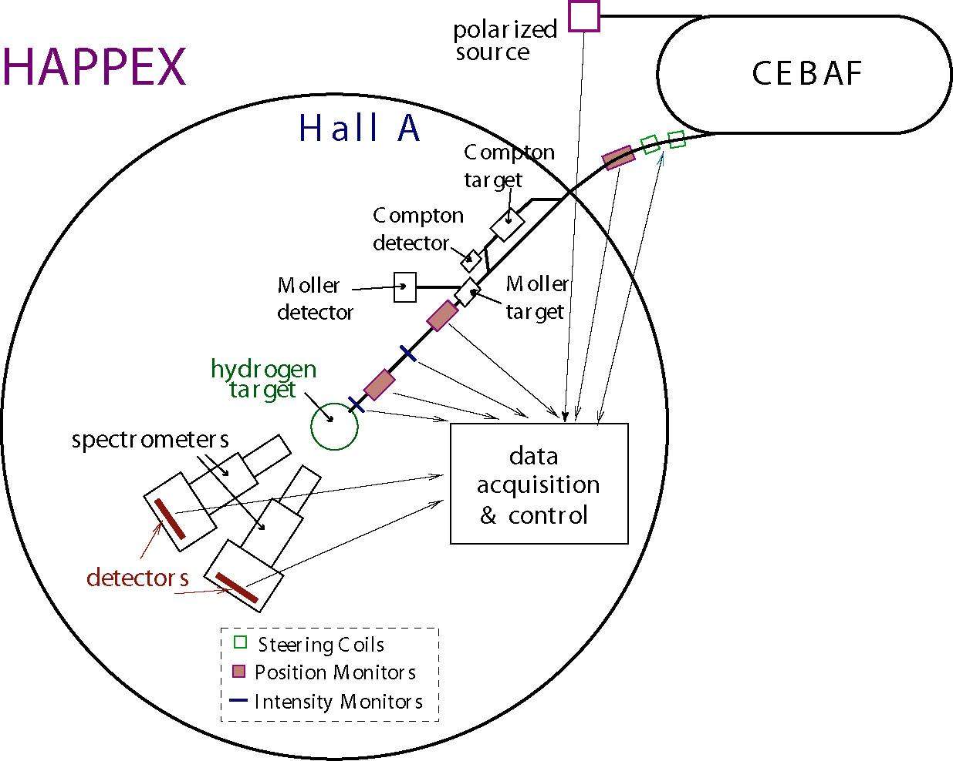
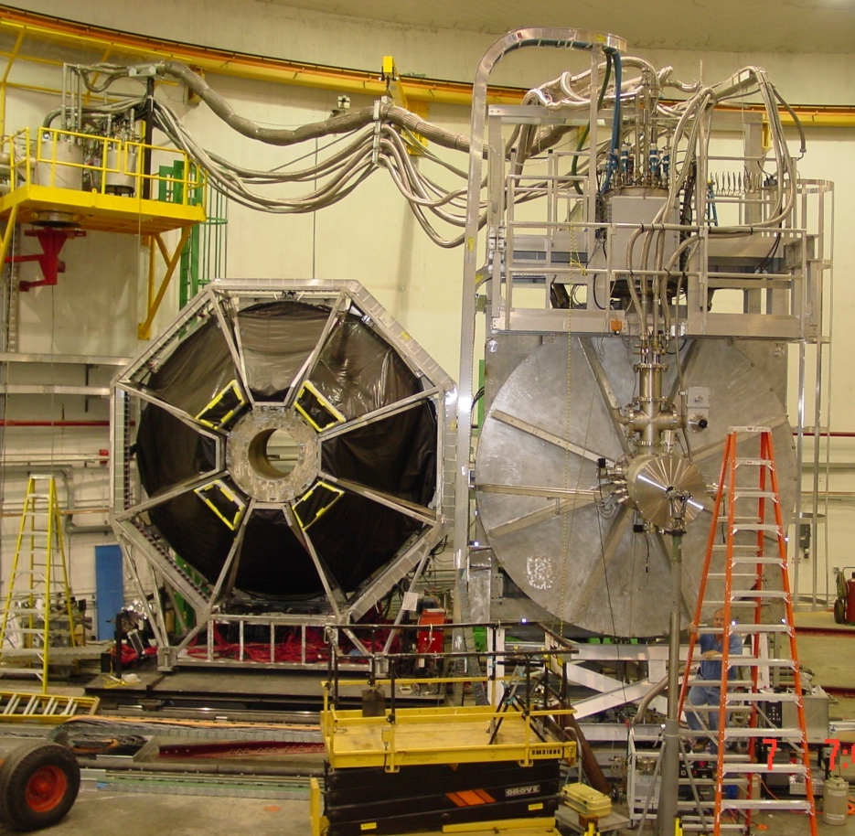
Weak form factors at JLAB
G-Zero in Hall C
High precision,
forward angles,
selected Q²
H and ⁴He targets
H and D targets,
forward/backward angles

Slide 23
PV-A4 at Mainz
PbF₂ Calorimeter
phases I &II:
forward angles, H target
F. Maas et al.,
PRL 93 (2004) 022002,
PRL 94 (2005) 152001
phase III:
backward angles, higher E

Slide 24
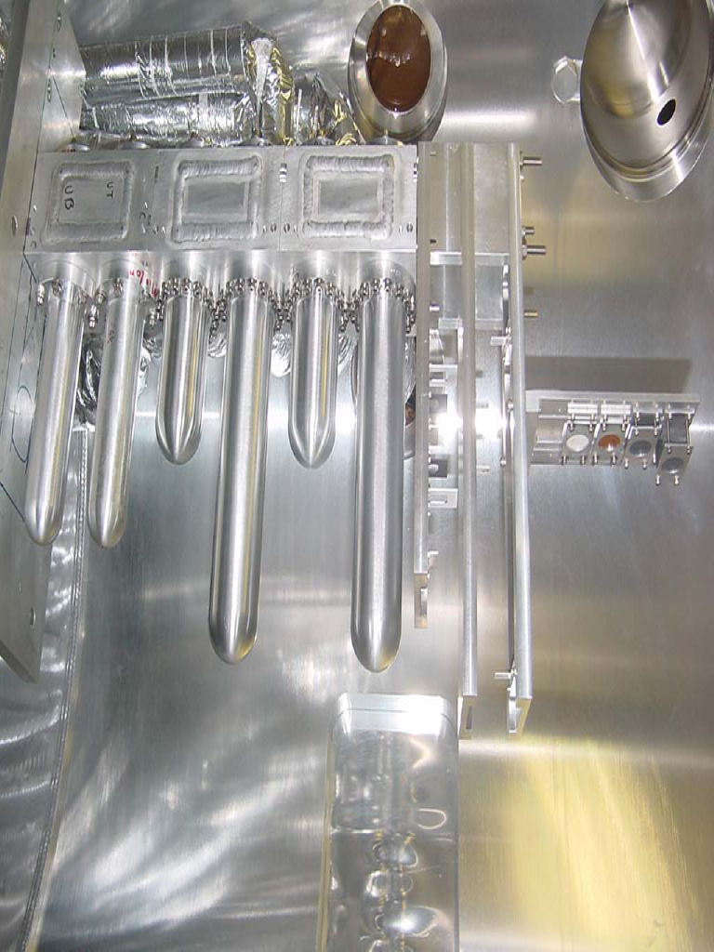
Cryogenic Targets
Hall C targets
liquid Hydrogen
liquid deuterium
solid targets
G0 target

Slide 25
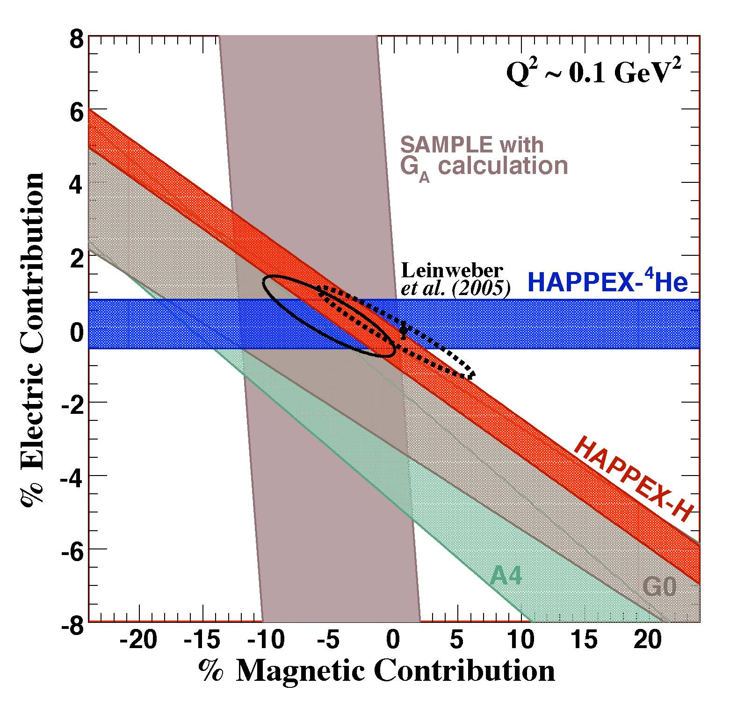
Summary of data at Q² =0.1 GeV²
Solid ellipse:
K. Pashke, private comm, [same as J. Liu, et al
PRC 76, 025202 (2007)],
uses theoretical constraints
on the axial form factor
Dashed ellipse:
R. Young ,et al.
PRL 97 (2006) 102002,
does not constrain G_{A}
Placement of SAMPLE band on the graph depends on choice for G_{A}
at Q²=0.23 GeV²
% contribution to proton:
electric: −3.0 ± 2.5 %
magnetic: +2.9 ± 3.2 %
Similar to Q²=0.1 GeV²
2007 Long Range Plan

Slide 26
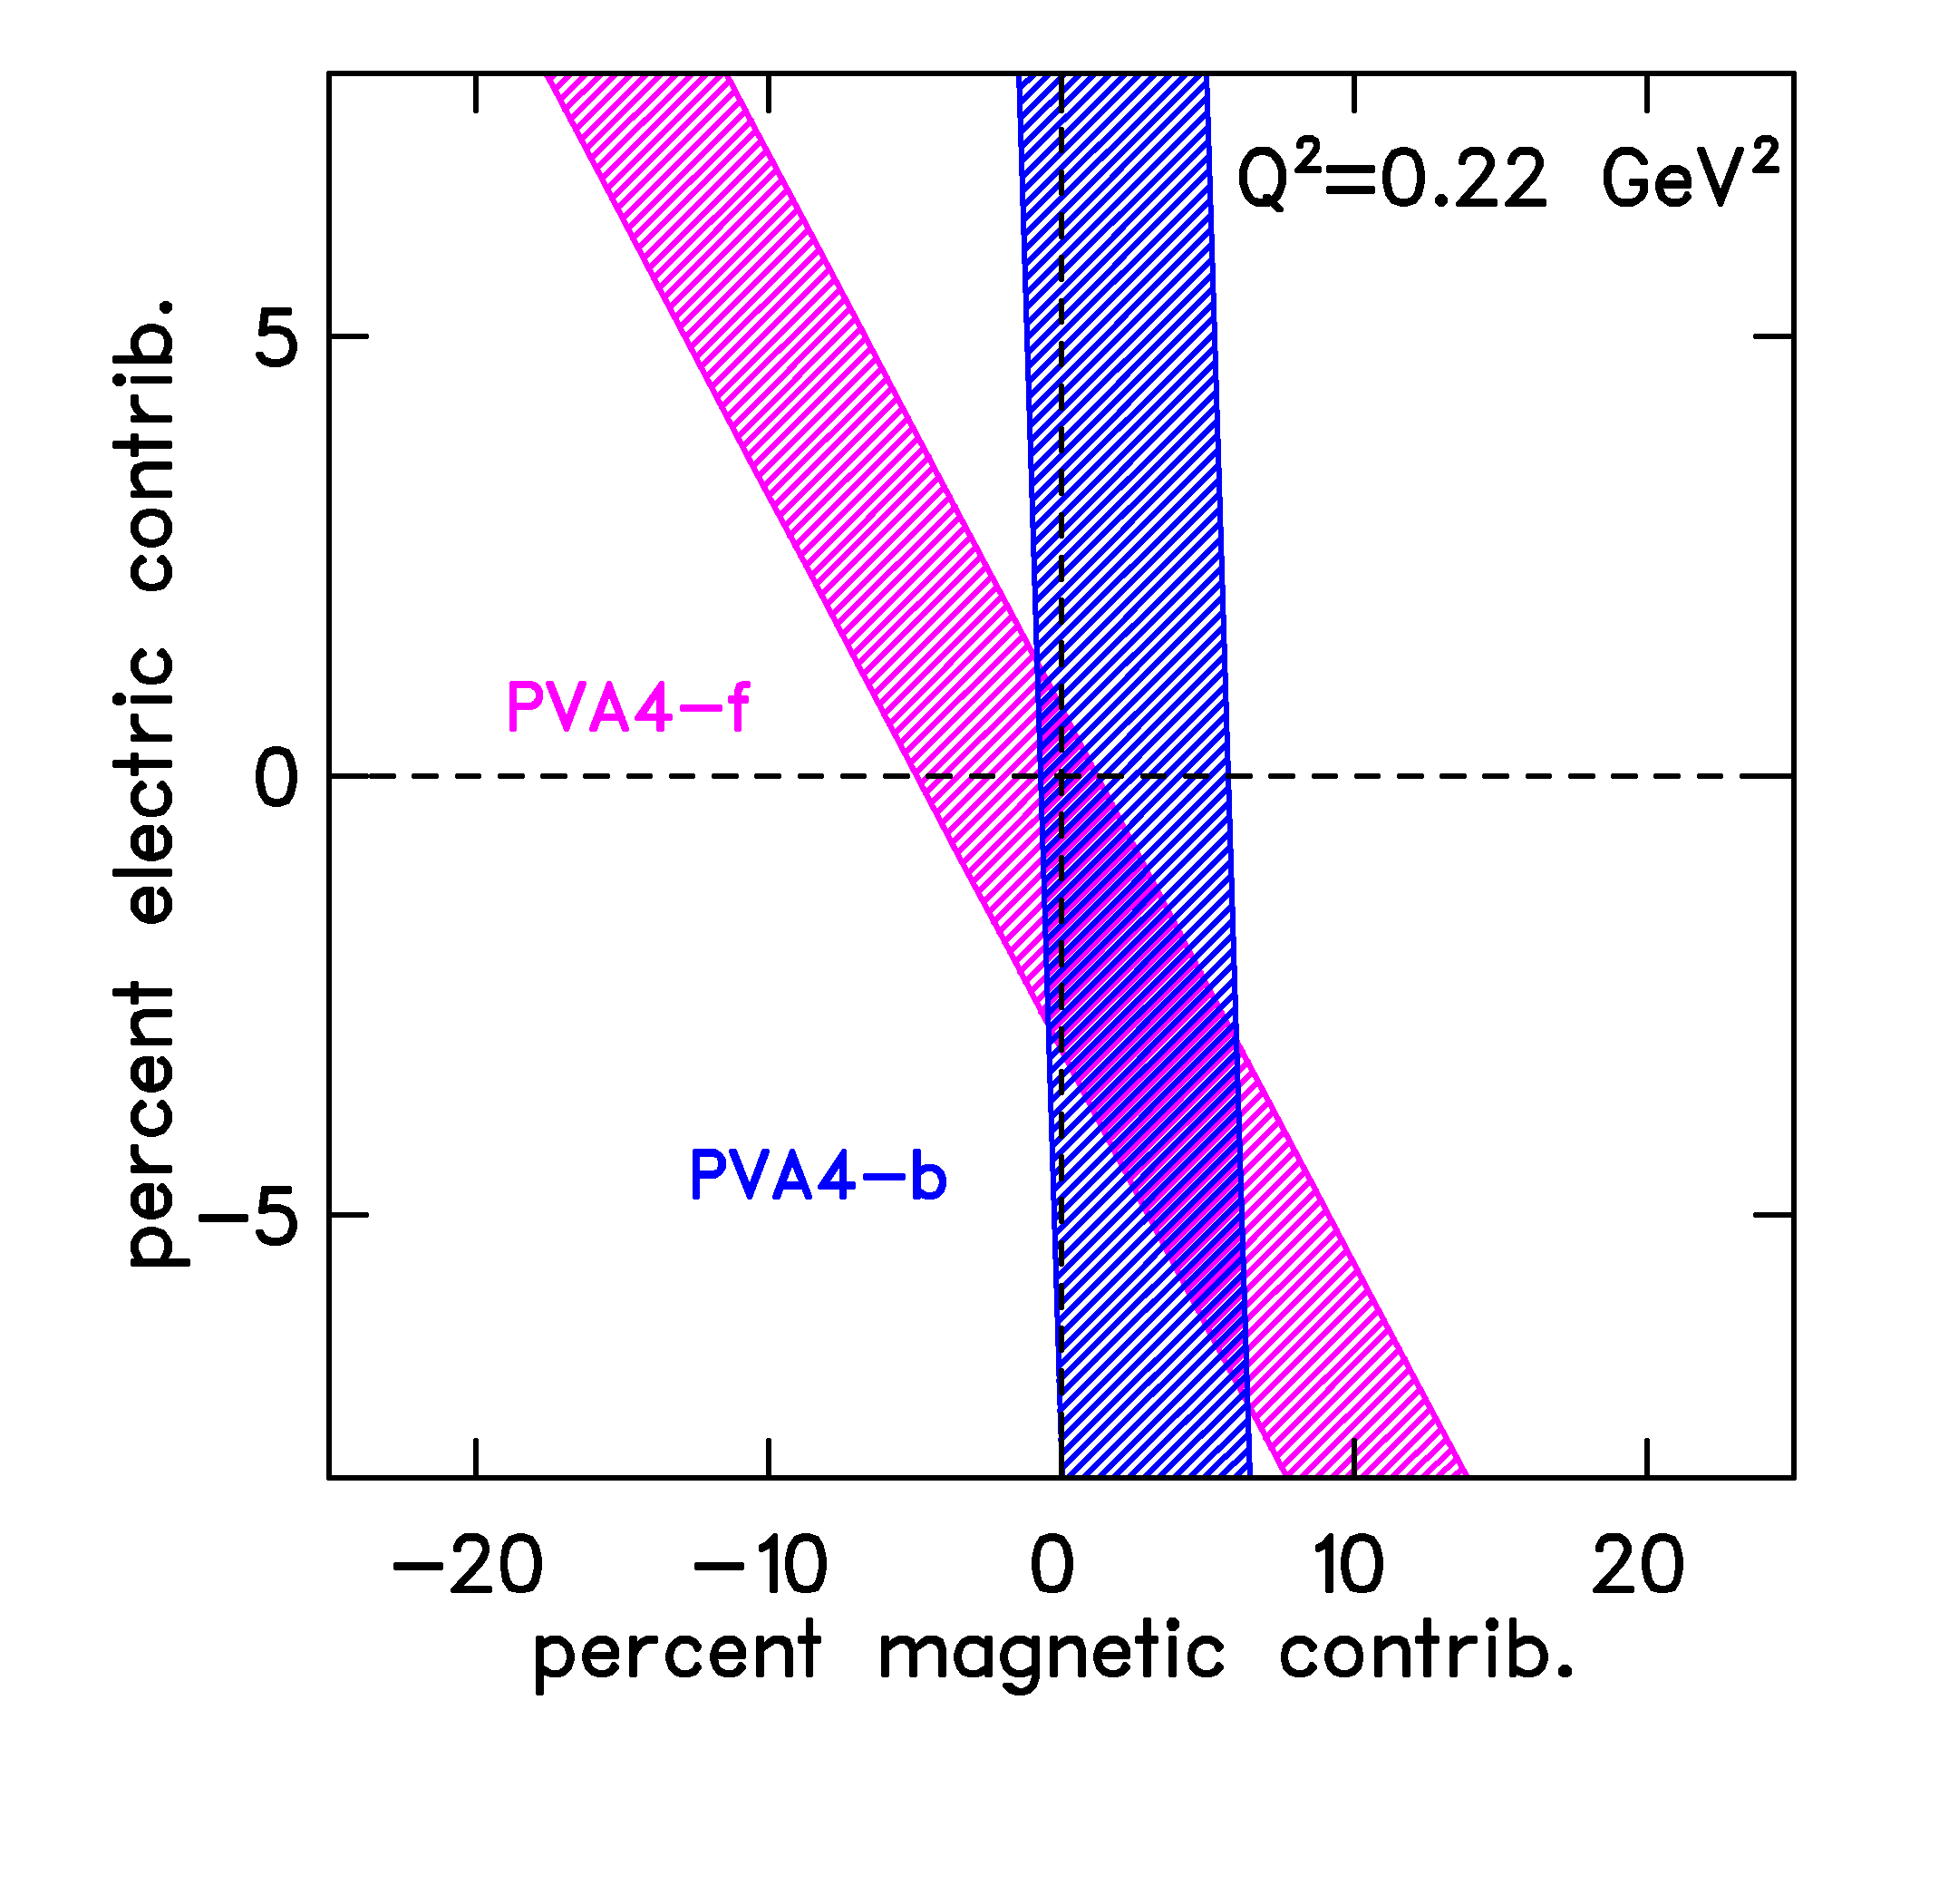
New Results from PVA4
S. Baunack et al., PRL 102 (2009) 151803
Q² = 0.22 GeV², θ = 145°
A_{meas}= −17.23 ± 0.82 ± 0.89 ppm
A_{nvs} = −15.87 ± 1.22 ppm
(uses theoretical constraint of
Zhu et al., for the axial FF)
% contribution to proton:
electric: −3.0 ± 2.5 %
magnetic: +2.9 ± 3.2 %

Slide 27

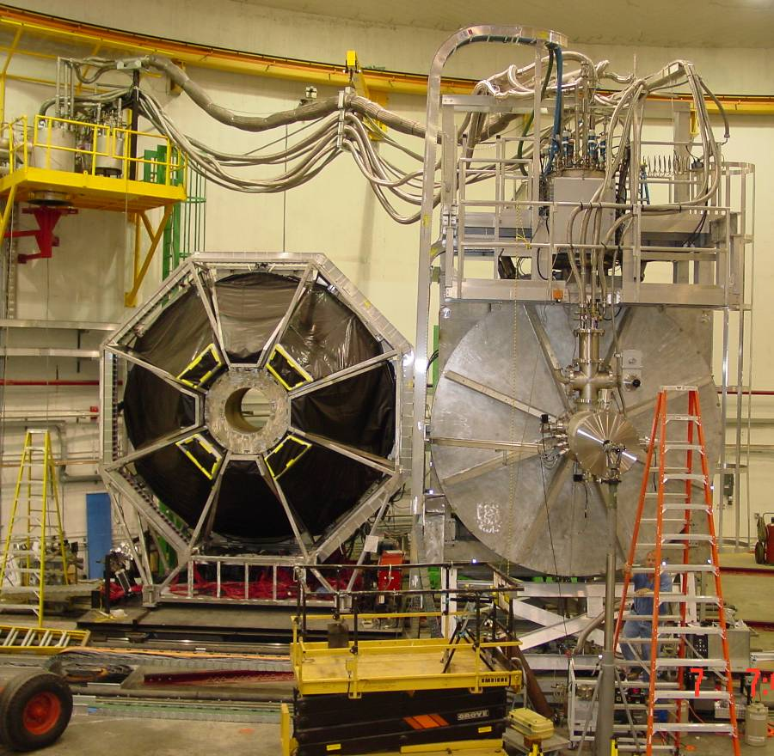
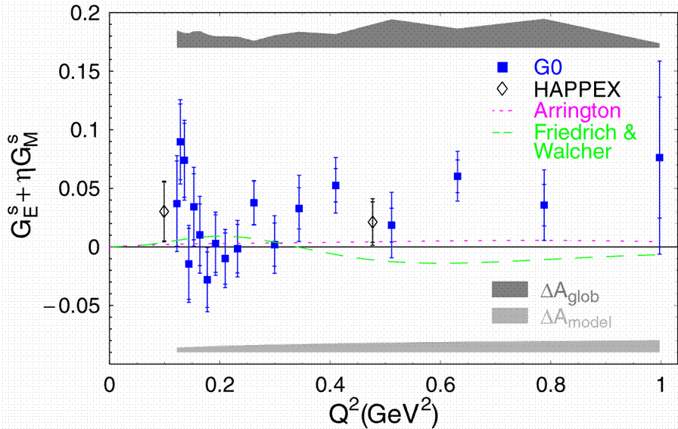
The “G0” experiment at JLab
D.S. Armstrong etal, PRL 95 (2005) 092001
smaller distance
H and D targets, wide range of distance scales
Independently determine neutral weak charge, magnetism
and axial form factors

Slide 28
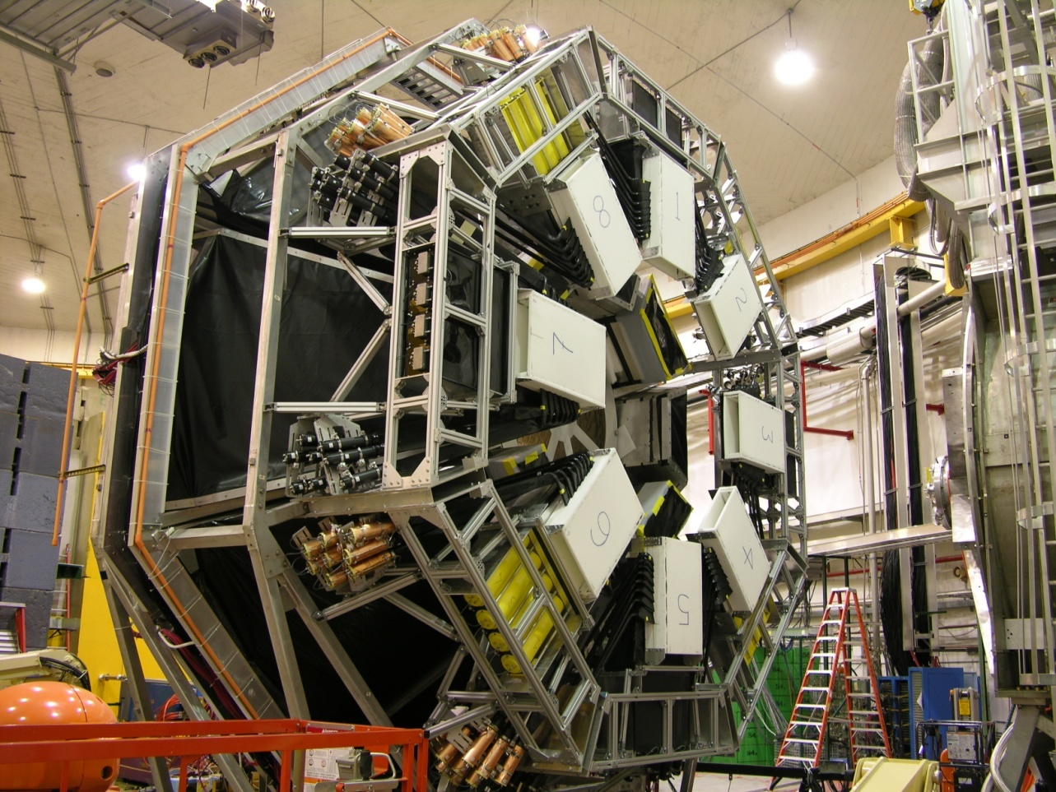
G0 Backward Angle (at Jlab)
Electron detection: θ = 108°, H and D targets
Add Cryostat Exit Detectors (CED) to define electron trajectory
Aerogel Cerenkov detector for π/e separation (p_{π} < 380 MeV/c)
1 scaler per channel FPD/CED pair (w/ and wo/ CER)
E_{e} (MeV) | Q² (GeV²)
362 | 0.23
687 | 0.62
Both H and D
at each kinematic setting
Common Q² with
HAPPEX-III and PVA4

Slide 29
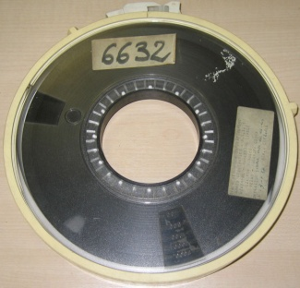
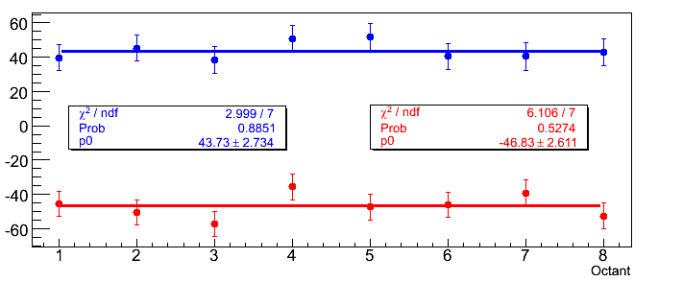
G0 fun facts
Run start to run end ~ 8940 hours, 330 C of beam, 3.5 Tb of data
measured 2,000 asymmetries 15 times / second
In 2400 hours, we measured 250 billion asymmetries
(or, each asymmetry is measured 13 million times)
3.5 Tb ~ 5.5 x 10⁸ inches of 6250 bpi tape
~ 14,000 km
distance from Newport News, VA to Katmandu, Nepal
~ 14,000 data tapes
blinded raw asymmetries (ppm)
H-687 MeV data sample
octant # (azimuthal distribution)

Slide 30
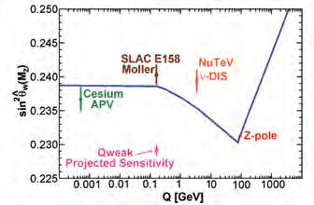
Precision tests of TeV-scale Electroweak Physics
Indirect searches for extensions to Standard Model of particle physics using precision measurements of sin²θ_{W} at several energy scales are complementary to experiments at the LHC.
Case 1: electron-electron scattering (Moller) → SLAC E158
A_{meas} = −131 ± 14 ± 10
parts per billion
P. Anthony et al.,
PRL 95 (2005) 081601
Limits existence of new
e-e interactions on scale
of 7-16 TeV
from M. Pitt

Slide 31
Precision tests of TeV-scale Electroweak Physics
Case 2: e-p scattering: Weak Charge of the Proton
precise measurement
of known e-q interactions (C_{1u}, C_{1d}) can place limits on existence of new ones on scale of a few TeV
from M. Pitt

Slide 32
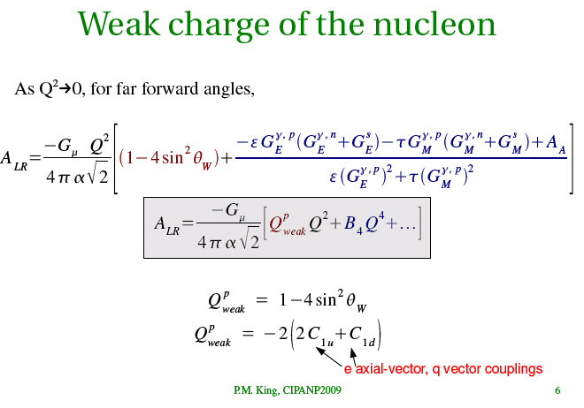

Slide 33
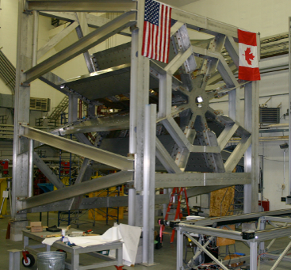
QWeak: Parity violating e-p scattering
R. Carlini, etal
combined existing PV electron
scattering data provide most precise
experimental limit on proton’s
weak charges
QWeak toroidal magnet at MIT-Bates lab
expected asymmetry ~ 0.3 ppm
measure to few %.
R. Young et al., PRL 99 (2007) 122003

Slide 34
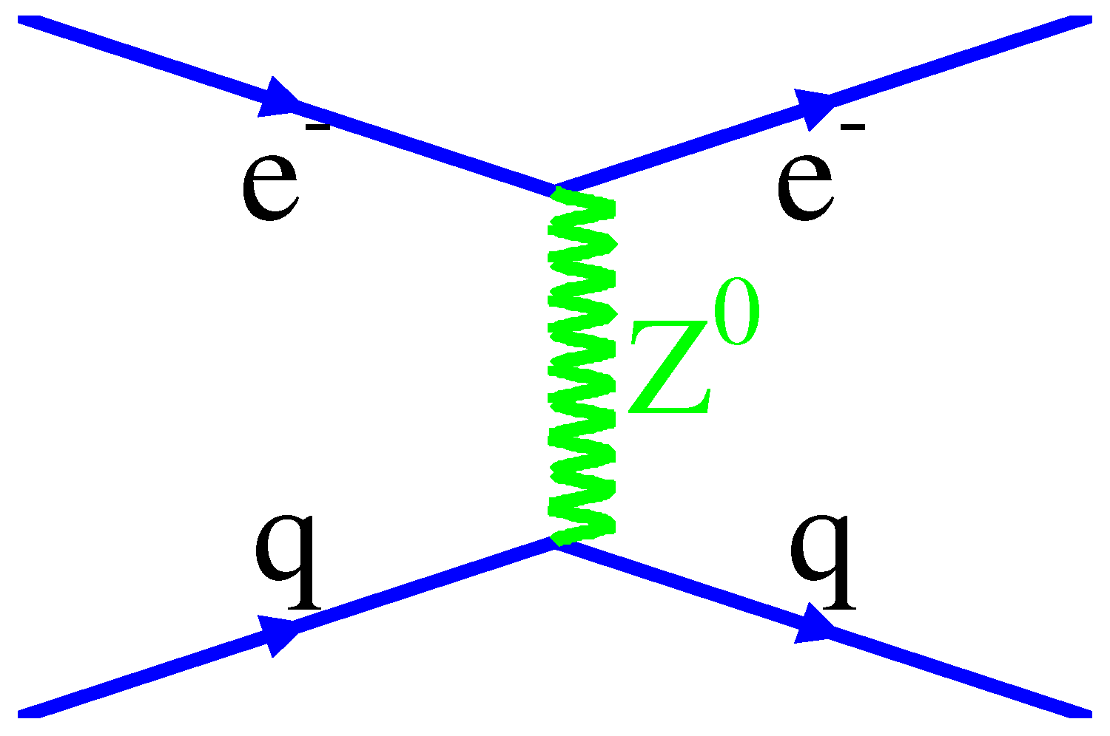
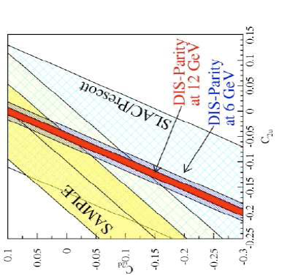
Precision tests of TeV-scale Electroweak Physics
Case 3: Direct electron-quark scattering
A
high precision return to SLAC 1978 measurement
V
V
A
w/ 6 GeV, strong interaction important
X. Zheng, U Va & P.Reimer, ANL

Slide 35
Weak interactions between nucleons
1 fm
from P. Mumm, NIST
Fundamental interaction is q-q weak interactions, but these are buried inside strongly bound systems
→ typical size of effect < 10⁻⁷
5 leading contributions
see H. Griesshammer, NNPSS 2008
need a minimum of 5 experiments (more is better, and preferably without too many nucleons)
need a theoretical framework to interpret the results → chiral EFT

Slide 36
Required Experimental program
→
→
Asymmetry in p-p and p-⁴He scattering
    p-p measurement from TRIUMF
spatial γ asymmetry in n+p→ d+γ and n+d → t+γ
  n+p→ d+γ underway, moved from LANSCE to SNS
→
→
circular pol’n of γ in n+p → d+γ
→
→
spin rotation of n in ⁴He and n in p
  recently completed at NIST
Also: laser spectroscopy on heavy rare isotopes (e.g., Francium)
  installation in progress at TRIUMF (L. Orozco, et al.)

Slide 37
neutron spin rotation in ⁴He
(at NIST, Gaithersburg, MD)
φ_{PV} from σ•p term in forward scattering amplitude (P odd)

Slide 38
Polarized neutron beta decay
u
G_{F} from μ-decay, apparently the same for quarks and leptons
d
p
u
u
d
e⁻
d
W⁻
n
ν_{e}
decay rate
measurable and non-zero
T odd, P even
neutron lifetime
measures this piece
a, b, B, and A each depend differently on λ

Slide 39
Polarized neutron decay
measurable and non-zero
T odd, P even
from P. Mumm andT. Gentile, NIST, 2007

Slide 40
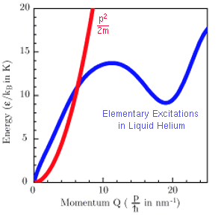
“cold” and “ultracold” neutrons
“cold”:
Produce by moderating thermal neutrons from reactor or spallation source
Can be transported long distances by total internal reflection
“ultra-cold”:
Scatter cold neutrons from solids, liquids, etc., that can absorb bulk of neutron KE into a “phonon” resonance
Can be trapped:
material walls
magnetic fields
gravity!
Golub & Pendelbury, 1977

Slide 41
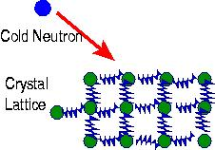
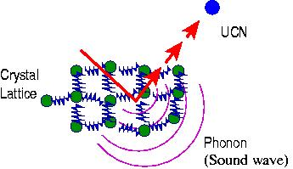
Ultracold Neutrons: Superthermal Process
slide from C.-Y. Liu, Indiana Univ.
R. Golub and J. M. Pendlebury, Phys. Lett, A53, 133 (1975)
Cold neutrons downscatter in the solid, giving up almost all their energy, becoming UCN.
UCN upscattering (the reverse process) is suppressed by cooling the moderator to low temperatures.

Slide 42
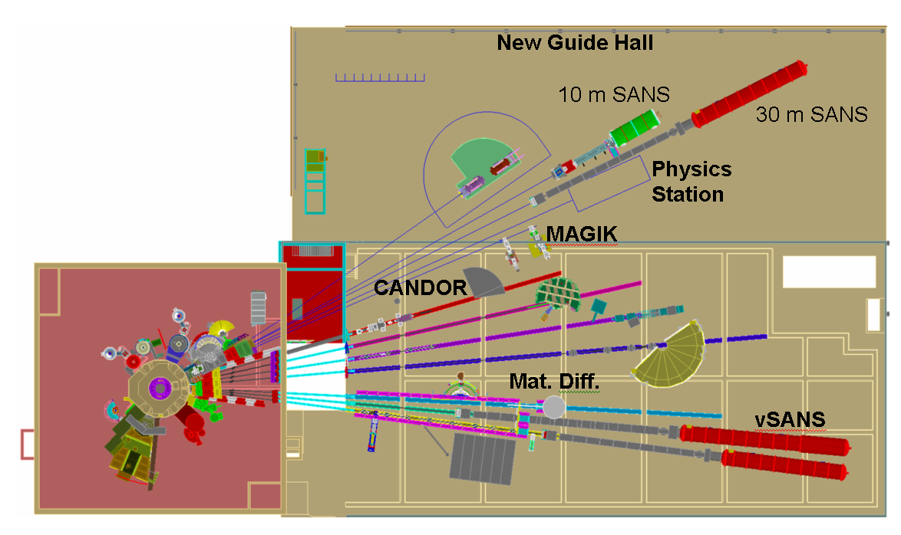
NIST Center for Neutron Research
20 MW reactor is source of “cold” neutrons: T_{n} ~10⁻⁵-10⁻² eV
reactor core

Slide 43
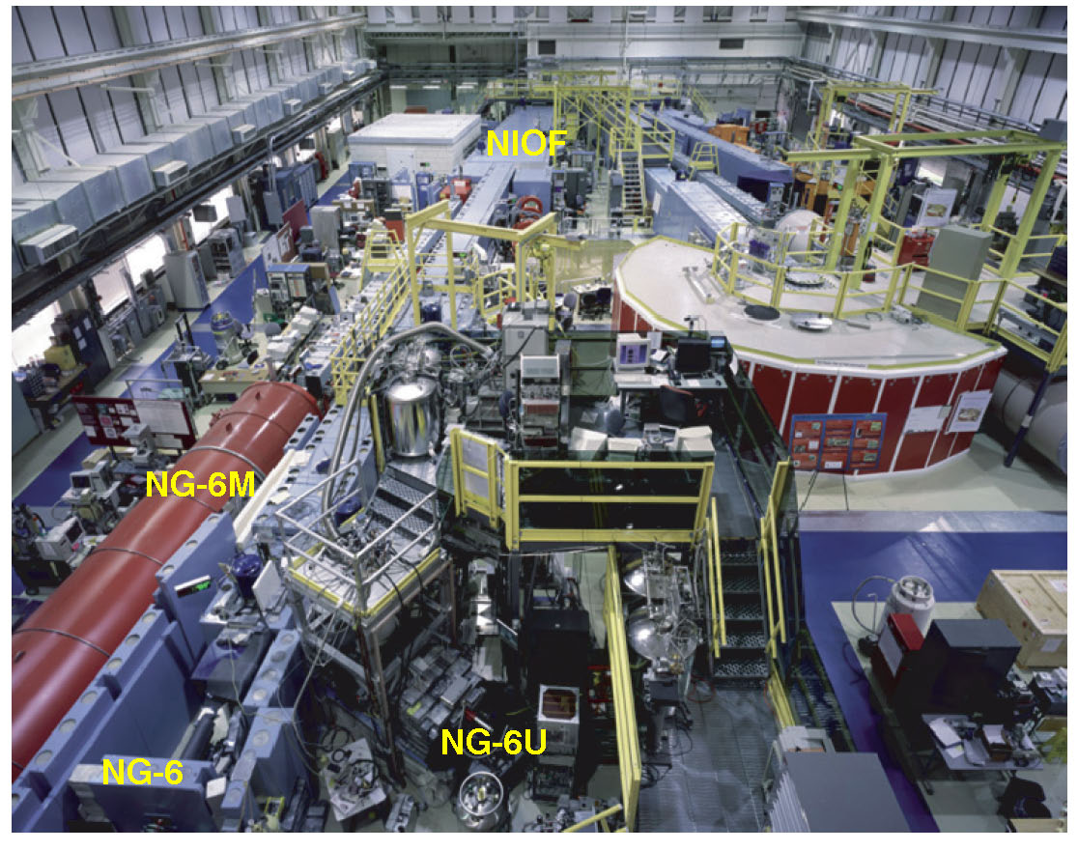
NIST Center for Cold Neutron Research

Slide 44
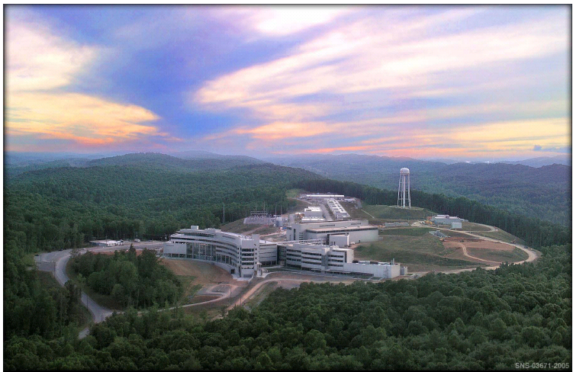
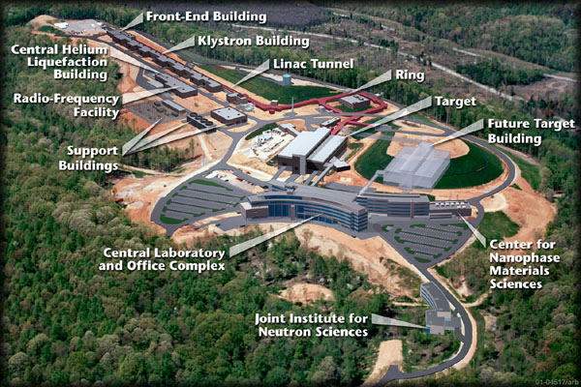
The Spallation Neutron Source

Slide 45
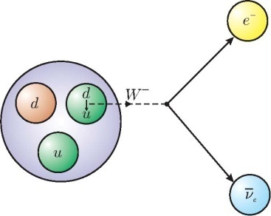
neutron lifetime experiments
Historically two techniques:
1) beam: send “cold” neutrons through a well-defined volume, determine the “loss rate” by counting decay products:
decay product
rate into a
detector
# neutrons incident on the
defined volume
2) “bottle” or “storage”: trap neutrons, measure decay products vs time.
other loss mechanisms

Slide 46
T-odd effects in polarized neutron decay
D-coefficient
measurement,
emiT
Slide from P. Mumm, NIST, 2007

Slide 47
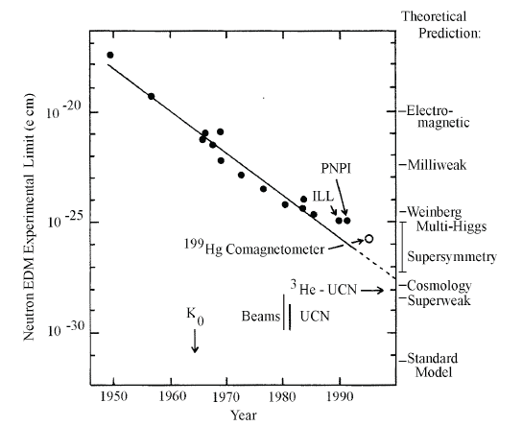
T-odd → CP odd: neutron EDM
-
+
CP-violation is important to
understanding of original of matter (vs
antimatter)
d•E
s = 1/2
If neutron possesses an electric dipole moment, then, in an electric field:
will reverse sign under reversal of E. This is CP-odd observable.
many EDM experiments underway
or proposed, in many systems.
New U.S. experiment planned using
ultracold neutrons at SNS –Oak Ridge
http://p25ext.lanl.gov/edm/edm.html

Slide 48
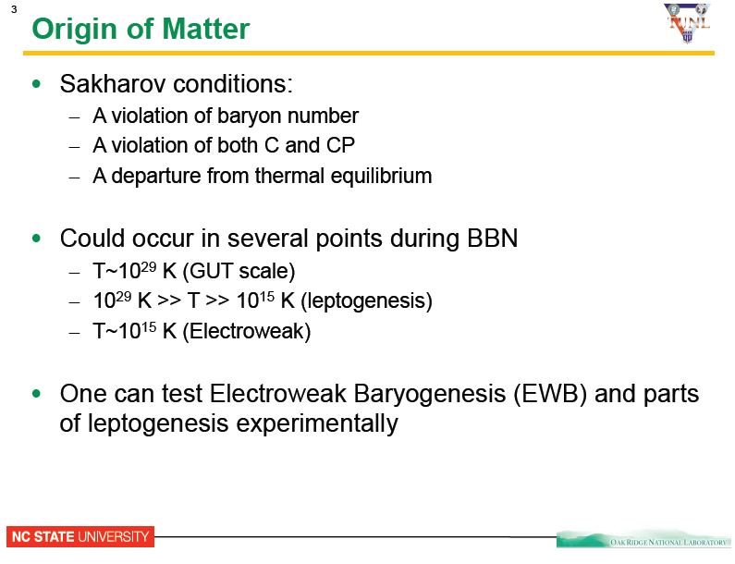

from P. Huffman, NSCU
[JETP 5 (1967) 24]
A. Sakharov, 1943
(from Wikipedia)

Slide 49
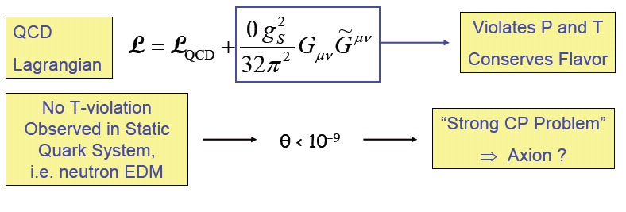
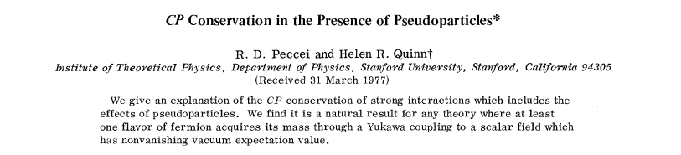
neutron EDM and CP in the strong interaction

Slide 50
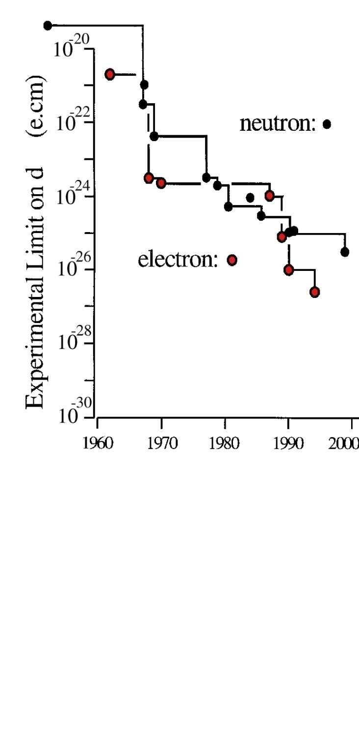
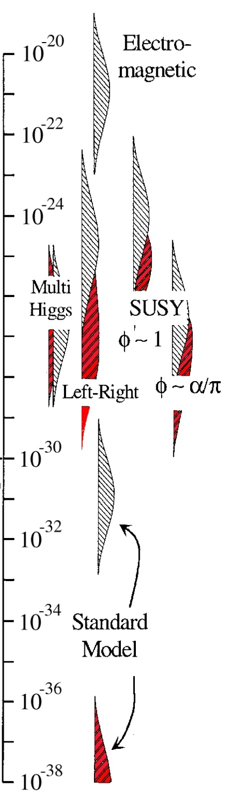
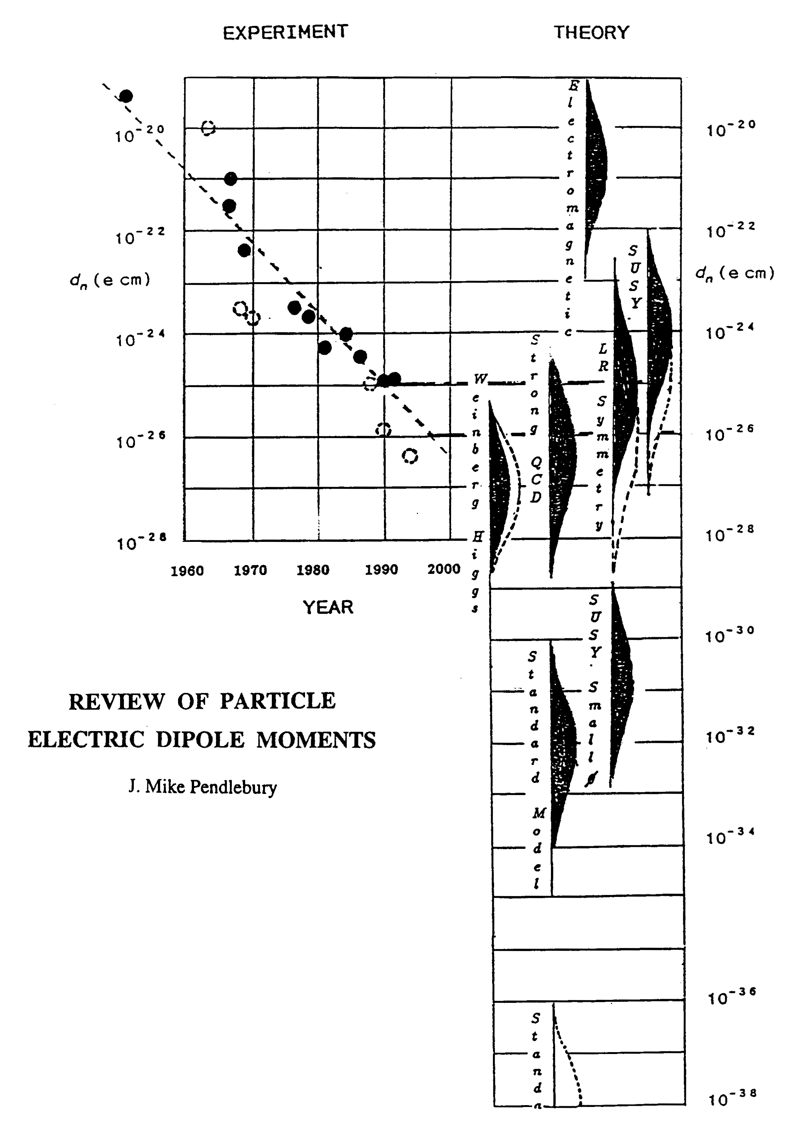
Model Sensitivity to EDM
Gray: Neutron
Red: Electron
slide from J. Long, CIPANP 2009
neutron
current
limit
GUT SUSY
Electroweak
Baryogenises
SNS target
e-cm
J.M.Pendlebury and E.A. Hinds, NIMA 440 (2000) 471

Slide 51

proposed n-EDM experiment at the SNS
slide from J. Long, CIPANP 2009
~ 5 m
stay tuned → 2016….

Slide 52



Thanks for your attention
and enjoy the NSCL tour….
picture courtesy of Jefferson Lab

Slide 53
Polarized neutron decay
measurable and non-zero
T odd, P even
from P. Mumm andT. Gentile, NIST, 2007

