Slide 1







New Results from the G0 Experiment
Elizabeth Beise, University of Maryland
Parity-violating electron scattering from the nucleon
  Hydrogen and deuterium targets
  Strange quark contributions to electromagnetic form factors
  Axial-vector N-Δ transition
  Weak interaction contribution to pion photoproduction
  Transverse beam spin asymmetries

Slide 2
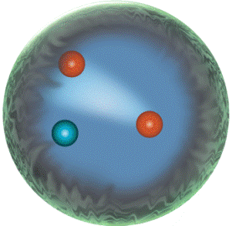
Spatial distribution of s-quarks in the nucleon
Access via form factors: contribution to nucleon charge and magnetism
courtesy of JLab
Electromagnetic:
charge
symmetry
and use
sin²θ_{W} = 0.2312

Slide 3
Parity Violating elastic e-N scattering
polarized electrons, unpolarized target
forward, H
back, H
back, D
 | a₀ (ppm) | a₁ (ppm) | a₂ (ppm) | a₃ (ppm)
A_{F} | -24 | 80 | 43 | 3
A_{B} | -39 | 22 | 63 | 12
A_{d} | -50 | 19 | 13 | 14
e.g.: G0 at 687 MeV (Q²~ 0.6 GeV²)

Slide 4
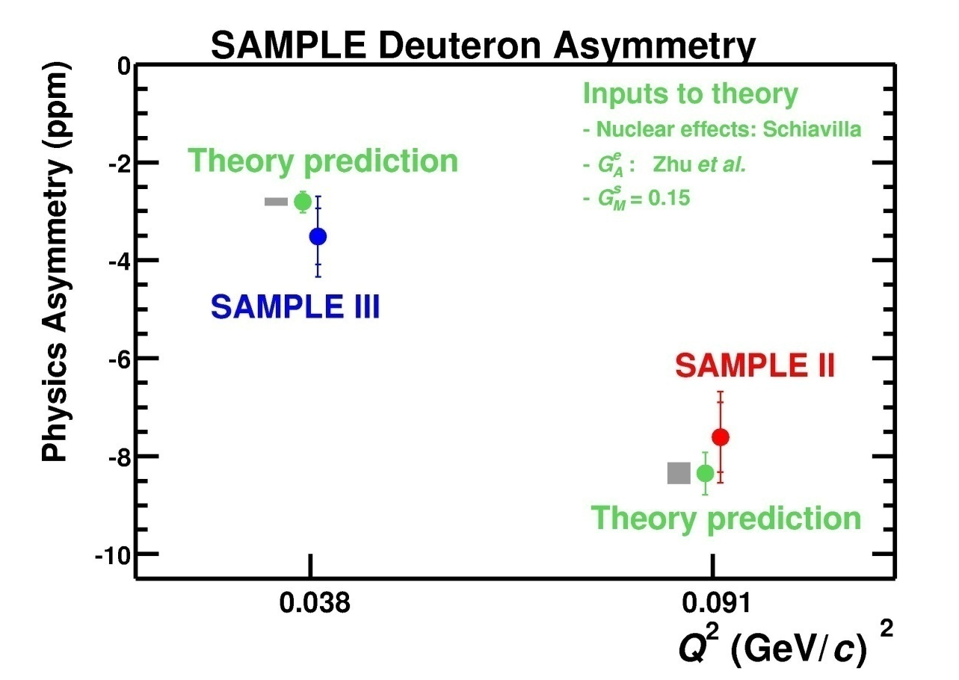
Axial form factor seen by PV electron scattering
+
+
(ηF_{A}^{γ} + R^{e}) at Q²=0 computed
by Zhu etal,
PRD 62 (2000) 033008
SAMPLE deuterium asymmetry data agree well
but Q² behavior is not well constrained

Slide 5
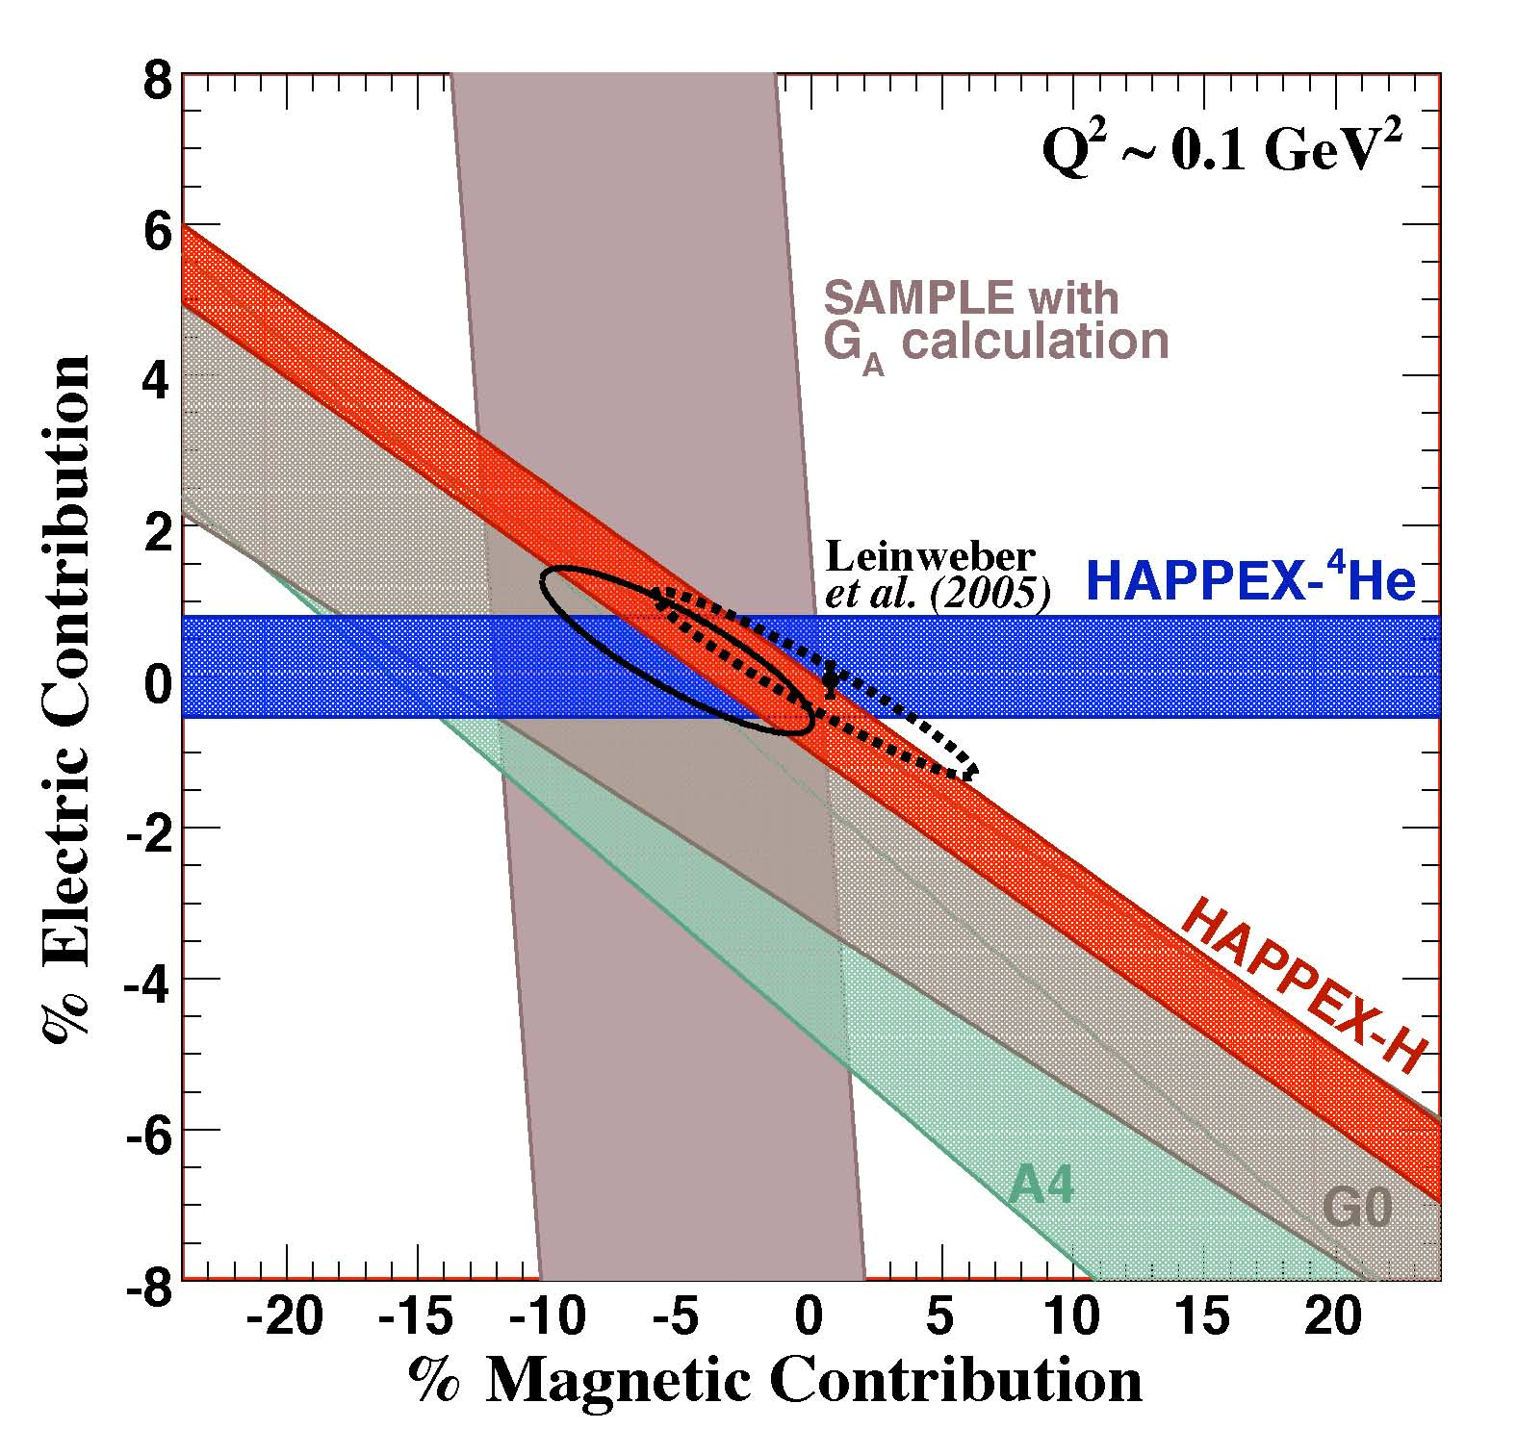
Summary of data at Q² =0.1 GeV²
Solid ellipse:
K. Pashke, private comm, [same as J. Liu, et al
PRC 76, 025202 (2007)],
uses theoretical constraints
on the axial form factor
Dashed ellipse:
R. Young ,et al.
PRL 97 (2006) 102002,
does not constrain G_{A}
note: Placement of SAMPLE band on the graph depends on choice for G_{A}
2007 Long Range Plan
(thanks to K. Pashke, R. Young)

Slide 6
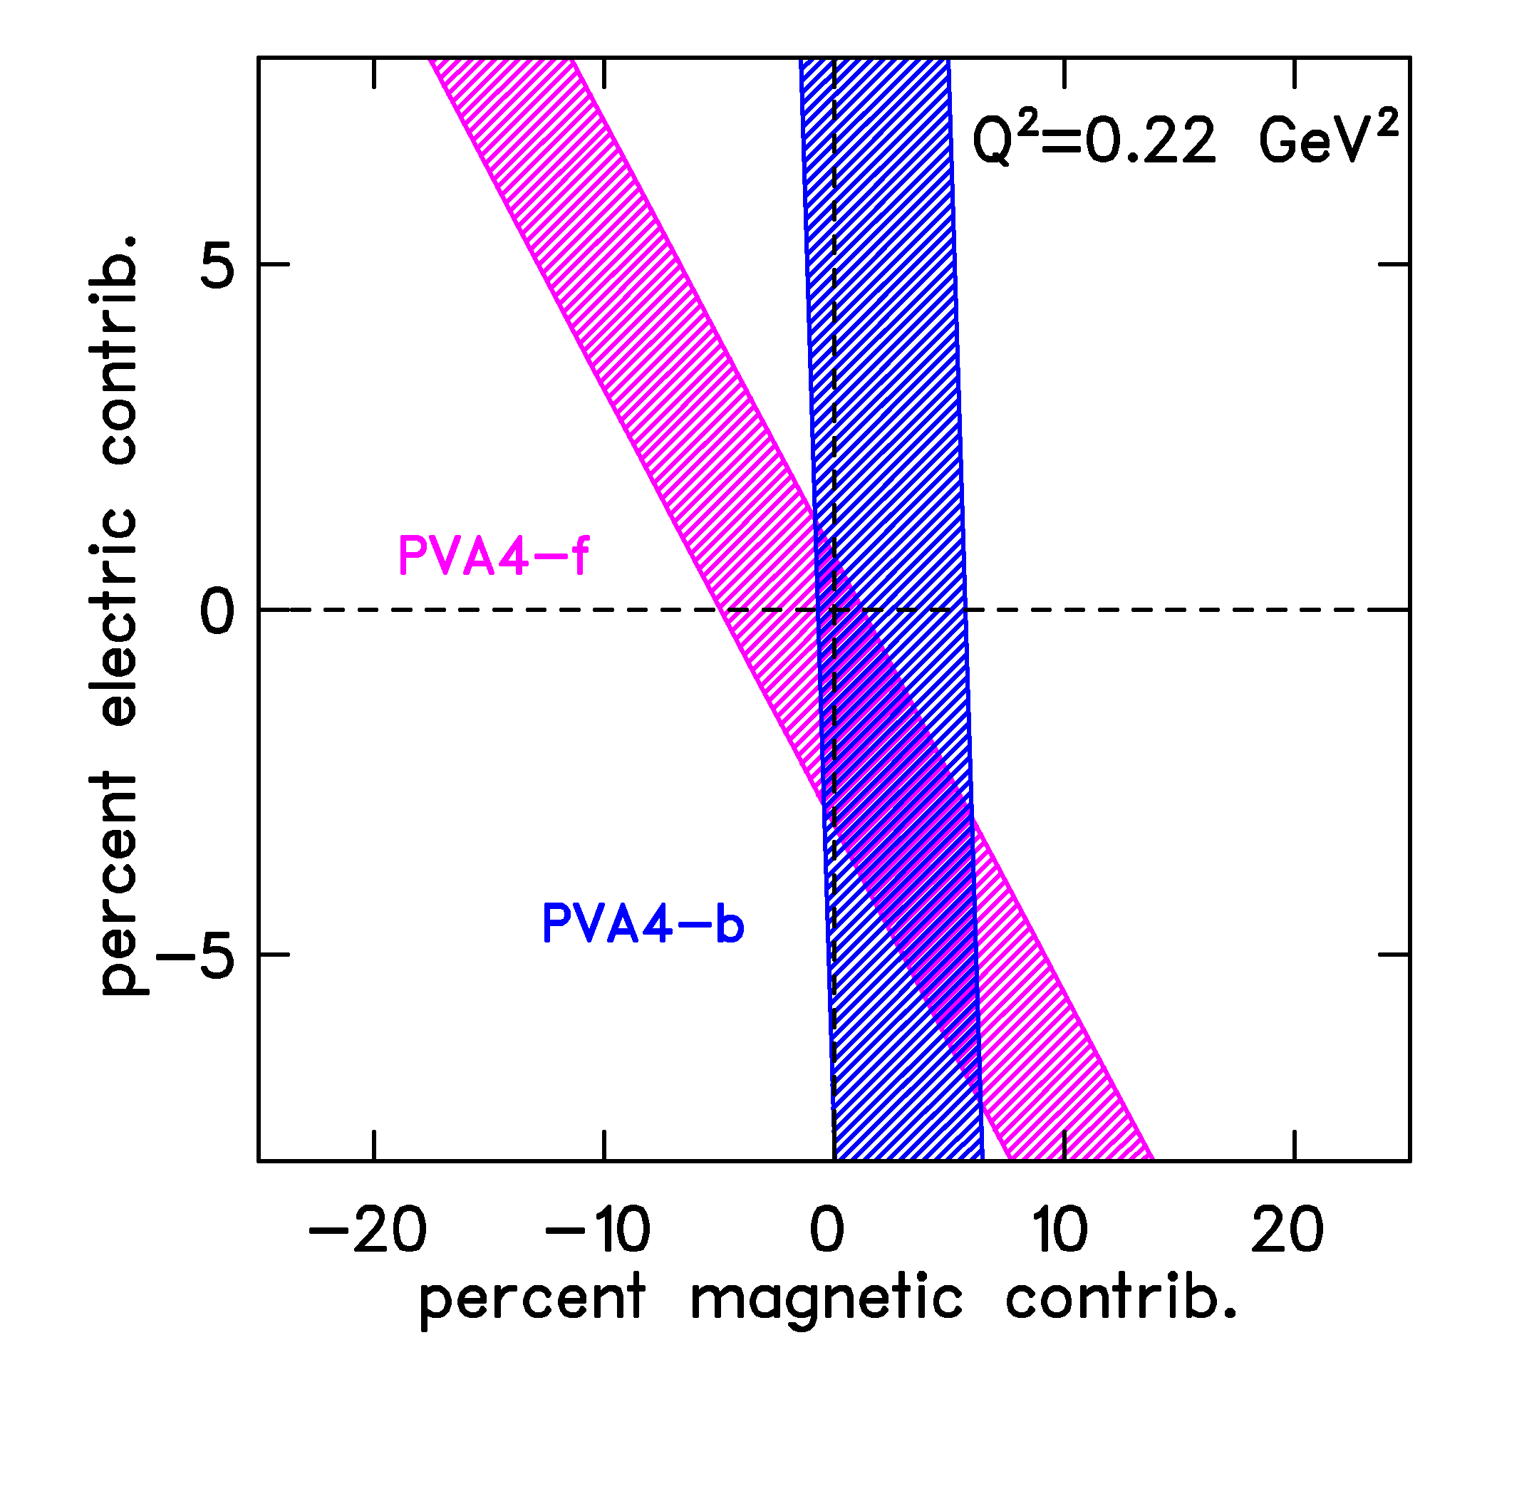
New Results from PVA4
S. Baunack et al., PRL 102 (2009) 151803
Q² = 0.22 GeV², θ = 145°
A_{meas}= −17.23 ± 0.82 ± 0.89 ppm
A_{nvs} = −15.87 ± 1.22 ppm
(uses theoretical constraint of
Zhu et al., for the axial FF)
% contribution to proton:
electric: −3.0 ± 2.5 %
magnetic: +2.9 ± 3.2 %

Slide 7
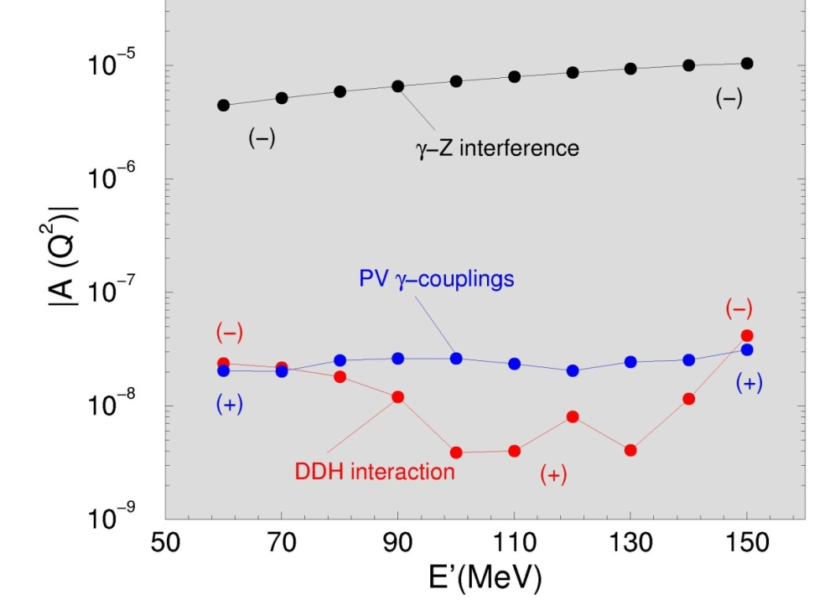
Quasielastic PV (ee’) in Deuterium
Use Quasielastic scattering from deuterium as lever arm for G_{A}^{e}(Q²)
Parity conserving nuclear corrections to the asymmetry are generally small, 1-3% at backward angles. Calculation provided to us by R. Schiavilla includes final state interactions and 2-body effects.
(Diaconescu, Schiavilla + van Kolck,
PRC 63 (2001) 044007)
Schiavilla, Carlson + Paris,
PRC 67 (2003) 032501
See also
Hadjimichael, Poulis + Donnelly, PRC45 (1992) 2666
Schramm + Horowitz, PRC 49 (1994) 2777
Kuster + Arenhovel, NPA 626 (1997) 911
Liu, Prezeau, + Ramsey-Musolf,
PRC 67 (2003) 035501

Slide 8
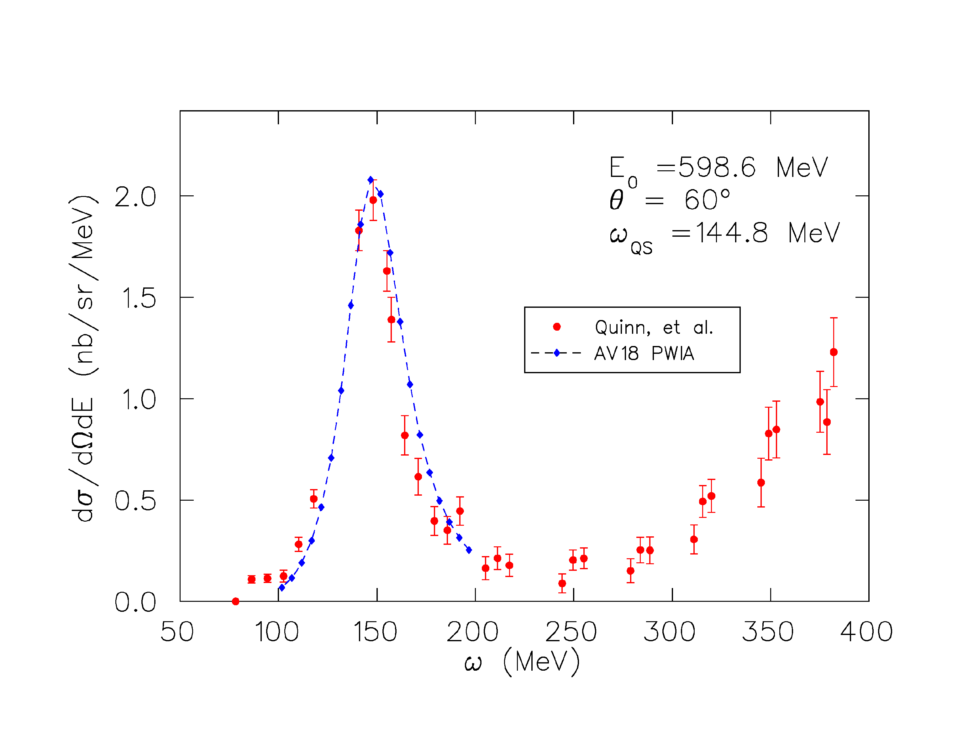
Deuterium model comparison to cross section data
calculation from R. Schiavilla
see also
R.S., J. Carlson, and M. Paris,
PRC70, 044007 (2004).
AV18 NN potential
relativistic kinematics
J.J. Kelly fit to nucleon
form factors
data from:
S. Dytman, et al., Phys. Rev. C 38, 800 (1988)
B. Quinn, et al., Phys. Rev. C 37, 1609 (1988)

Slide 9
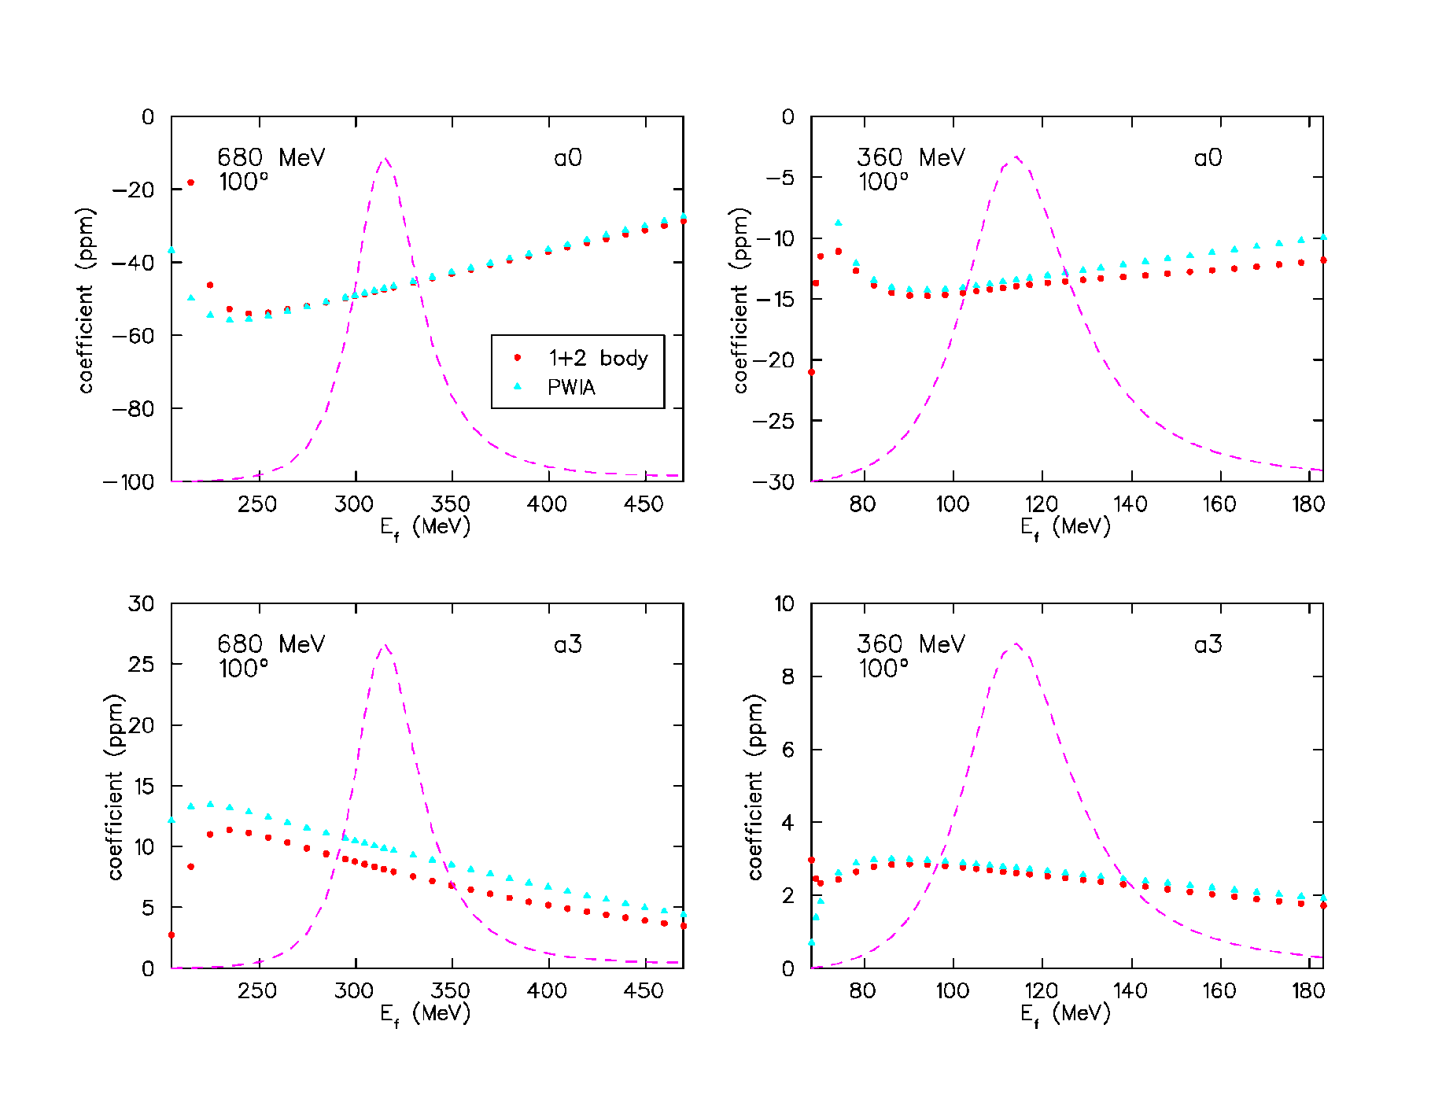
2-body effects in the D asymmetry
calculations from R. Schiavilla
leading term
of the
asymmetry
axial form
factor coefficient
has ~15%
correction from
2-body effects

Slide 10
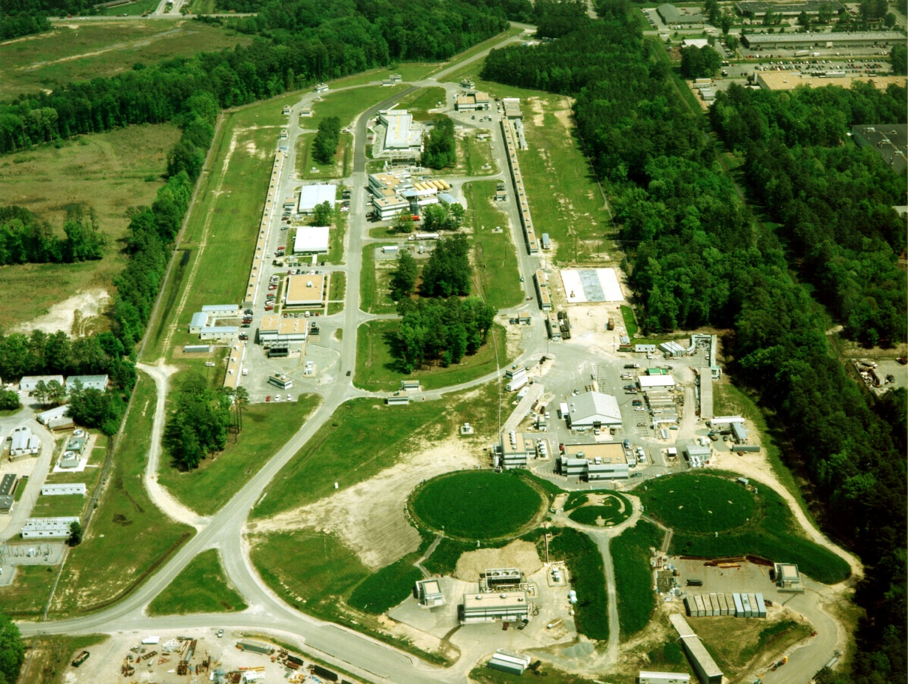
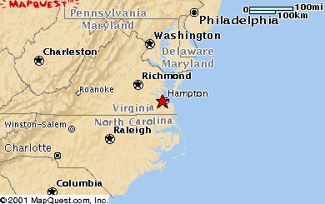
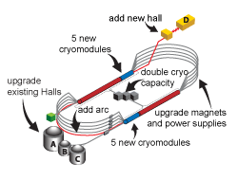

Jefferson Laboratory
G0
upgrade to 12 GeV
now underway
A
C
E ~ 6 GeV
Continuous Polarized Electron Beam
> 100 μA
up to 85% polarization
concurrent to 3 Halls

Slide 11
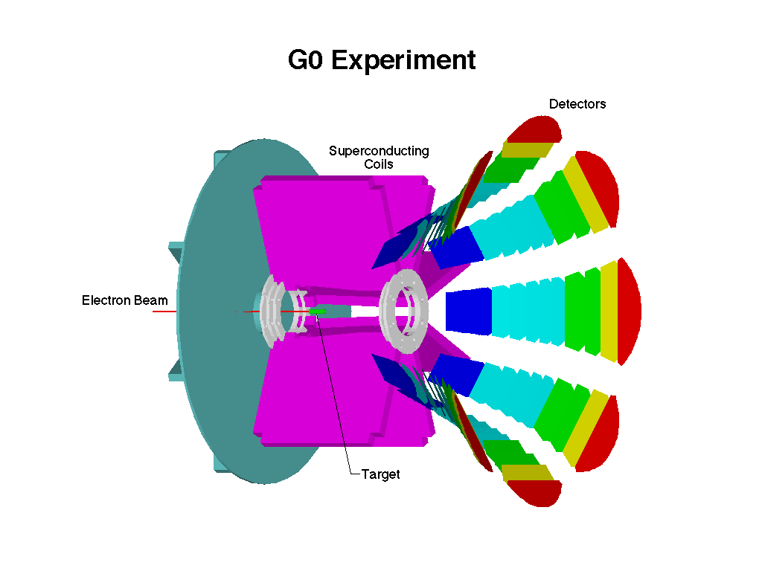
The G0 experiment at JLAB
Forward and backward angle PV e-p elastic and e-d (quasielastic) in JLab Hall C
superconducting toroidal magnet
scattered particles detected in segmented scintillator arrays in spectrometer focal plane
custom electronics count and process scattered particles at > 1 MHz
forward angle data published 2005
backward angle data: 2006-2007

Slide 12
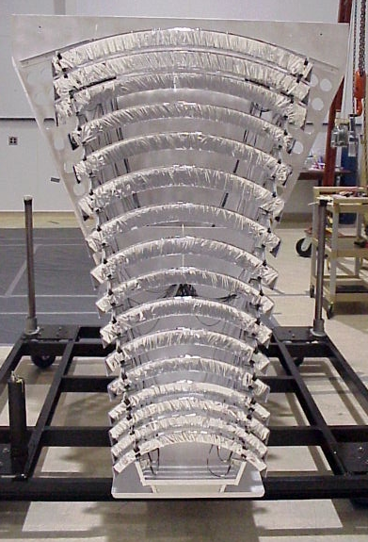
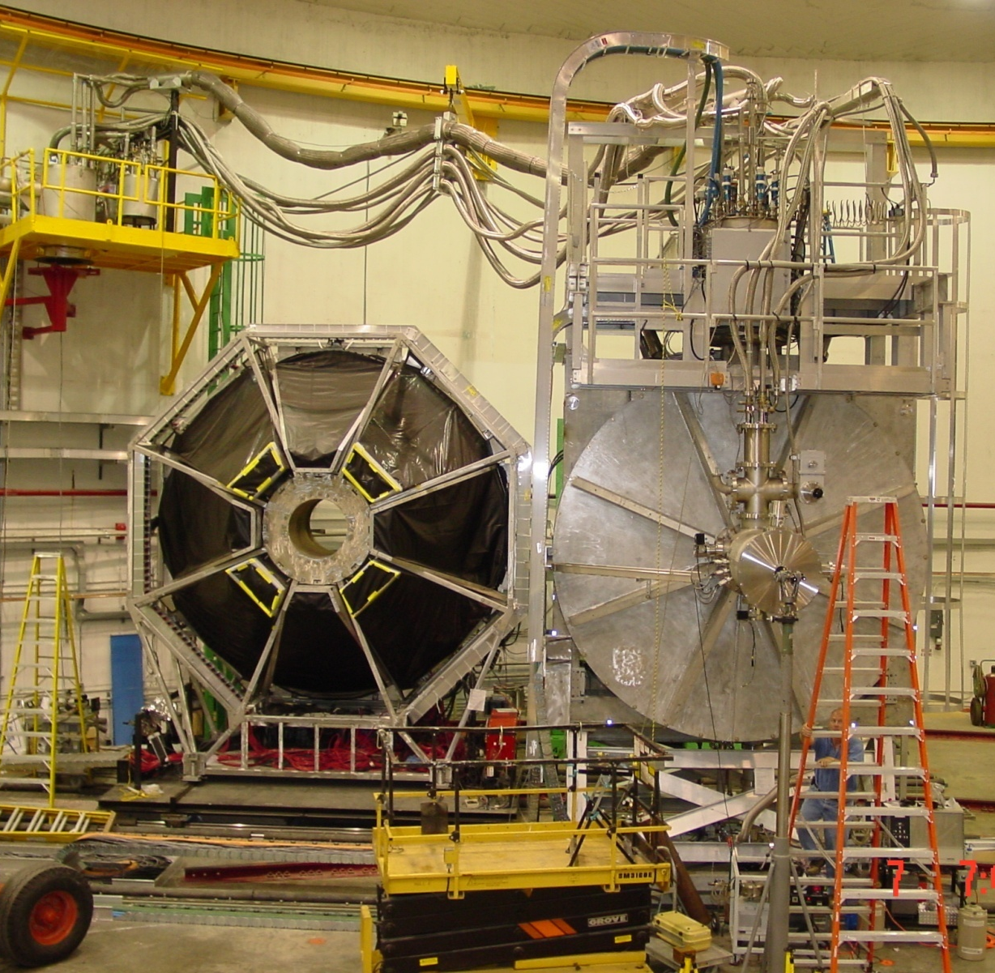
G0 Apparatus
One octant’s scintillator array
20 cm LH₂ Target

Slide 13
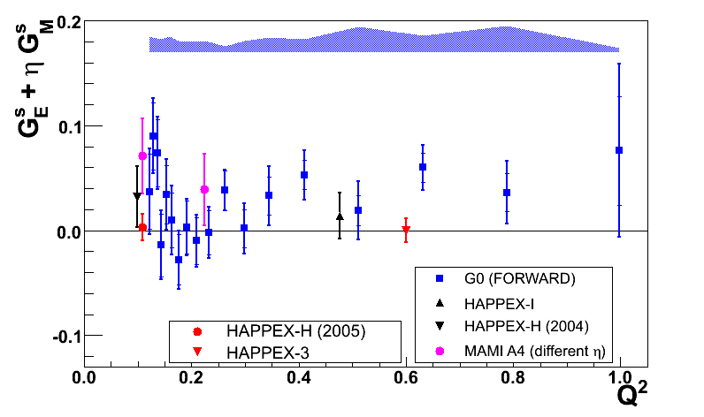
G0 Forward angle Results
EM form factors:
J.J.Kelly, PRC 70,
068202 (2004)
G0 Backward
HAPPEX-3
D.S. Armstrong et al.,
PRL 95 (2005) 092001

Slide 14
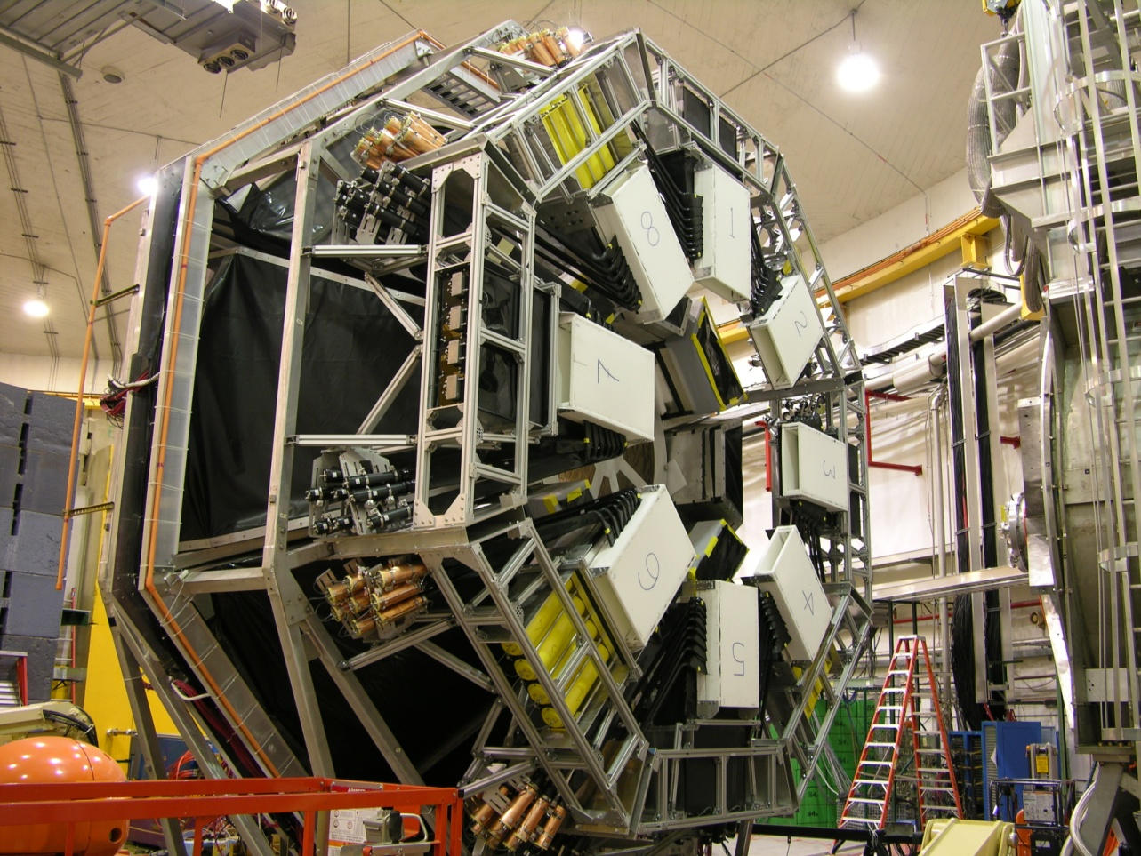
G0 Backward Angle
Electron detection: θ = 108°, H and D targets
Add Cryostat Exit Detectors (CED) to define electron trajectory
Aerogel Cerenkov detector for π/e separation (p_{π} < 380 MeV/c)
1 scaler per channel FPD/CED pair (w/ and wo/ CER)
E_{e} (MeV) | Q² (GeV²)
362 | 0.23
686 | 0.62
Common Q² with
HAPPEX-III and PVA4

Slide 15
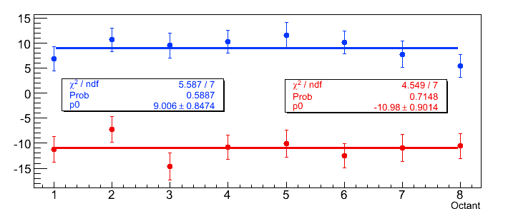
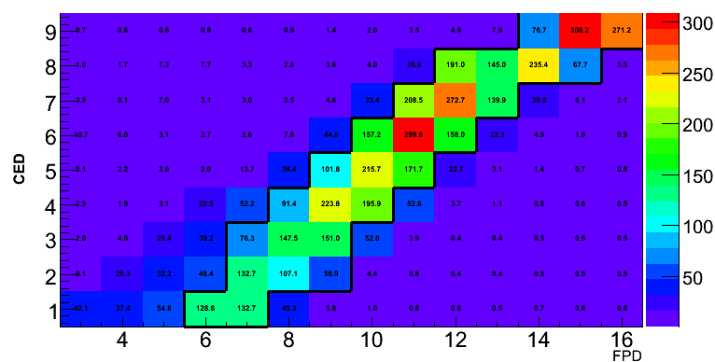
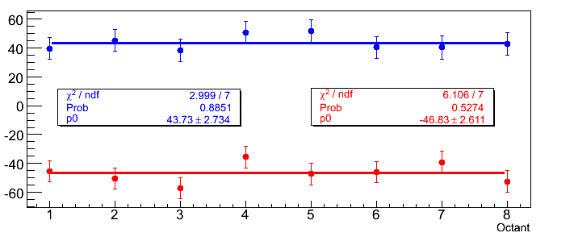
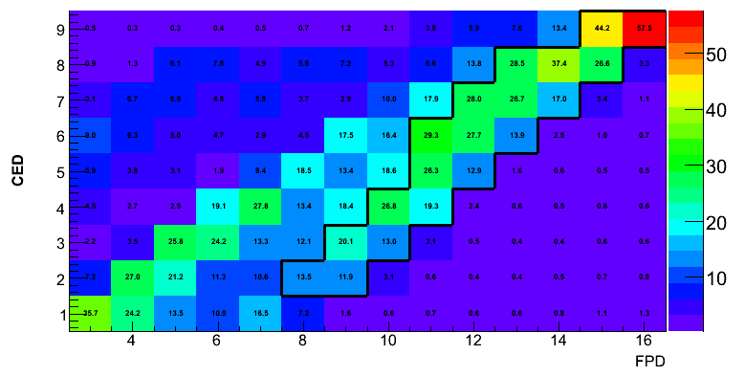
Hydrogen raw electron data
d
blinded raw asymmetries (ppm)
362 MeV
Hz/uA
octant # (azimuthal distribution)
687 MeV
Hz/uA

Slide 16
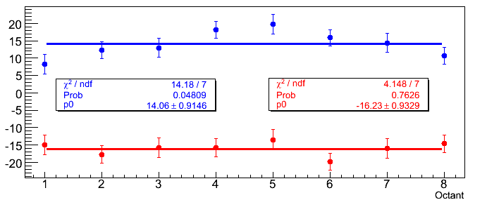
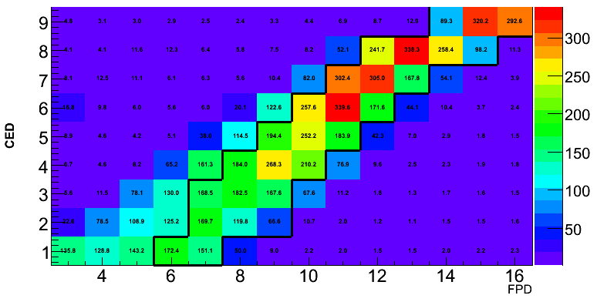
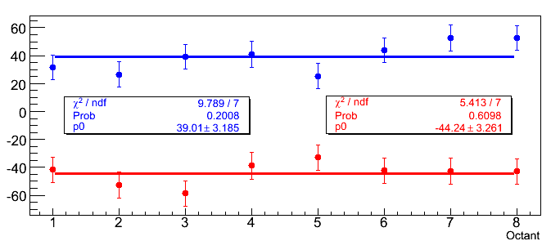
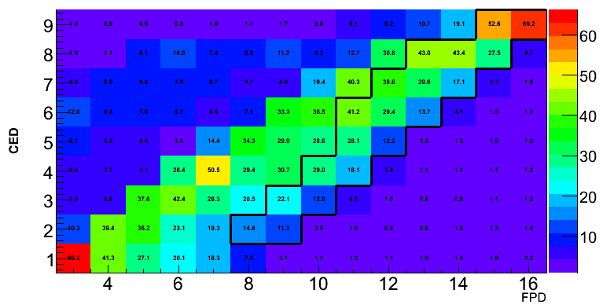
Deuterium raw electron data
d
blinded raw asymmetries (ppm)
362 MeV
Hz/uA
octant # (azimuthal distribution)
687 MeV
d
Hz/uA

Slide 17
Analysis Strategy
Blinding
Factors
× 0.75-1.25
H, D Raw Asymmetries, A_{meas}
~10-50 ppm
Corrections
Scaler counting correction
Rate corrections from electronics
Helicity-correlated corrections
Background corrections
Beam polarization
< 1% of A_{phys}
< 0.1 ppm
4% on asymmetry
P= 0.8578
± 0.0007 (stat)
± .014 (sys)
Electromagnetic
radiative corrections
(from simulation)
Unblind
Q² Determination
(from simulation)
H, D Physics Asymmetries, A_{phys}
± 0.003 GeV²
Other measurements
A(E_{i} , Q²)

Slide 18
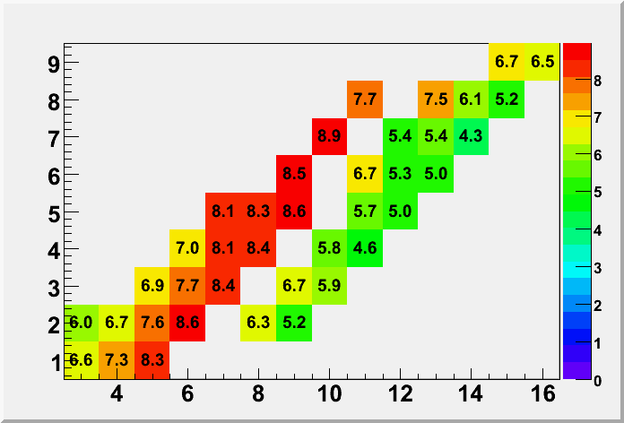
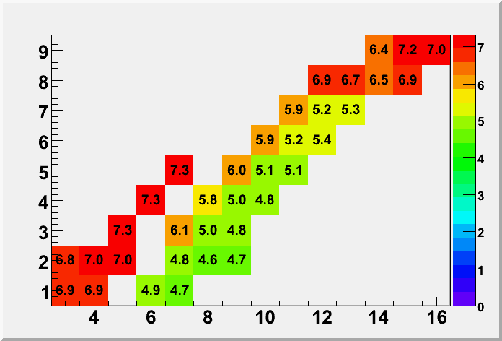
Rate Corrections
Deadtimes (%)
Correct the yields for random coincidences and electronic deadtime prior to asymmetry calculation
randoms small except for D-687
(due to higher pion rate). Direct
(out-of-time) measurements made for D-687
Validated with simulation of the complete electronics chain
H 687 MeV
Data set | Correction to Yield (%) | AsymmetryCorrection (ppm) | systematic error (ppm)
H 362 | 6 | 0.3 | 0.06
H 687 | 7 | 1.4 | 0.17
D 362 | 13 | 0.7 | 0.2
D 687 | 9 | 6 | 1.8
H 362 MeV

Slide 19
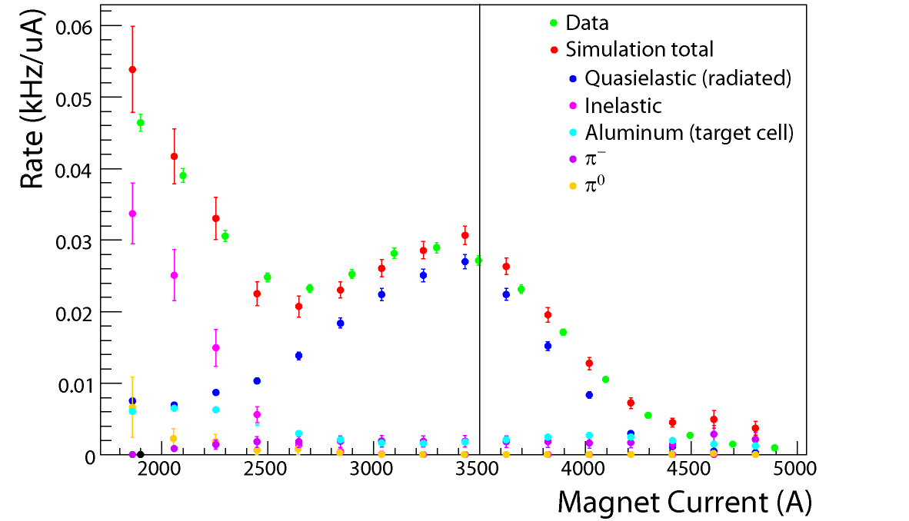
Backgrounds: Field Scans
D-687
CED 7, FPD 13
Use simulation shapes to help determine dilution factors
Main contributions are Aluminum windows for H runs, pions for D runs.
Data set | Correction to Yield (%) | Asymmetry Correction (ppm) | systematic error (ppm)
H 362 | 13.2 | 0.50 | 0.37
H 687 | 13.3 | 0.13 | 0.78
D 362 | 0.5 | 0.06 | 0.02
D 687 | 4.5 | 2.03 | 0.37

Slide 20
“Physics” Asymmetries
all entries in ppm
Data Set | Asymmetry | Stat | Sys pt | Global
H 362 | -11.01 | 0.84 | 0.26 | 0.37
D 362 | -16.50 | 0.79 | 0.39 | 0.19
H 687 | -44.76 | 2.36 | 0.80 | 0.72
D 687 | -54.03 | 3.22 | 1.91 | 0.62
H: systematic uncertainties dominated by beam polarization
D: rate corrections also contribute to uncertainty

Slide 21
Asymmetries to Form Factors
Electromagnetic form factors: Kelly (PRC 70 (2004))
  also used in Schiavilla calculation for D
  does not include new low Q² data from BLAST or JLab
  eventually use new fits (Arrington & Melnitchouk for p, Arrington & Sick for n)
differences in fits become 0.5 – 1 % in the asymmetry
Two-boson exchange corrections to Asymmetry: 0.5 -1.2%
  (see Tjon, Blunden & Melnitchouk, arXiv:0903.2759v1)
  includes D contributions, calculation for n in progress

Slide 22
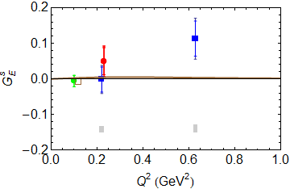
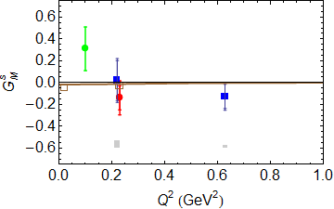
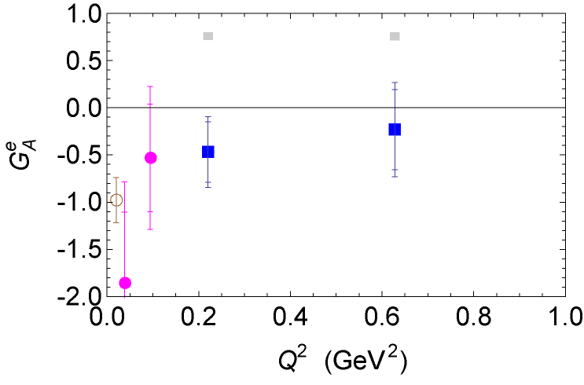
Form Factor Results
Using interpolation of G0 forward measurements
G0 forward/backward
PVA4: PRL 102 (2009)
Q² = 0.1 GeV² combined
Global uncertainties
Calculations:
Leinweber, et al. PRL 97 (2006) 022001
Leinweber, et al. PRL 94 (2005) 152001
Wang, et al arXiv:0807.0944 (Q² = 0.23 GeV²)
Liu, et al, arXiv:0903.3232v1
G0 forward/backward
SAMPLE
Zhu, et al. PRD 62 (2000)

Slide 23
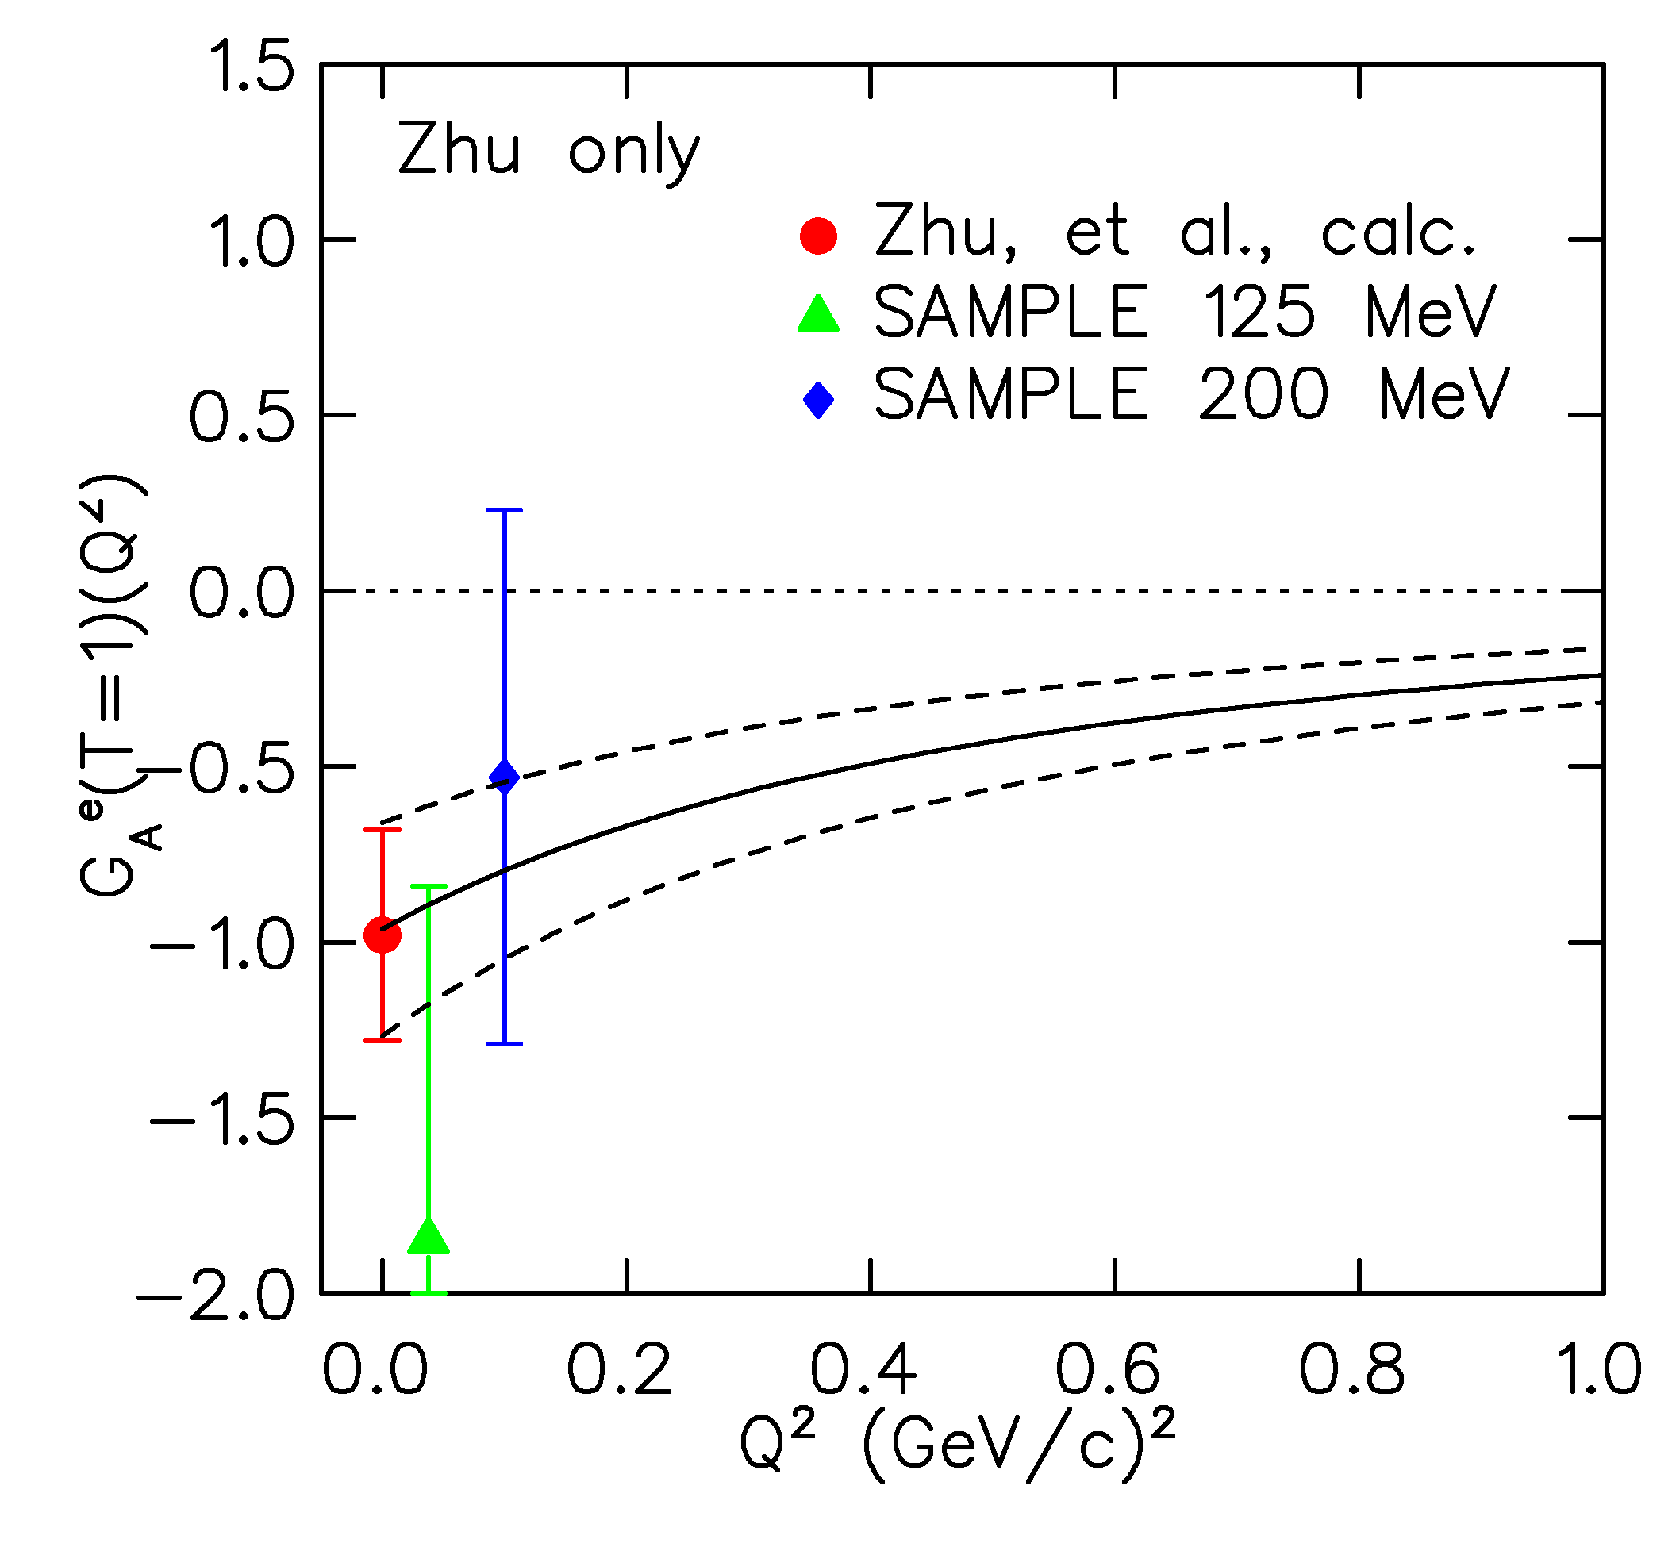
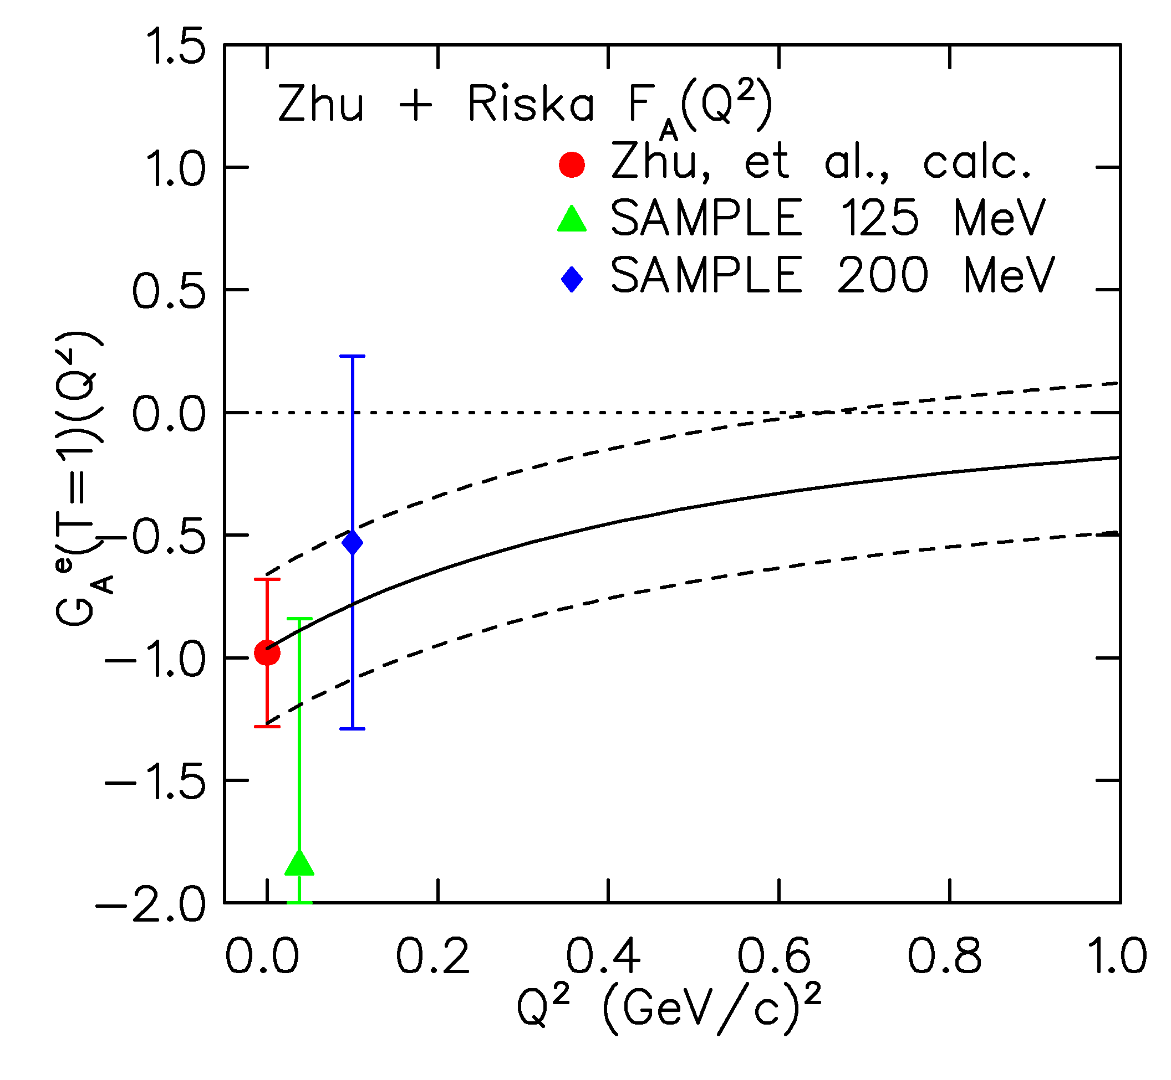
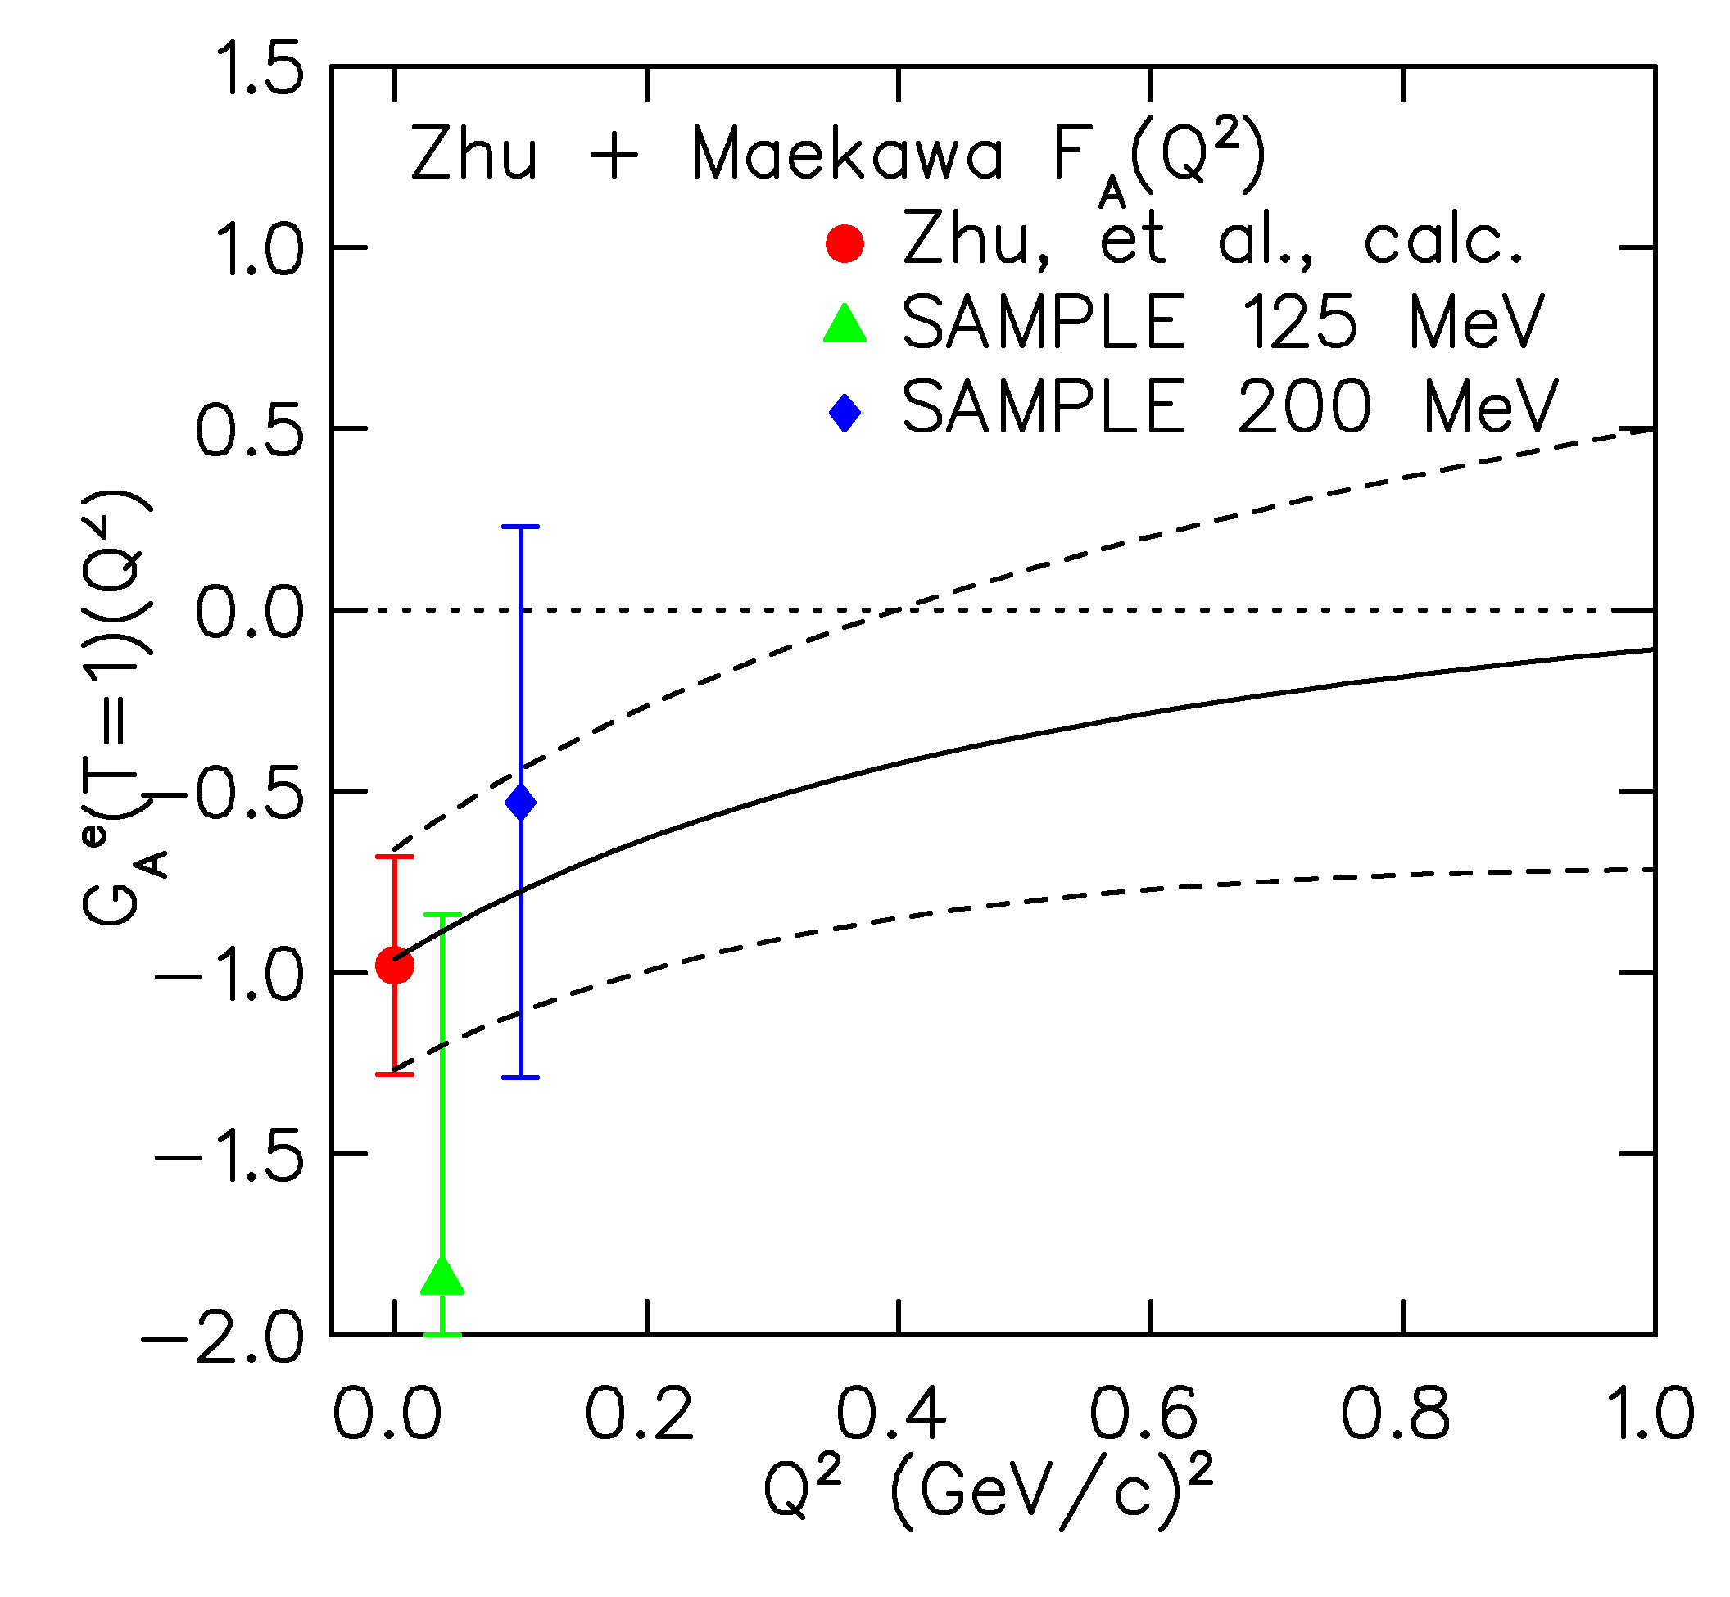
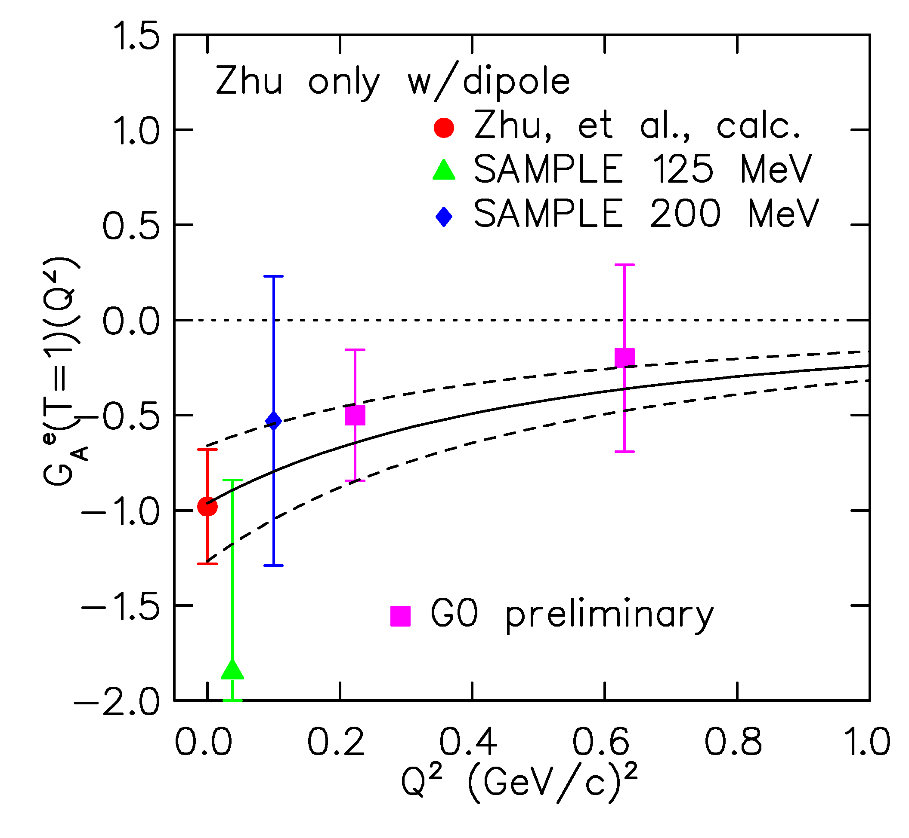
Anapole form factor F^{γ}_{A}(Q²)
Three scenarios
1. F_{A}(Q²) is like G_{A}(Q²)
2. F_{A}(Q²) is flat
(Riska, NPA 678 (2000) 79)
3. F_{A}(Q²) ~ 1 + Q²
(Maekawa, Viega, van Kolck, PLB 488 (2000) 167)
– (shown here are the most extreme set of model parameters)
Notes:
Need to fix the GAe values to match most recent extraction

Slide 24

Summary
first look at Q² behavior of strangeness contribution to proton’s charge and magnetism: continue to be small
first results for the Q² behavior of the anapole contributions to the axial form factor
other results to come soon from G0:
  → transverse beam spin asymmetries (2-γ exchange) in H and D
  → PV in the N-Δ transition: axial transition f.f.
  → PV asymmetry in inclusive π− production

Slide 25
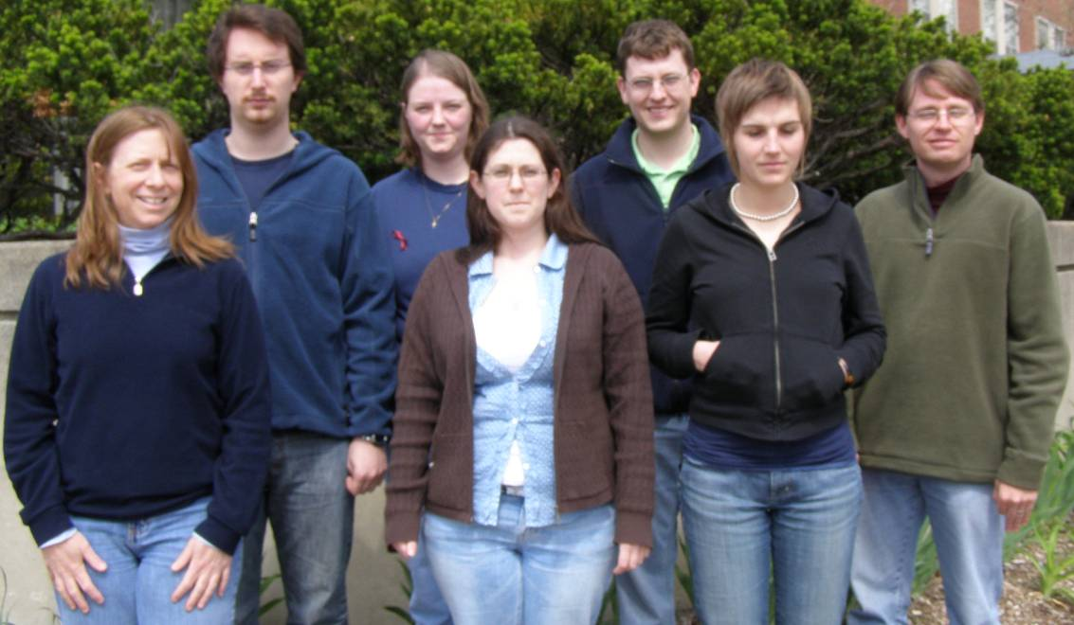
The G0 Collaboration (backward angle run)
California Institute of Technology, Carnegie Mellon University,
College of William and Mary, Grinnell College,
Institut de Physique Nucléaire d'Orsay,
Laboratoire de Physique Subatomique et de Cosmologie-Grenoble,
Louisiana Tech University, New Mexico State University, Ohio University, Thomas Jefferson National Accelerator Facility, TRIUMF, University of Illinois, University of Kentucky, University of Manitoba, University of Maryland, University of Winnipeg, University of Zagreb, Virginia Tech,
Yerevan Physics Institute
Graduate Students:
C. Capuano (W&M), A. Coppens (Manitoba), C. Ellis (Maryland),
J. Mammei (VaTech), M. Muether (Illinois), J. Schaub (New Mexico State), M. Versteegen (Grenoble); S. Bailey (Ph.D. Jan. 07 W&M)
Analysis Coordinator:
F. Benmokhtar - Carnegie Mellon (Maryland)

Slide 26
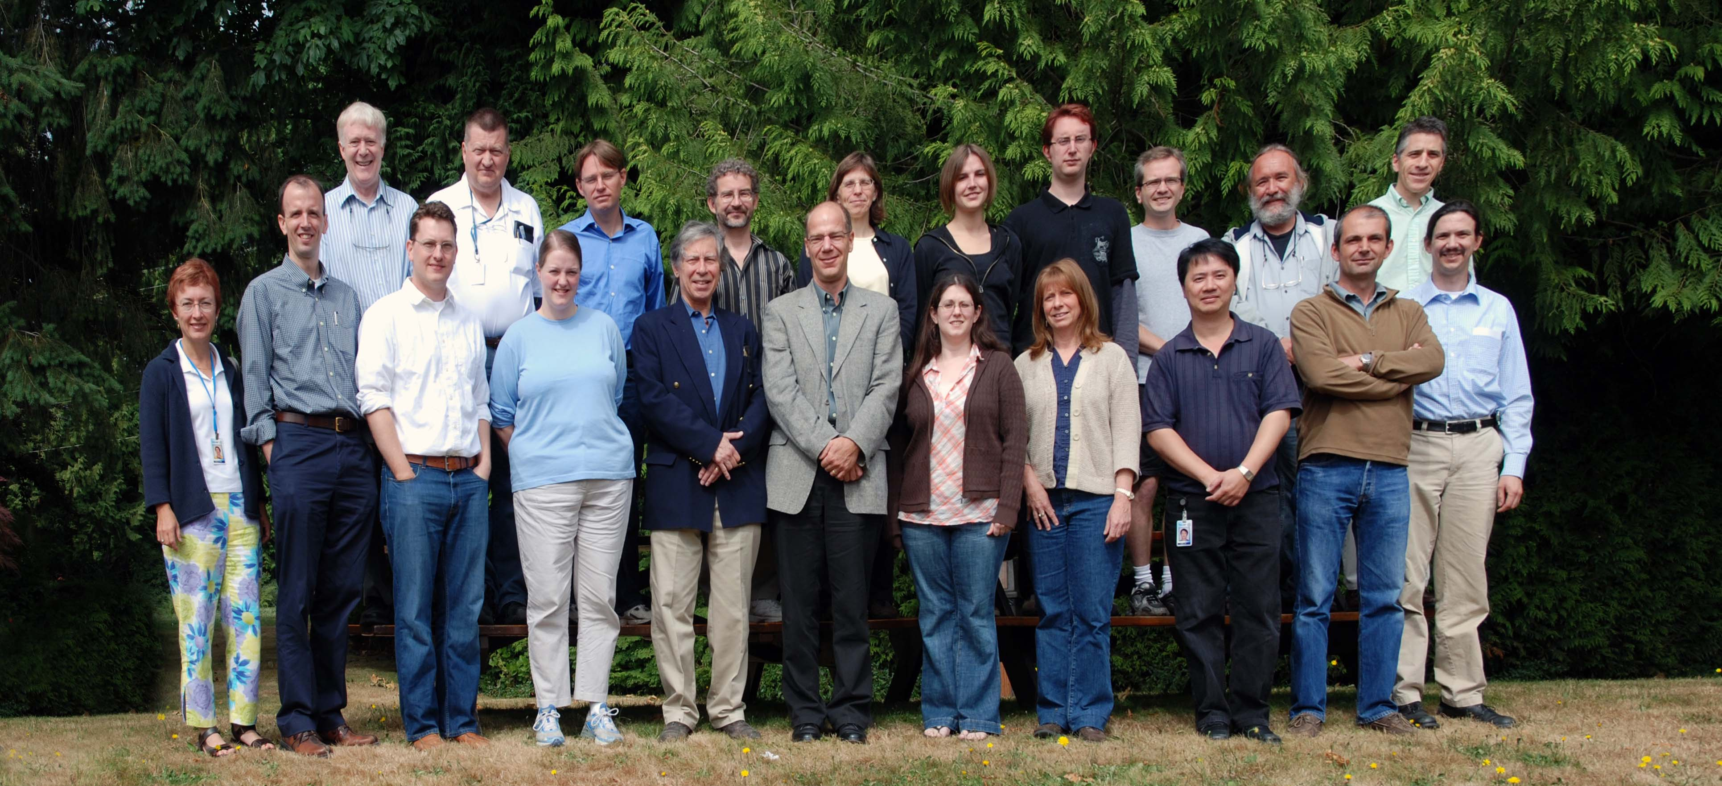
The G⁰ Collaboration (backward angle run)
Caltech, Carnegie Mellon, William and Mary, Hendricks College, Orsay, Grenoble, LA Tech, NMSU, Ohio, JLab, TRIUMF, Illinois, Kentucky, Manitoba, Maryland, Winnipeg, Zagreb, Virginia Tech, Yerevan Physics Institute

Slide 27
backups

Slide 28
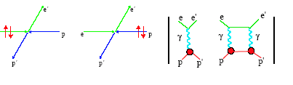
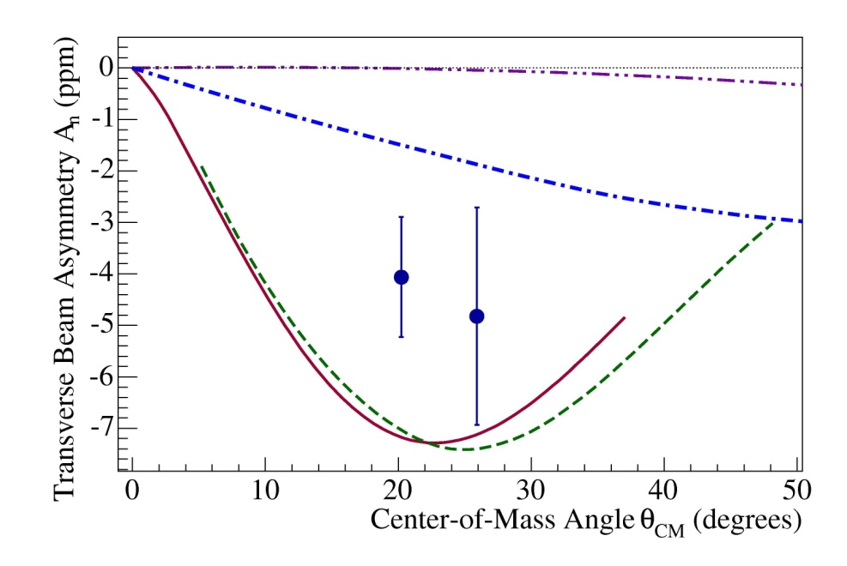
2γ exchange and Beam spin asymmetries
Byproduct of parity violation
experiments determines Im(2γ)
N (elastic)
Δ
Pasquini+ Vanderhaeghen, PRC 70 (04) 045206
Mainz data: PRL 94 (05) 082001
G0 / Hall C: forward angle data:
(PRL 99 (07) 092301)
E_{e} = 3 GeV
need more than Δ in intermediate state
N + Δ
M. Gorshtein (07)
Afanasev & Merenkov, (04)

Slide 29
Scaler Counting Issue with Electronics
Electronics sorts detector coincidences (CED_{i} and FPD_{j}) into separate scaler channels
  FPGA-based system in North American electronics (4 octants)
Because of error in FPGA programming, two short (~3 ns) pulses could be sent to scaler in < 7 ns
  ~ 1% of events have such miscounts
Such pulse pairs can cause scaler to drop or add bits
  Detailed simulation of ASIC with propagation delays between (flip flop) elements
Effect on asymmetry is <0.01 A_{phys}
  Test by cutting data; compare with French octants
Data
Simulation

Slide 30
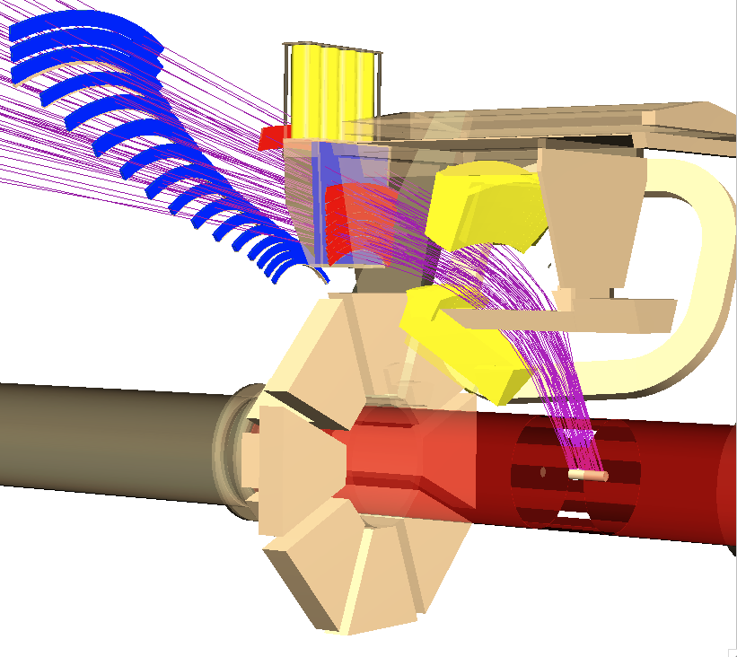
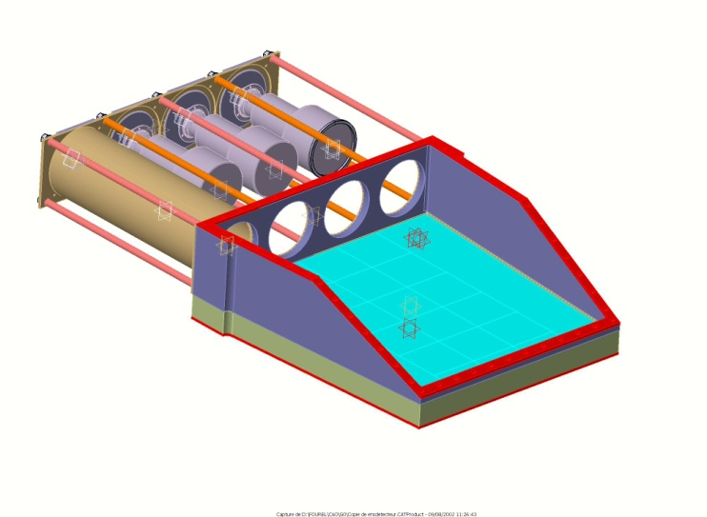
G0 Backward angle configuration
Particle detection and identification
  Turn-around of the magnet
    Detection of the electrons (θ_{e} ~ 110°)
  Extensive simulation of background
    Need for new shielding around the target cell
    and at the magnet exit window
  Cryostat Exit Detectors (CED)
  to separate elastic and inelastic electrons
Cherenkov detector
  π/e separation (both are recorded)
    5 cm aerogel, n= 1.03 (OK for p_{π} < 380 MeV/c),
    90% efficient for e⁻ and π rejection factor  100
    From cosmic muons and test beam : 5-8 p.e.
    Special design for Magnetic shielding (SMS fringe field)
CED + Cherenkov
FPD
e⁻ beam
target

Slide 31
Correction due to misidentified pions
3 Ways to calculate
  runs with special beam structure providing timing reference allowing particle TOF
  PMT Multiplicity (two versus three of the cerenkov PMT’s firing)
  Pulse heights (waveform digitized)
cerenkov detector
4 pmts
687 MeV
counts
red: pions
blue: electrons
aerogel
π⁻ contamination to
electron yield (A_{π} ~ 0)
D 362: 0.5%
D 687: 4%
# single photo electrons
threshold

Slide 32
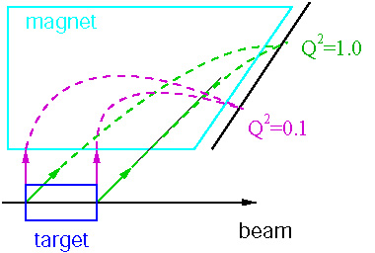
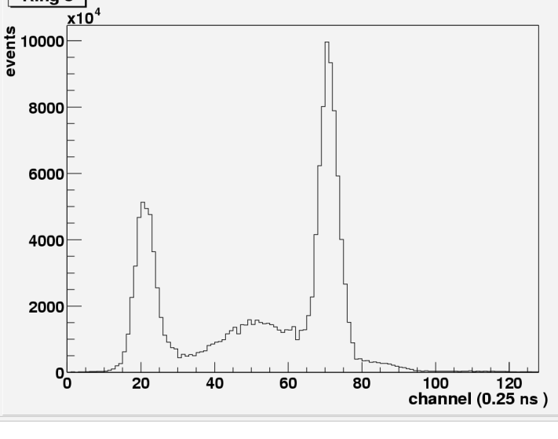
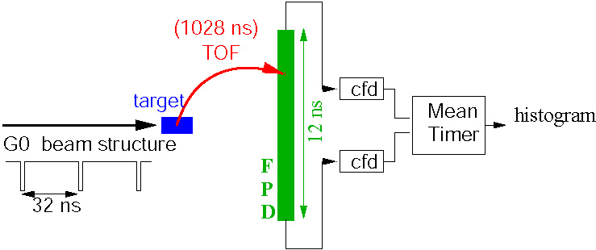
G0 Forward Detection Scheme
Detect scattered Protons:
Magnet sorts protons by Q²
at one setting
Beam bunches 32 nsec apart
Flight time separates p and π⁺
Beam spin flipped every 30 ms: + − − +
Det 8
pions
elastic protons
inelastic protons

Slide 33
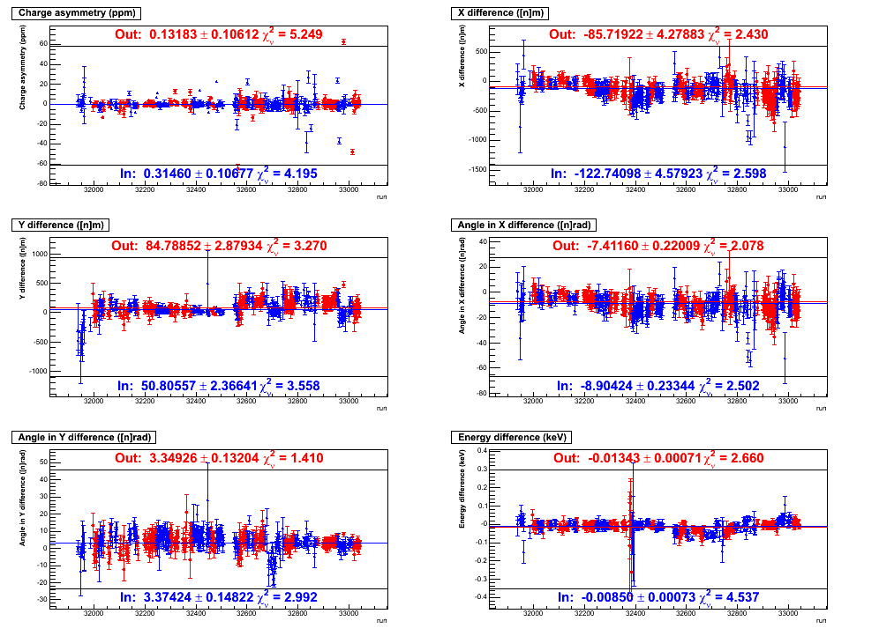
Polarized Beam Properties
2 ns time structure
Polarization reversal: 30 Hz, random quartets (+--+, -++-)
Slow helicity reversal: λ/4 wave plate IN and OUT
Helicity-correlation properties:
w/ feedback
Δx (nm)
Charge Asymmetry
Δy (nm)
Δθ_{x} (nrad)
Beam Parameter | Achieved (OUT-IN)/2 | “Specs”
charge asymmetry | 0.09 +/- 0.08 | 2 ppm
x position difference | -19 +/- 3 | 40 nm
y position difference | -17 +/- 2 | 40 nm
x angle difference | -0.8 +/- 0.2 | 4 nrad
y angle difference | 0.0 +/- 0.1 | 4 nrad
energy difference | 2.5 +/- 0.5 | 34 eV
Beam halo (out 6 mm) | < 0.3 x 10⁻⁶ | 10⁻⁶
Δθ_{y} (nrad)
ΔE (keV)
Run Number

Slide 34
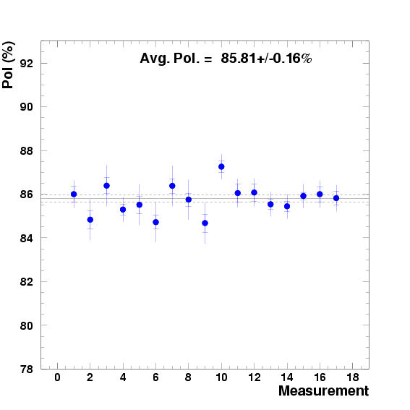
Beam Polarization
687 MeV Møller Results
Measurements of Møller asymmetry at 687 MeV
  Low energy tune of Møller spectrometer
Use Mott scattering for 362 MeV measurements
  Mott asymmetry measured at 5 MeV in injector
  New work on effect of background improves agreement with Møller
April 2006
March 2007
Sep.-Dec. 2006
Bottom Lines:
P_{e}(687 MeV) = 85.78 ± 0.07 ± 1.38%
P_{e}(362 MeV) = ± 2.05%

Slide 35
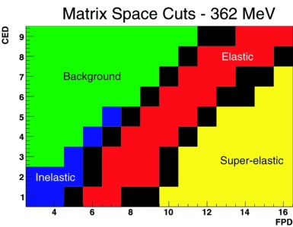
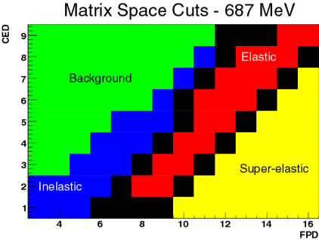
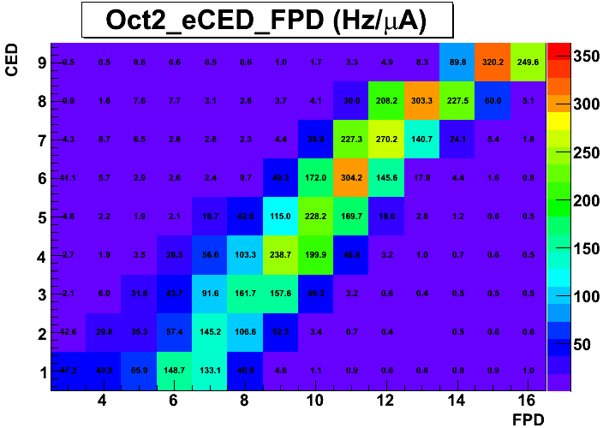
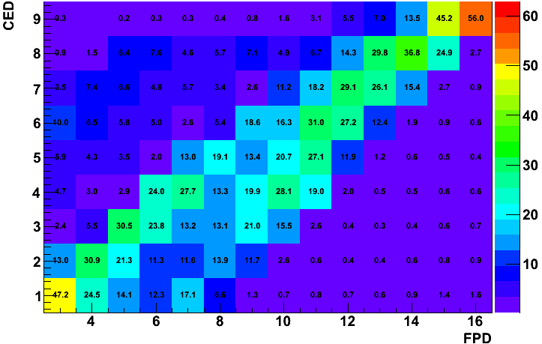
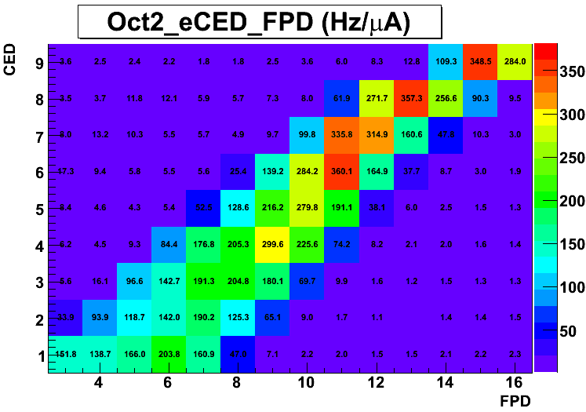
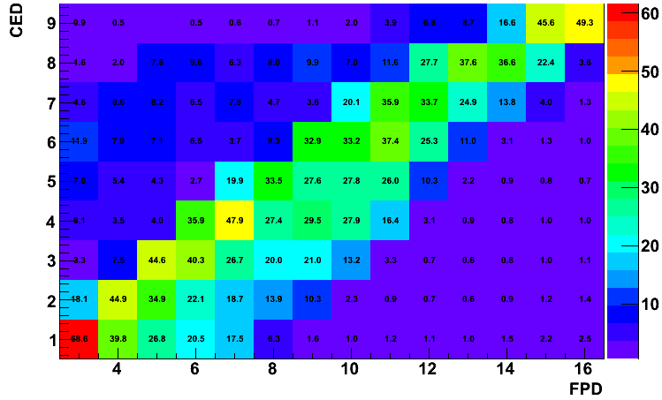
Electron Yields (Hz/uA)
Elastic
H 362 MeV
H 687 MeV
Inelastic
Quasi Elastic
D 362 MeV
D 687 MeV
Inelastic

Slide 36
Backgrounds: Field Scans
Use simulation shapes to help determine dilution factors
D-687
CED 7, FPD 13

Slide 37
From Raw asymmetries to unblinding
Rate Corrections for Electronics
→Deadtime & Random Coincidences
~7-13 % correction to the yield, prior
to computing the asymmetry
Helicity Correlated Beam Corrections
< 0.1 ppm (E, charge, or position
beam- induced false asymmetry)
Dilution corrections:
(inelastic electrons, target windows,
misidentified pions )
Inelastic electrons: ~1% to yield
Al target windows ~12% to yield
Pions: 5% for D-687, ~0 for rest
EM Radiative Corrections
(via Simulation)
~4% correction to the asymmetry
Beam Polarization
P= 0.8578 ± 0.0007 (stat) ± .0138 (sys)
Notes:
362 Pass2 – pass3 yields varied by 1 to 14%--pass3 were a net gain in yield
Each pass had ~7% uncert in each cell

Slide 38
Asymmetry Uncertainties (1)
Hydrogen, 687 MeV
(all in parts per million)
 | Value | Stat | Sys Pt | Sys Gl | Total
Measured Asymmetry | -38.14 | 2.43
Background Asymmetry | -38.27 |  | 0.40
Dilution Correction |  |  | 0.47 | 0.52
Transverse Correction |  |  |  | 0.008
Rate Correction | -38.39 |  | 0.17
Beam Polarization | -44.76 |  | 0.52 | 0.53
EM Radiative Correction | -46.14 |  | 0.16
Physics Asymmetry | -46.14 | 2.43 | 0.84 | 0.75 | 2.68
Notes:
Added RC 20090517

Slide 39
Asymmetry Uncertainties (2)
Deuterium, 687 MeV
(all in parts per million)
 | Value | Stat | Sys Pt | Sys Gl | Total
Measured Asymmetry | -44.02 | 3.34
Background Asymmetry | -46.05 |  | 0.001
Dilution Correction |  |  | 0.38
Transverse Correction |  |  | 0.009 | 0.008
Rate Correction | -46.35 |  | 1.82
Beam Polarization | -54.03 |  | 0.62 | 0.64
EM Radiative Correction | -55.87 |  | 0.19
Physics Asymmetry | -55.87 | 3.34 | 1.98 | 0.64 | 3.92
Notes:
Added RC 20090517

Slide 40


Preliminary Inelastic Asymmetries
Background, radiative corrections not included
OUT + IN = 0.07 ± 5.1 ppm
OUT + IN = -9.9 ± 10.5 ppm

Slide 41

Preliminary Pion Asymmetries
Constrain small photoproduction asymmetry “d_{Δ}”
  working on systematic uncertainties (~ 0.5 ppm)
(OUT – IN)/2 = -0.56 ± 1.03 ppm
OUT + IN = 3.84 ± 2.15 ppm

Slide 42



Preliminary Transverse Asymmetries
Background, radiative corrections not included
H 362 MeV
D 362
H 687 MeV
  need theory for em radiative corrections

Slide 43

Determining Form Factors
Interpolation of G0 forward angle measurement

Slide 44

New Results from G0: Parity Violating Electron Scattering at JLab
Elizabeth Beise, University of Maryland
  Hydrogen and deuterium targets: access to strange quark contributions to electromagnetic form factors
  Proton’s axial form factor, as seen by electrons
  PV asymmetries (10-50 ppm) measured at Q² = 0.22, 0.63 GeV²
blinded raw asymmetries (ppm)
from hydrogen, Q² = 0.22 GeV²

