Slide 1
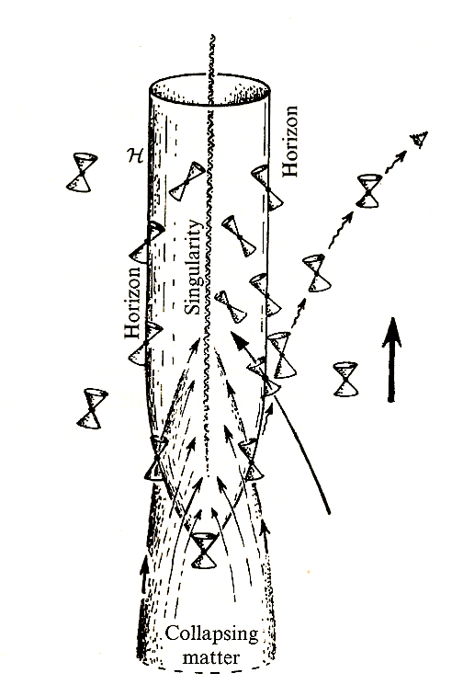
Black Holes
and
Warped Spacetime
Ted Jacobson
Picture by Roger Penrose
The Road to Reality (Knopf, 2005)

Slide 2
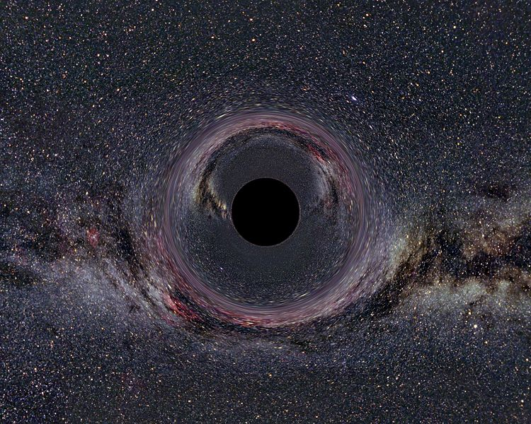
Notes:
What a black hole might look like. Strong gravity, light cannot escape. Light is bent around.
Will explain what it is, the difficulty physicists had coming to terms with it, and how it manifests
In the world around us.

Slide 3
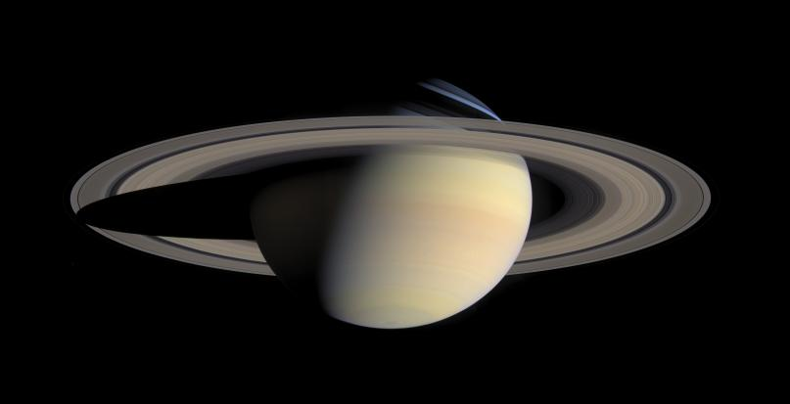
Gravity
Composite photo from NASA/ESA Cassini spacecraft

Slide 4
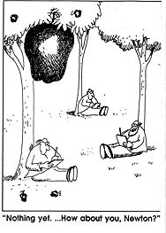
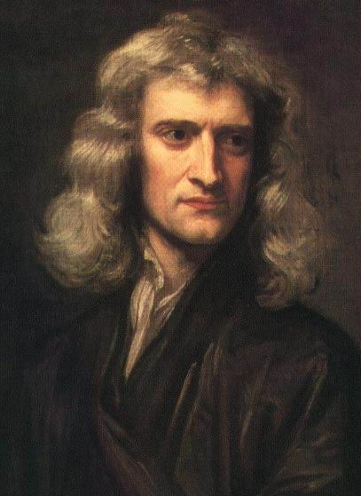
Gravity
is a force of attraction between any two masses,
proportional to each mass and inversely to the square of their separation.
With this Newton unified the fall of an apple, the tides, and the orbits of the moon and the solar
system.
Isaac Newton, aged 46, 1689
With this Newton explained the fall of an apple,
the tides, the orbit of the moon, and the
Notes:
It is said he was inspired while watching an apple fall…

Slide 5

Escape velocity
Notes:
Since gravity becomes weaker as the distance increases, an object can escape completely if it is tossed upwards fast enough.

Slide 6
Escape velocity
Notes:
Since gravity becomes weaker as the distance increases, an object can escape completely if it is tossed upwards fast enough.

Slide 7
Escape velocity
faster
Notes:
Since gravity becomes weaker as the distance increases, an object can escape completely if it is tossed upwards fast enough.

Slide 8
Escape velocity
faster yet
faster
Notes:
Since gravity becomes weaker as the distance increases, an object can escape completely if it is tossed upwards fast enough.

Slide 9
fast enough
Escape velocity
faster yet
faster
Notes:
Since gravity becomes weaker as the distance increases, an object can escape completely if it is tossed upwards fast enough.

Slide 10
fast enough
Escape velocity
faster yet
V_{esc} is speed of light if R small enough:
faster
If Sun were compressed to a radius of 3 km, keeping the mass the same, the escape velocity would be the speed of light …
Notes:
Since gravity becomes weaker as the distance increases, an object can escape completely if it is tossed upwards fast enough.

Slide 11
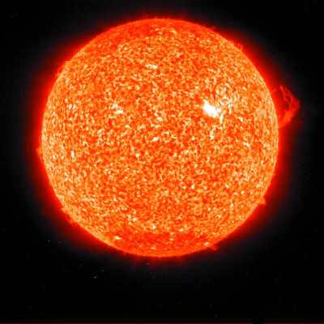
Notes:
If the fire burns out, and sun begins to shrink…

Slide 13

Notes:
…it would turn into a pumpkin!

Slide 16
…but to deal with objects moving at the speed of light,
we need to use Einstein’s special relativity theory…
…and to deal with extremely strong gravity,
we need to use Einstein’s general relativity theory…

Slide 17
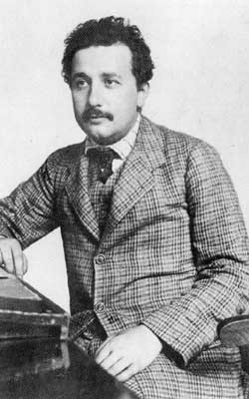
Light is always propagated in empty space with a definite velocity c which is independent of the state of motion of the emitting body or the observer.
Special Relativity Theory
Einstein, 1905
This led to a new view of the world,
replacing “space over time” by
“spacetime”
Notes:
Analogy…

Slide 18

A spacetime analogy
Notes:
The analogy is a finite speed of influence.
A flaw is that the water determines a particular rest frame, but spacetime does not.
This is not a problem for my purposes, since I use only the analogy with the speed of light.

Slide 19
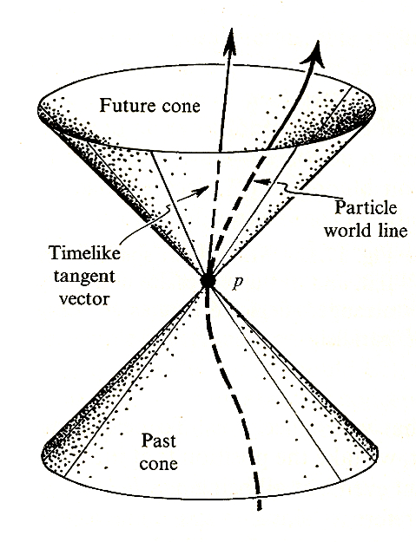
The Light Cone
paths of light light
rays in spacetime
Light ray
No time passes for
something moving at
the speed of light
along a light ray

Slide 20
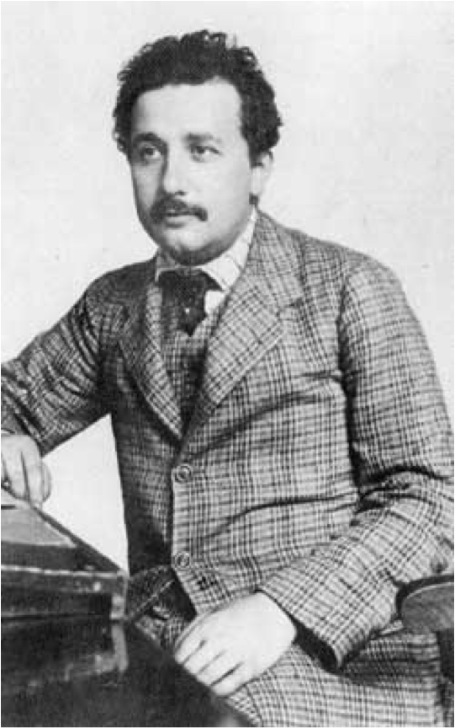
Notes:
Demonstrate this with a ball and a piece of paper.

Slide 21
Gravity cannot be held responsible for people falling in love.
Notes:
Demonstrate this with a ball and a piece of paper.

Slide 22
“I was sitting in my chair in the Patent Office in Bern when all of a sudden a thought occurred to me: ‘If a person falls freely, he won’t feel his own weight.’ I was startled. This simple thought made a deep impression on me…”
“At this point there occurred to me the happiest thought of my life…”
“…if one considers an observer in free-fall, e.g,. from the roof of a house, there exists for him during this fall no gravitational field --- at least not in his immediate vicinity.”
So true gravity is the relative acceleration of
falling bodies...or light rays.
Notes:
Demonstrate this with a ball and a piece of paper.

Slide 23
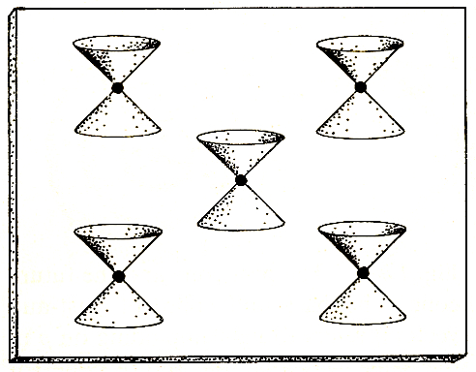
Special relativity: spacetime

Slide 24
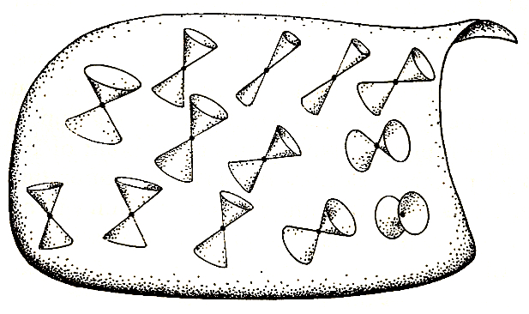
General relativity:
Gravity is nothing but curvature of spacetime

Slide 25
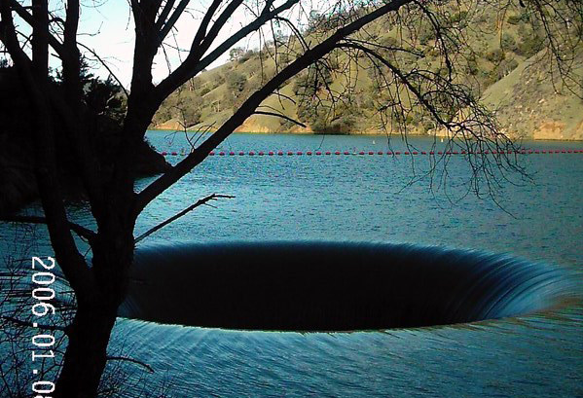
A black hole analogy
Notes:
A black hole analogy. Spillway, Monticello Dam, Napa Valley

Slide 26
A black hole analogy
Notes:
A black hole analogy. Spillway, Monticello Dam, Napa Valley

Slide 27
A black hole analogy
Notes:
A black hole analogy. Spillway, Monticello Dam, Napa Valley

Slide 28
A black hole analogy
Notes:
A black hole analogy. Spillway, Monticello Dam, Napa Valley

Slide 29
A black hole analogy
Notes:
A black hole analogy. Spillway, Monticello Dam, Napa Valley

Slide 30
A black hole analogy
event horizon
Notes:
A black hole analogy. Spillway, Monticello Dam, Napa Valley

Slide 31

Spacetime picture
of an event horizon
Event
horizon
time
increasing radius
Notes:
This is a preview of the picture as it finally emerged. This is where the story is headed.

Slide 32
Could a black hole ever arise in nature?
Four persistent sources of confusion:
Mathematical: coordinate breakdown misunderstood
Physical: forces that support a star not fully understood
Psychological: insistence on static configurations of matter
Metaphysical: difficulty accepting existence of the unknown
The history of insights and confusion is complicated and fascinating –
(cf. Werner Israel’s “Dark Stars: The Evolution of an Idea”)

Slide 33
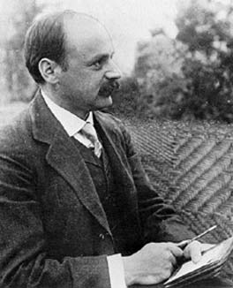
The Schwarzschild Singularity
(1916)
The true, non-singular nature of the Schwarzschild “singularity”
was not widely understood until 42 years later..
Notes:
Now I’ll tell the story, just touching on five episodes. There were many more.
Begin with the gravitational field outside a star in general relativity. Einstein found an approximate solution,
but Schwarzschild found the exact solution to the Einstein field equation!
ds^2 specifies the gravitational field: the time elapsed along any path in spacetime, and the paths of light rays.
Something strange happens at the Schwarzschild radius.
No time, and infinite distance…?

Slide 34
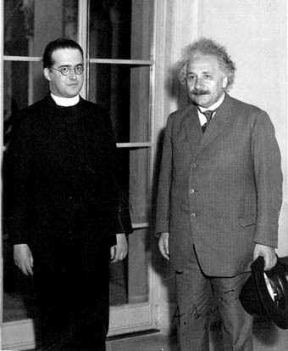
Georges Lemaitre
First person to understand the nature of the Schwarzschild singularity as an event horizon (1933).
Belgian mathematician and physicist, catholic priest, President of
Pontifical Academy of Sciences 1960-66
Educated at Cambridge and MIT
Inventor of physical cosmology:
Expanding universe, cosmic fireball, origin of structure from quantum fluctuations, beginning of time…
Notes:
“As far as I can see, such a theory remains entirely outside any metaphysical or religious question. It leaves the materialist free to deny any transcendental Being… For the believer, it removes any attempt at familiarity with God… It is consonant with Isaiah speaking of the hidden God, hidden even in the beginning of the universe.”

Slide 35
Why was Lemaitre not confused?
Mathematical: coordinate breakdown misunderstood
he was mathematically brilliant
Physical: lack of knowledge about the forces that support a star
he was focused on the cosmos, which is mostly empty space
Psychological: insistence on static configurations
he was focused on the cosmos, which is expanding
Metaphysical: difficulty accepting existence of the unknown
what lies behind a cosmological horizon is more of the same

Slide 36
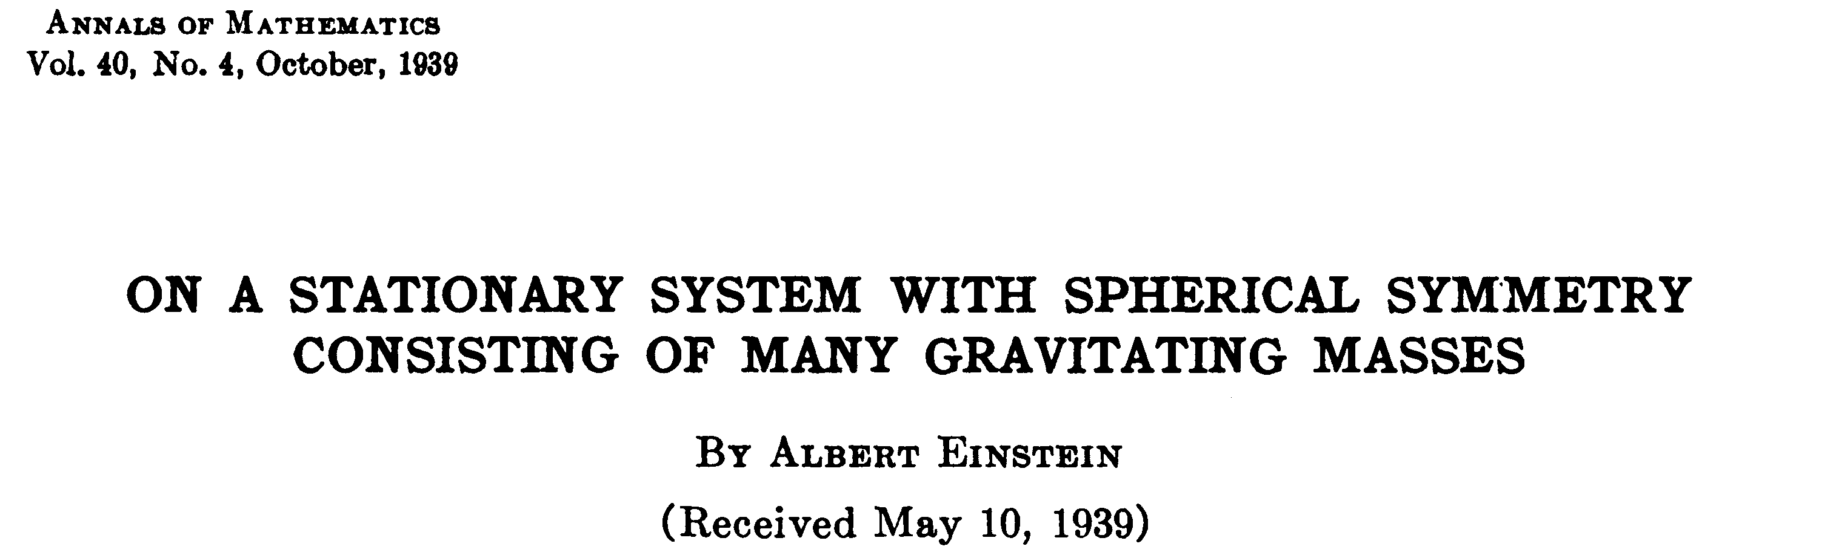
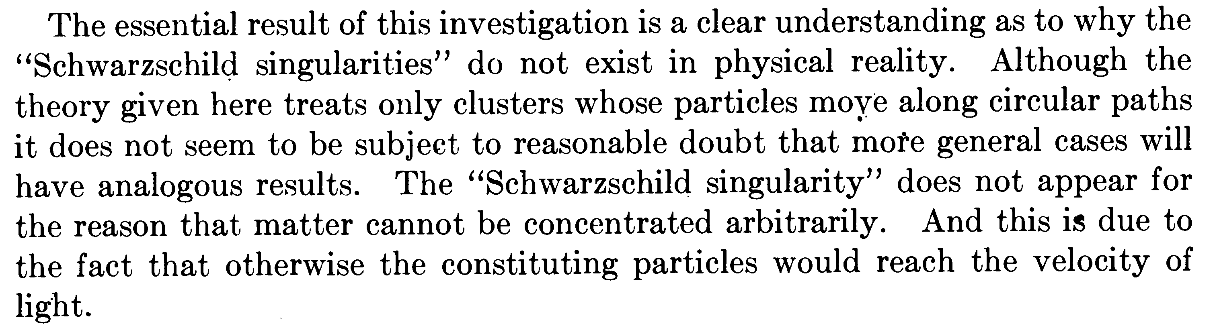
Einstein (1939) repeated his earlier, cosmological error,
insisting on stationary matter configurations.
Notes:
When Einstein heard about Lemaitre’s claim, he once again reacted badly to time dependence…

Slide 37
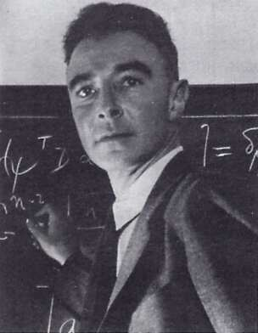
Oppenheimer and Snyder (1939) analyzed collapsing matter and showed
how an event horizon forms in a finite time.

Slide 38
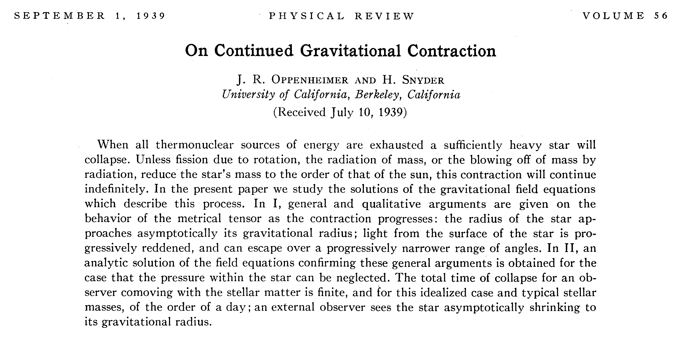
Oppenheimer and Snyder (1939) analyzed collapsing matter and showed
how an event horizon forms in a finite time.
First paper to discuss the viewpoint of an observer who
falls in, and contrasted with the view of an external observer.

Slide 39
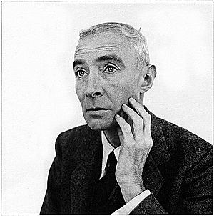
Twenty years later, it still wasn’t accepted.
Oppenheimer, at 1958 Solvay Congress:
“Would not the simplest assumption about the fate of a star more than the critical mass be this, that it undergoes continued gravitational contraction and cuts itself off from the rest of the universe?”
Oppenheimer,1958
by Richard Avedon,
currently on display at
The Corcoran Gallery

Slide 40
Why was Oppenheimer not confused?
Mathematical: coordinate breakdown misunderstood
he was not looking at the static solution
Physical: lack of knowledge about the forces that support a star
1) he had just previously found an upper limit for the mass
of stars supported by nuclear matter,
2) he simplified the problem by neglecting pressure!
Psychological: insistence on static configurations
he was convinced by his previous work that the
star could not remain static
Metaphysical: difficulty accepting existence of the unknown

Slide 41
Why was Oppenheimer not metaphysically confused?
Oppenheimer “worked at physics,” Bethe told a biographer, “mainly because he found physics the best way to do philosophy.”
From article by Richard Rhodes, American Heritage vol. 28, #6, October 1977
I.I. Rabi wrote:
“.…It seems to me that in some respects Oppenheimer was overeducated in those fields which lie outside the scientific tradition, such as his interest in religion, in the Hindu religion in particular, which resulted in a feeling for the mystery of the universe that surrounded him almost like a fog. He saw physics clearly, looking toward what had already been done, but at the border he tended to feel that there was much more of the mysterious and novel than there actually was.…”
Notes:
Rabi, trying to explain why despite his brilliance Oppenheimer did not achieve even more…

Slide 42
Still missing was a picture of the spacetime structure…

Slide 43
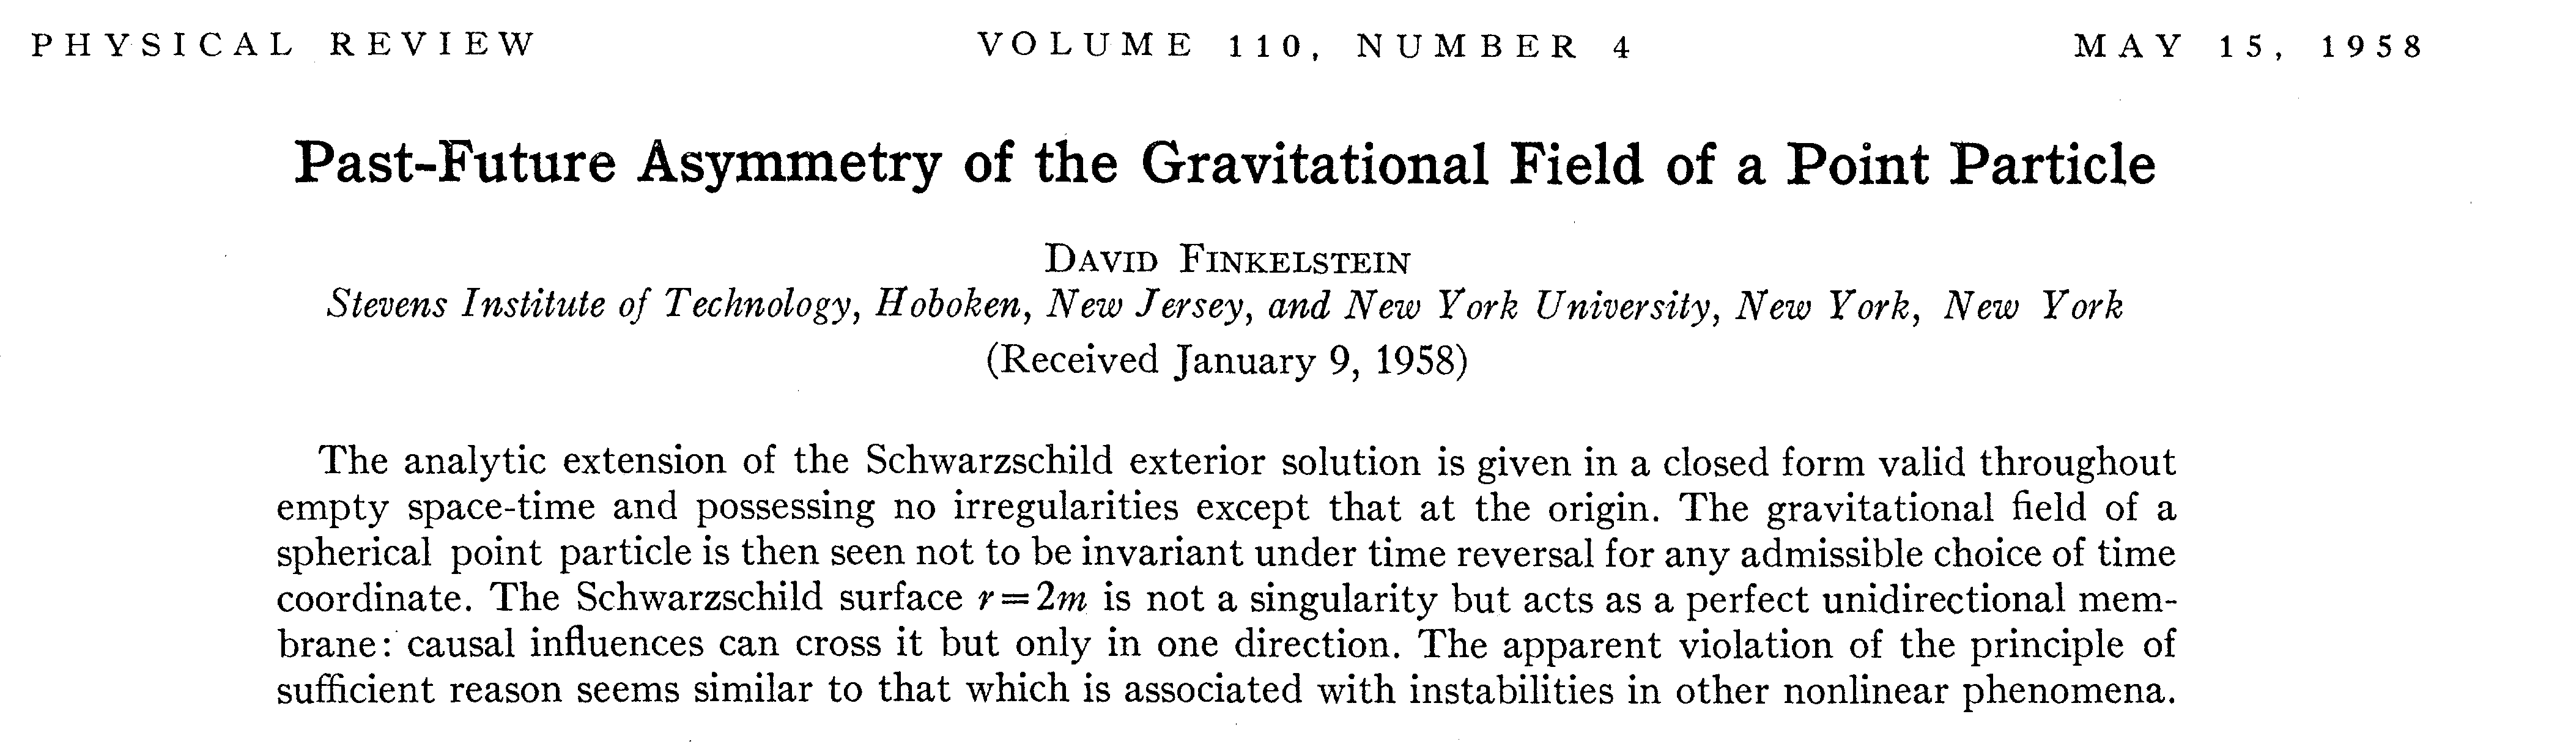
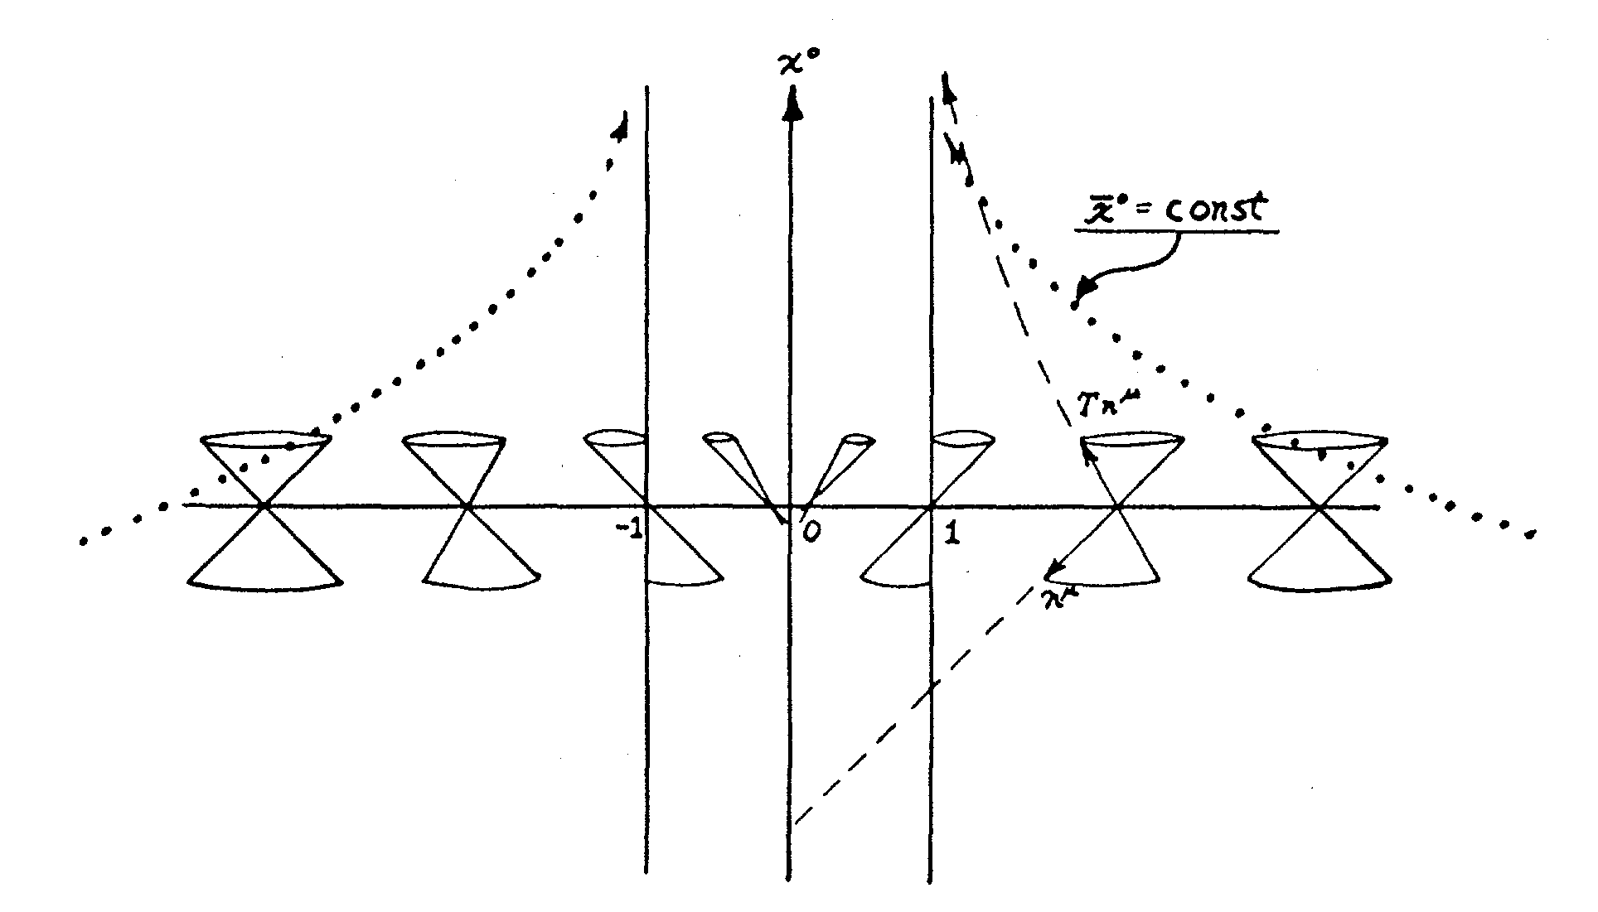
The combined outside-inside view visualized…
Notes:
He saw that there were two ways to extend the spacetime, but did not realize that collapse made the choice.
However it was surely quickly realized, and I suppose it was this one spacetime diagram that set people’s imaginations free.

Slide 44
The combined outside-inside view visualized…
Notes:
He saw that there were two ways to extend the spacetime, but did not realize that collapse made the choice.
However it was surely quickly realized, and I suppose it was this one spacetime diagram that set people’s imaginations free.

Slide 45
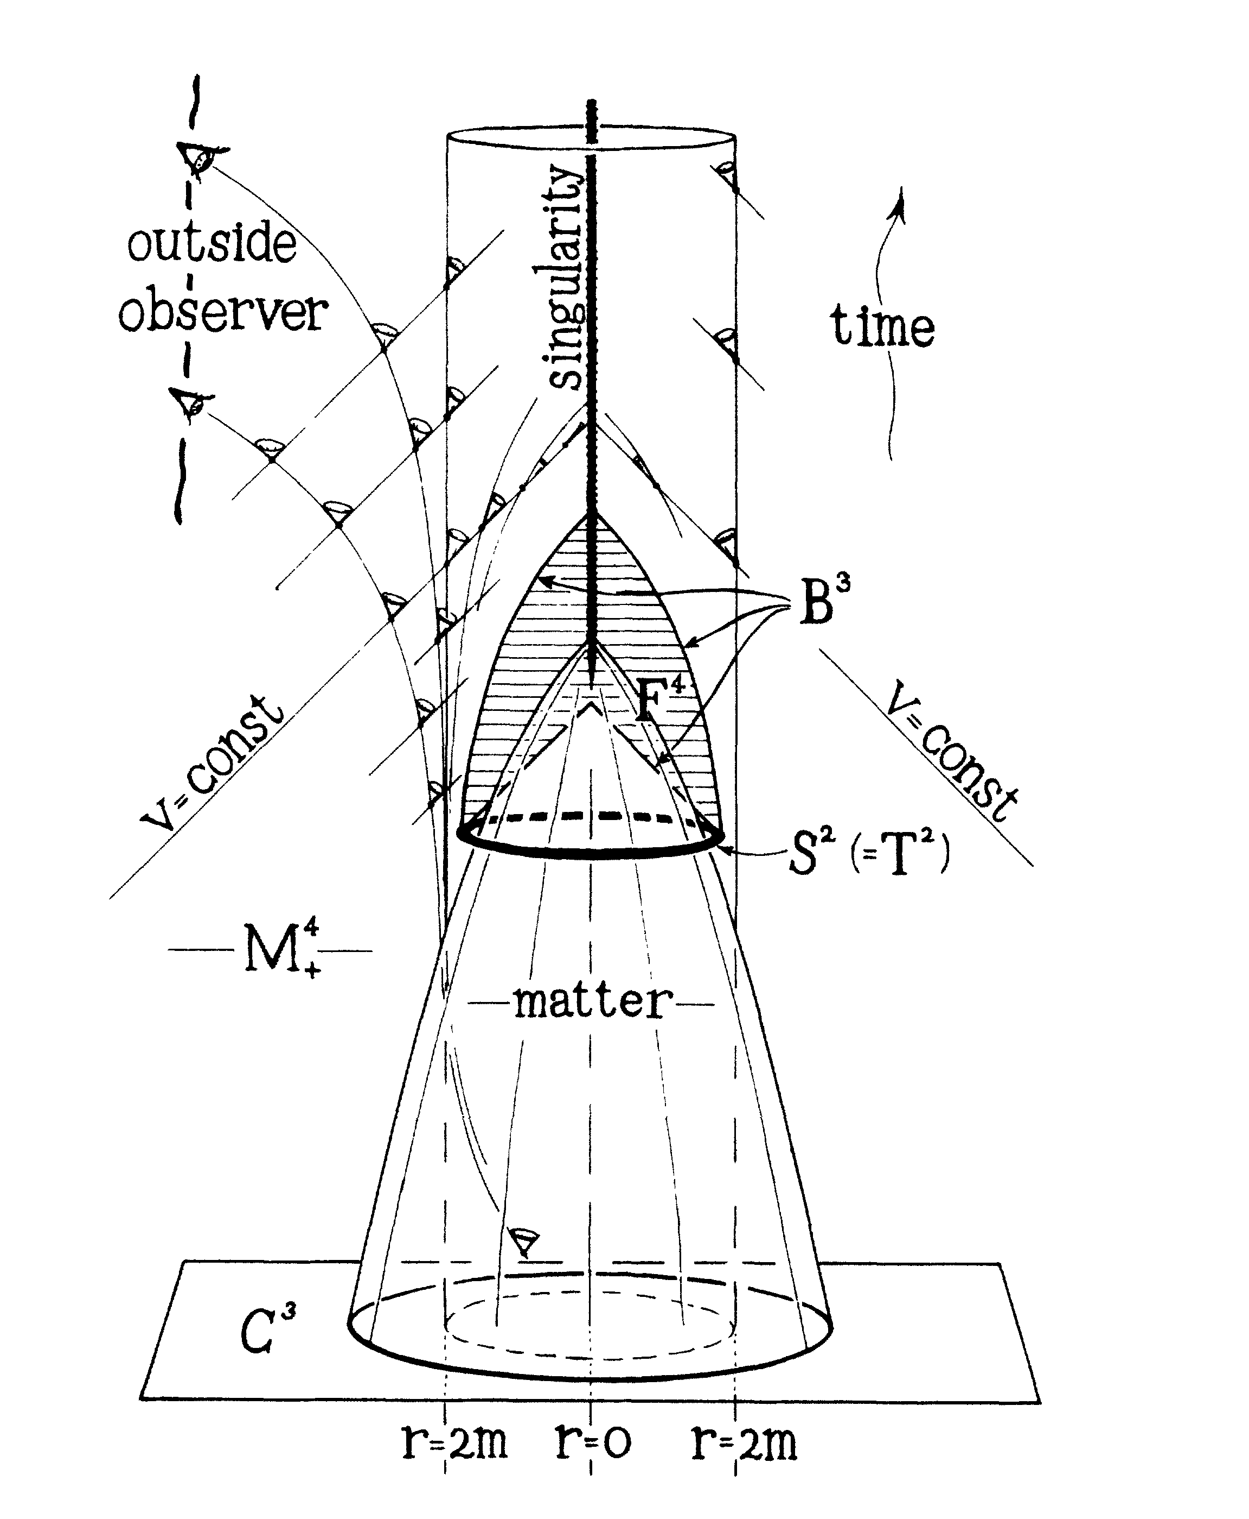
Penrose singularity
theorem (1964)
Once a trapped surface
forms, a singularity
is inevitable, regardless
of spherical symmetry.
“When eventually we have a better theory of nature, then perhaps we can try our hands again, at understanding the extraordinary
physics which must take place at a space-time singularity.”
(Penrose, 1969)
Notes:
For example Roger Penrose, who in a brilliant stroke addressed the question of what was happening INSIDE the black hole,
The known unknown that so many had done all they could to avoid. It was known in the spherically symmetric case to be truly singular,
an infinite stretching and squeezing of spacetime, a tearing of the spacetime fabric. Some argued that without symmetric there
would be no singularity. Penrose proved otherwise.

Slide 46
Notes:
What could possibly happen there??!

Slide 47
Fate of a black hole singularity?
The End
fractured time
continues
plump baby
Universe born
time ends

Slide 48
“Black hole” nucleation in a splash of milk
Laurent Courbin, James C. Bird, Andrew Belmonte, and Howard A. Stone

Slide 49
Will we ever see what happens at a singularity?
Does “cosmic censorship” hold?
Will we see mini black holes
explode from Hawking radiation?
Was the big bang a black hole singularity?

Slide 50
The outside view…

Slide 51
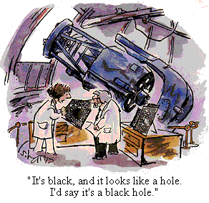

Slide 52
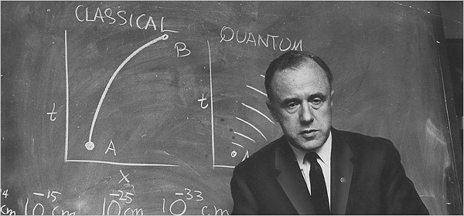
In the fall of 1967, he was invited to give a talk on pulsars, then-mysterious deep-space objects, at NASA's Goddard Institute of Space Studies in New York. As he spoke, he argued that something strange might be at the center, what he called a gravitationally completely collapsed object. But such a phrase was a mouthful, he said, wishing aloud for a better name. "How about black hole?" someone shouted from the audience.
"I had been searching for just the right term for months, mulling it over in bed, in the bathtub, in my car, wherever I had quiet moments," he later said. "Suddenly this name seemed exactly right.”

Slide 54
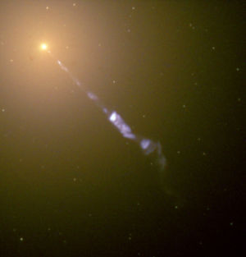
Jet, probably from rapidly spinning
3 billion solar mass black hole
M87, in Virgo cluster, 60 million light years away,
jet > 5000 ly long

Slide 55
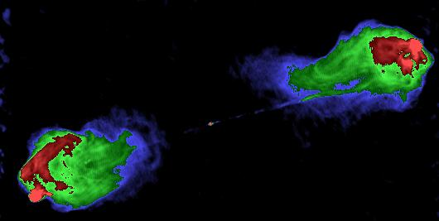
5-GHz radio image of Cygnus A (3C405), from VLA data.
600 million light years away.

Slide 56
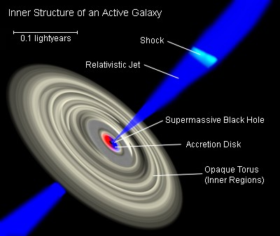
Energy source: gravity and/or spin energy of black hole

Slide 57
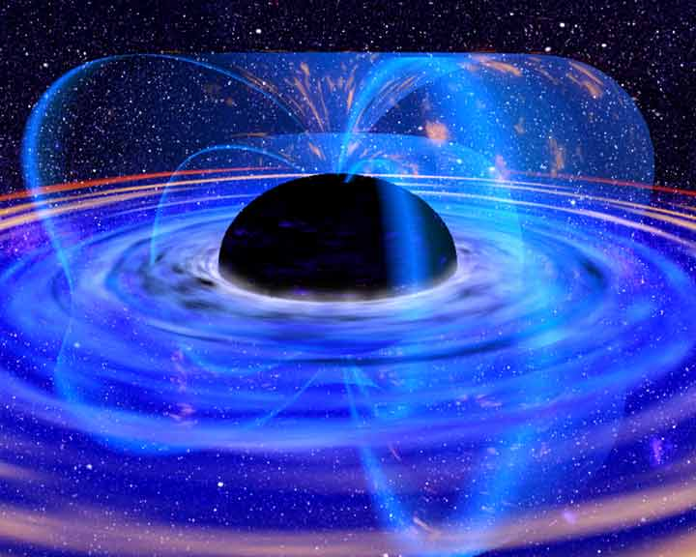
X-ray reflection spectroscopy
X-rays from corona/jet irradiate accretion disks… creates a backscattered spectrum rich in spectral features
Notes:
Nature has been extremely kind to us and has provided X-ray astronomers with a powerful probe of the region close to a BH.. Will spend some time talking about this
Whether from corona or jet, X-rays will illuminate the disk… in response, the disk emits a spectrum rich in spectral features. Calculation of spectrum from a patch of disk shown.
Highlight iron line… strong, isolated, ideal for characterization.

Slide 58
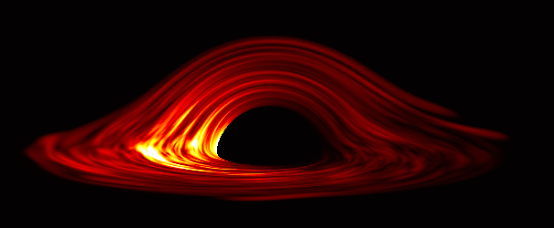
Picture by Chris Reynolds, UMD Astronomy Dept.
Computer-generated image of a turbulent accretion disk surrounding a Schwarzschild black hole (80 degree viewing inclination)…

Slide 59
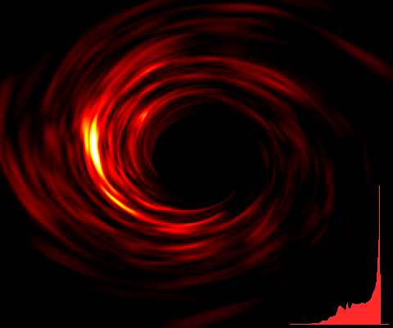
Animation by Chris Reynolds, UMD Astronomy Dept.
Animation of MHD turbulent accretion disk around Schwarzschild black hole (30 degree viewing inclination) - Bottom right shows the iron line profile that results.

Slide 60
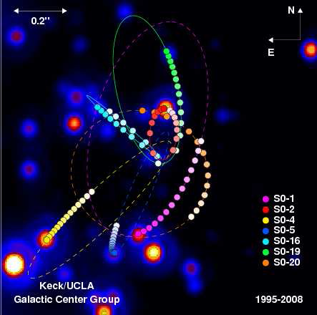
Orbits of stars around
center of Milky Way galaxy
All orbits fit the same central
mass of ~ 4 million M_{sun}
at the position of the radio source Saggitarius A*.
(Image courtesy A. Ghez.)
Notes:
But right in our own back yard, merely 33,000 light years away, in the center of the Milky Way galaxy…

Slide 61
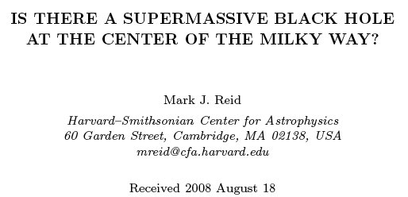
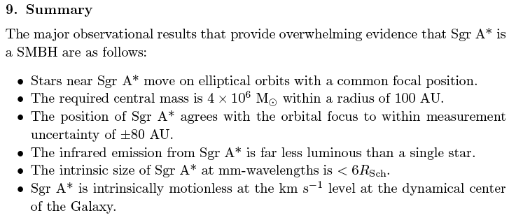

Slide 62
Black Holes
and
Warped Spacetime
Ted Jacobson
Picture by Roger Penrose
The Road to Reality (Knopf, 2005)

Slide 65
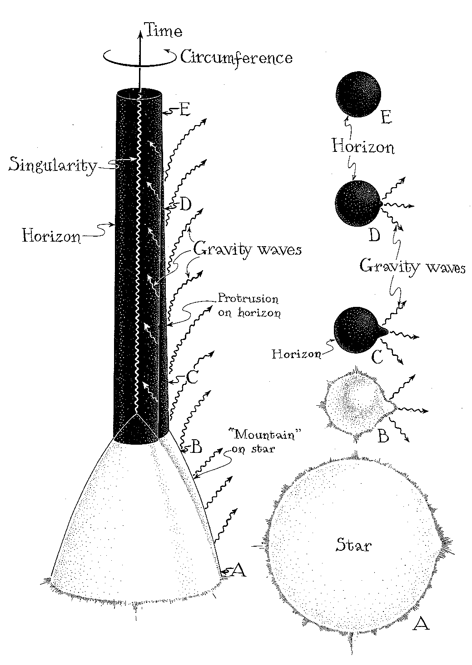
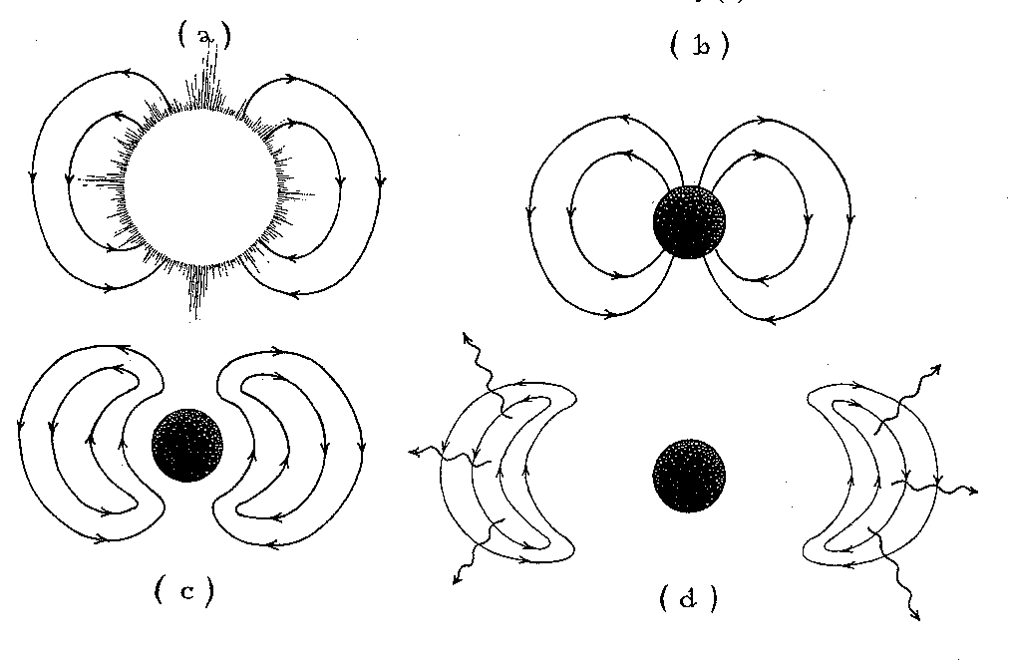
Black hole formation and uniqueness
Shedding a magnetic dipole
Pictures from Kip Thorne’s
Black Holes and Time Warps

Slide 66
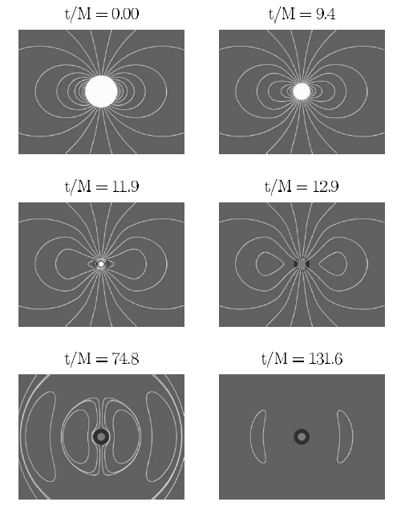
COLLAPSE OF A MAGNETIZED STAR TO A BLACK HOLE
Baumgarte & Shapiro, 2003

Slide 67
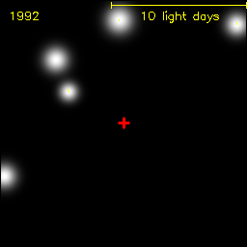
Stars orbit a giant black hole at the center of our galaxy

Slide 68
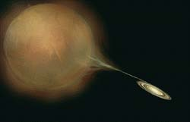

Slide 69
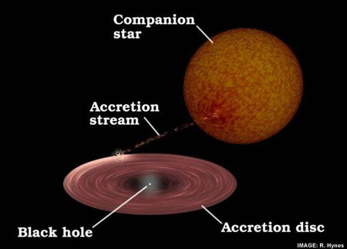

Slide 70
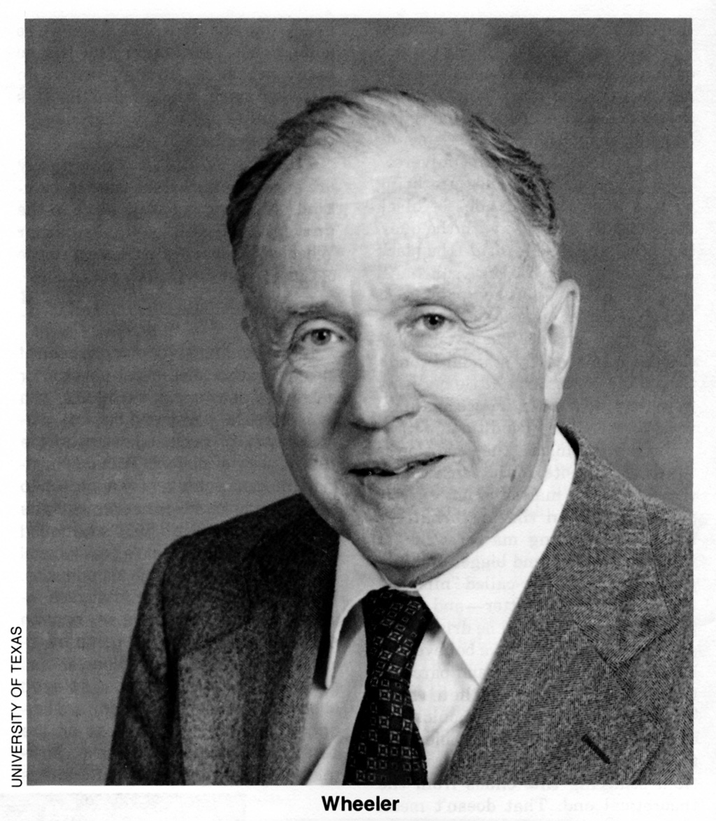

Slide 71
Dr. Wheeler at first resisted this conclusion, leading to a confrontation with Dr. Oppenheimer at a conference in Belgium in 1958, in which Dr. Wheeler said that the collapse theory “does not give an acceptable answer” to the fate of matter in such a star.

Slide 72
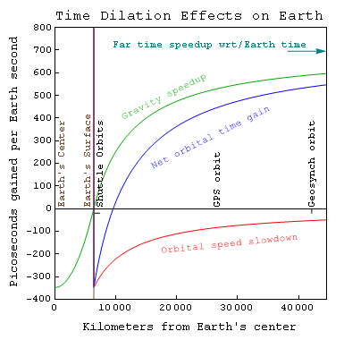

Slide 73
Weight of the box is proportional
to its mass

Slide 74
Weight of the box is proportional
to its mass energy

Slide 77
m
m

Slide 78
E
E = mc²

Slide 79
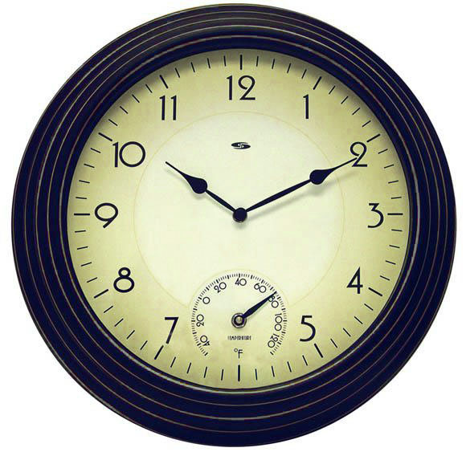

Slide 80
Lower clock runs slow compared to upper clock,
3 billionths of a second per year per meter

Slide 82
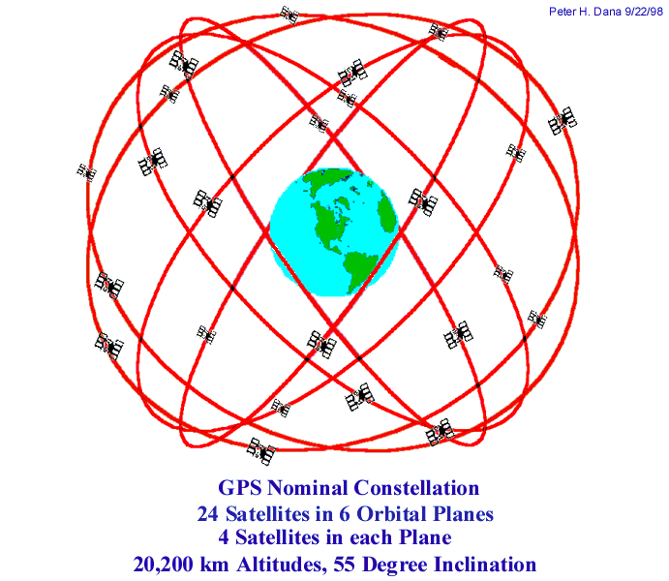
Global Positioning System
Satellite clocks run faster
by about half a billionth of
a second PER SECOND.
Microwaves travel about
six inches at the speed
of light in this much time.

Slide 83
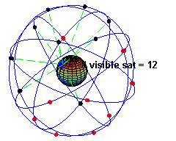

Slide 85
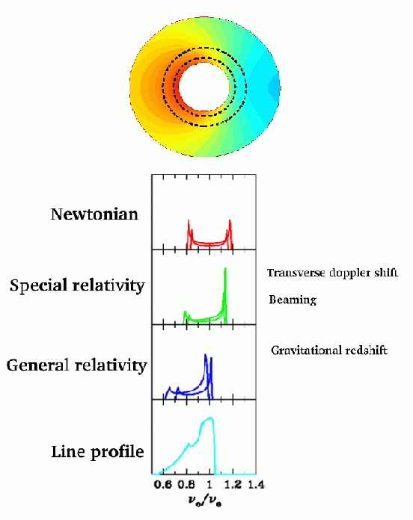
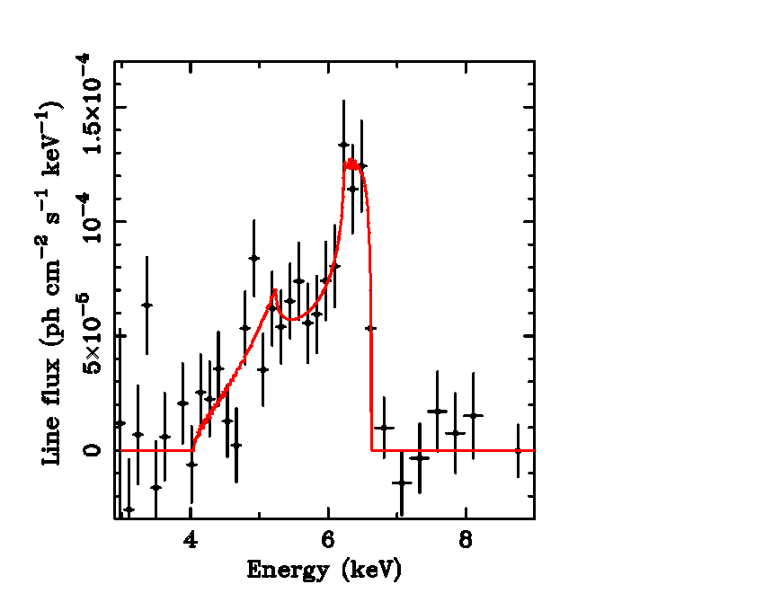
Relativistic effects imprint characteristic profile on the emission line…
Iron line profile in
MCG-6-30-15 (Tanaka et al. 1995)

Slide 86
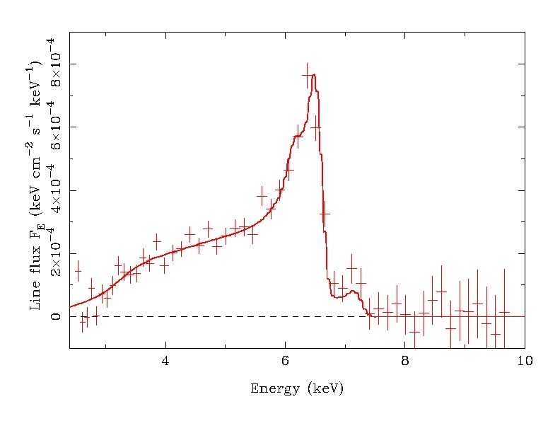
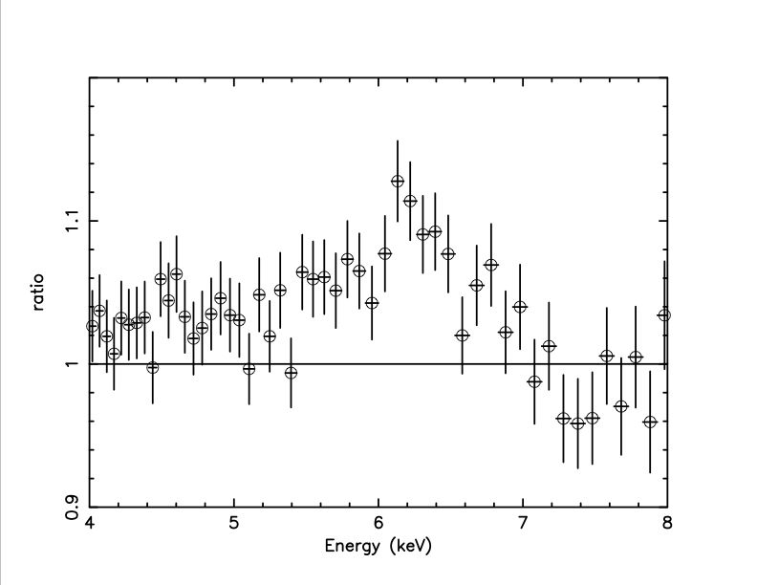
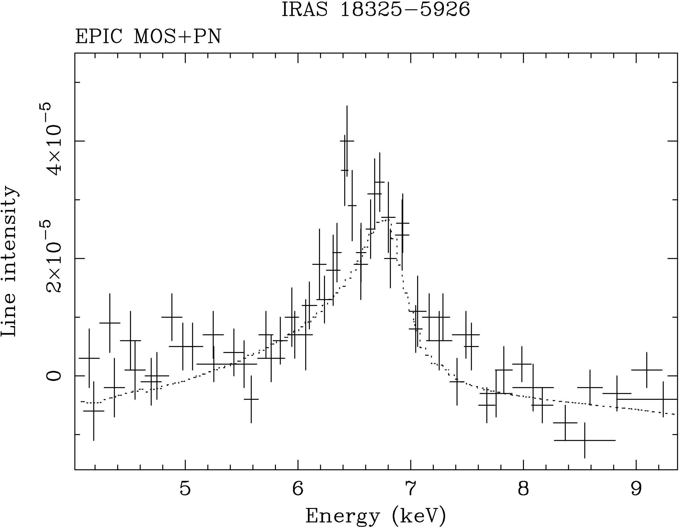
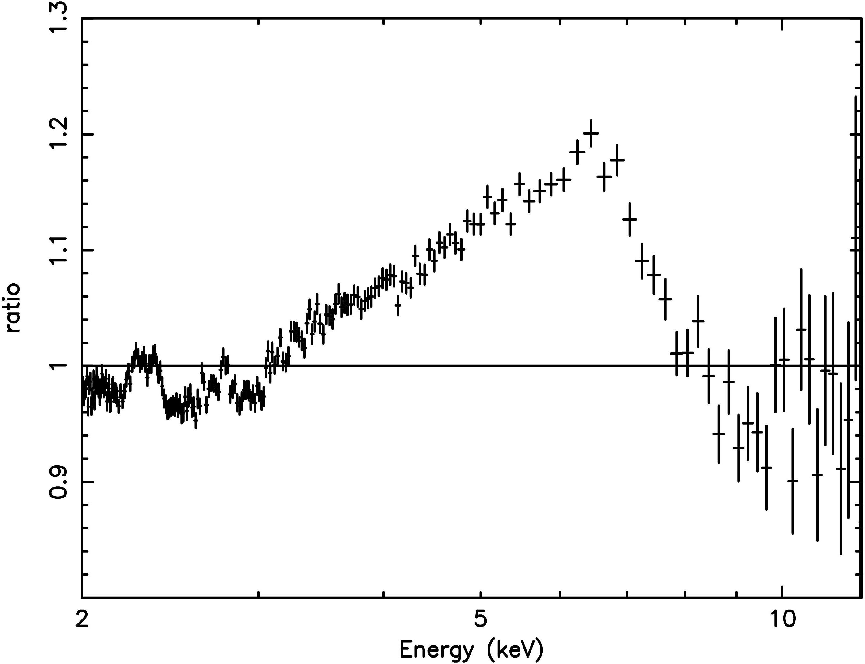











Gallery of broad iron lines
MCG-6-30-15
GX339-4
NGC2992
IRAS18325
MCG-5-23-16
Fairall 9
3C382
GRS1915+105
PG1211
NGC3516
XTEJ1550
NGC4151
Mrk766
Samples of…
Nandra (2006)
Miller (2007)
Cygnus X-1
Notes:
Selected gallery of objects with confirmed broad lines
Highligh lockman hole region
Both AGN and GBHBs… very similar, demonstrates mass independence of iron line

Slide 87

MCG-6-30-15
ASCA
Tanaka et
al. (1995)

Slide 88


MCG-6-30-15
XMM-Newton/350ks
Simple power-law fit

Slide 89


MCG-6-30-15 (AGN) with Suzaku
(Miniutti et al. 2006)
Extremely broad iron line ⇒ originate from matter very close to black hole (R_{emit}≈2Rg, R_{horizon}≈1Rg)
Notes:
So much for models and theory, what do we see
Well… we’ve had the ability to study these broad iron lines for about 12 years now, starting with the joint US-Japan satellite ASCA and, most recently, using another US-Japan mission Suzaku
Suzaku data for an active galacic nucleus (SMBHs in nearby galaxy) MCG-6-30-15
Ratio of observed spectrum against the continuum
Very broad iron line… Suzaku also let’s us see this hump… predicted by reflection models

Slide 90
Astrophysical evidence and phenomena:
Milky way black holes
Galactic black holes
Black hole mergers
Jets

Slide 91
Curved space – slice dependence
Time dilation effect – BH as time machine
Energy extraction: 100% of rest mass
Energy extraction: spin energy of BH
BH entropy and area
Hawking radiation
BH information “paradox”
Baby universe – fluid analogy – lack of ambient space

Slide 92

Spacetime as a flip-book

Slide 93


Slide 94

If a black hole with the mass of Saturn
(apparent diameter 5 yds) floated by…
(Image by Brian McLeod, Harvard-Smithsonian Center for Astrophysics.)

Slide 95


Slide 96



Slide 97


Slide 98

Chandrasekhar limit
“The theory of the polytropic gas spheres in conjunction with the equation of state
of a relativistically degenerate electron-gas leads to a unique value for the mass of a star built on this model. This mass (= 0.9 solar mass) is interpreted as representing the upper limit to the mass of an ideal white dwarf.” (1930)
“A star of large mass cannot pass into the white-dwarf stage and one is left speculating on other possibilities.” (1934)

Slide 99

Landau (1932)
“[For mass greater than a critical value]
there exists in the whole quantum theory
no cause preventing the system from
collapsing to a point….
As in reality such masses exist quietly
as stars and do not show any such
ridiculous tendencies we must conclude
that all stars heavier than 1.5 solar masses
certainly possess regions in which the laws
of quantum mechanics (and therefore of
quantum statistics) are violated.”

Slide 100


Slide 101

Free-fall
Morag Wightman, choreographer and performance artist

Slide 106
If Earth were compressed to half an inch, keeping the mass the same, the escape velocity would be the speed of light …

Slide 107
“…the phenomena of electrodynamics as well as of mechanics possess no properties corresponding to the idea of absolute rest.”
“…light is always propagated in empty space with a definite velocity c which is independent of the state of motion of the emitting body.”
“So we see that we cannot attach any absolute signification to the concept of simultaneity...”
“Special Relativity Theory”
Einstein, 1905
Notes:
simplify

Slide 108

Space over Absolute Time
From R. Penrose, The Road to Reality

Slide 109
Space over time
Spacetime
(flat)

Slide 110
Space over time
Spacetime
(flat)
Curved Spacetime

Slide 111
HOW does light not escape?
stationary
non-stationary
maximum
radius
maximum
radius
increasing radius

Slide 112
This behavior makes no sense for light, since it always travels
at the same speed!

Slide 113
At an event horizon, outgoing light
stays at the same radius ---
which might appear to
make even less sense but makes
actually more!
Notes:
Since gravity becomes weaker as the distance increases, an object can escape completely if it is tossed upwards fast enough.

Slide 114

circa 1930
“…the only elements in the construction of black holes are our basic concepts of space and time. They are, thus, almost by definition, the most perfect macroscopic objects there are in the universe. And since the general theory of relativity provides a single unique two-parameter family of solutions for their descriptions, they are the simplest objects as well. (Chandrasekhar, 1983)

Slide 115






R=1000rg
R=100rg
R=30rg
R=10rg
R=6rg
Disk Inclination
Inner edge of disk (spin)
Notes:
So you have an emission line coming from the disk surface
Consider a radius in the ring far from the black hole…
R=1000 in units of gravitational radii (radius of actual event horizon is 1-2 depending on spin)
material orbiting rather slowly… line gets slightly split into red/blue shifted components
Moving in… velocities are higher. Start to see relativistic effects.
Relativistic beaming means that emission from approaching (blue) is brighter
Closer still… see a new effect… center of line shifts down in energy; clocks running slowly close to BH
Effects more and more pronounced… go down to the inner edge of disk for non-rot hole (6rg)
Within that, GR effect destablizes matter orbits and matter rapidly plunges inwards
Adding up over all radii, have a skewed, asymmetric line profile…

Slide 116

Effect of spin on iron line profiles
Similar “variable spin” iron line models by Dovciak et al. (2004) and Beckwith & Done (2004)…
Ability to diagnose black hole spin comes from spin-dependence of innermost stable circular orbit (ISCO)
KERRDISK model
Brenneman & Reynolds (2006)

Slide 117
X-ray reflection spectroscopy
X-rays from corona/jet irradiate accretion disks… creates a backscattered spectrum rich in spectral features
Calculations of spectrum emitted by accretion disk in response to X-ray irradiation (Ross & Fabian 2005)
Very similar fluorescence features seen from surface of Sun during X-ray bright solar flare
Notes:
Nature has been extremely kind to us and has provided X-ray astronomers with a powerful probe of the region close to a BH.. Will spend some time talking about this
Whether from corona or jet, X-rays will illuminate the disk… in response, the disk emits a spectrum rich in spectral features. Calculation of spectrum from a patch of disk shown.
Highlight iron line… strong, isolated, ideal for characterization.

Slide 118


